Slide 1



Notes:
15 minute sessions on four areas important to practice management
“Speaking on Revenue Cycle Management, please welcome from The Retina Institute, Ashley Nahrwold
“Covering clinical research in ophthalmology, from Retina Consultants of America, Kevin Quinn”
“Then, we have a discussion on real estate considerations – should you rent or own. from Texas Retina Associates, Jeff Brockette.”
“To conclude this session, we’ll discuss the benefits of cross-training your staff. Joining us for this topic are, from Retina Consultants of America, Kristin Yockus, and from SouthEastern Retina Associates, Andy Laverghetta.”

Slide 2
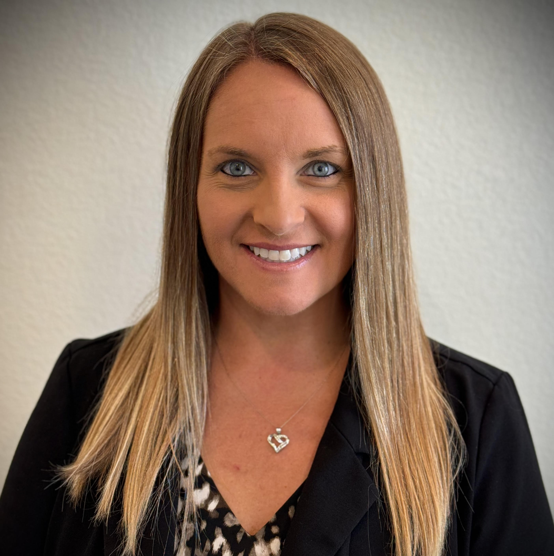
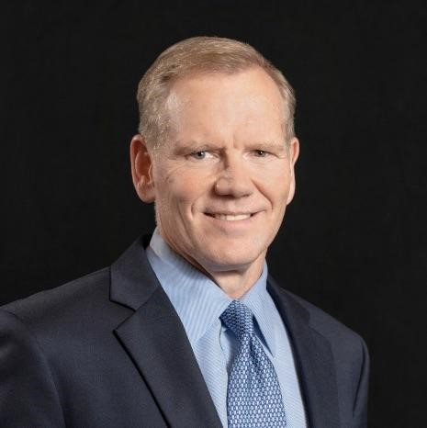

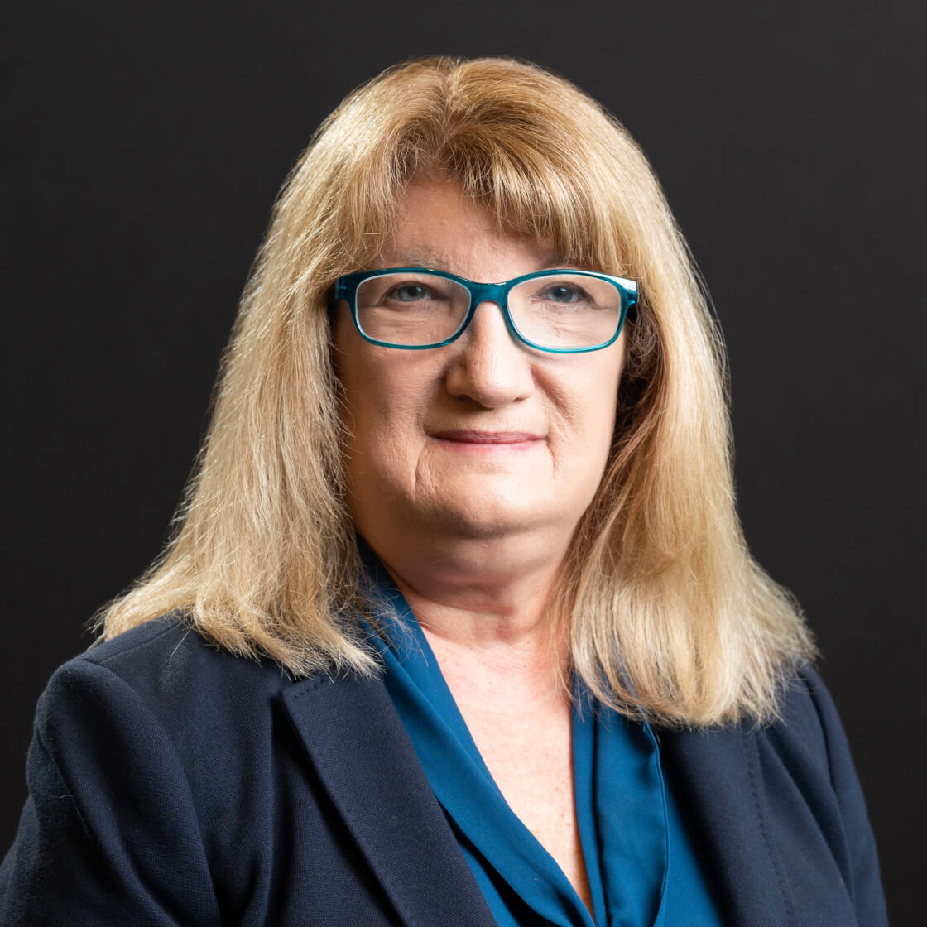
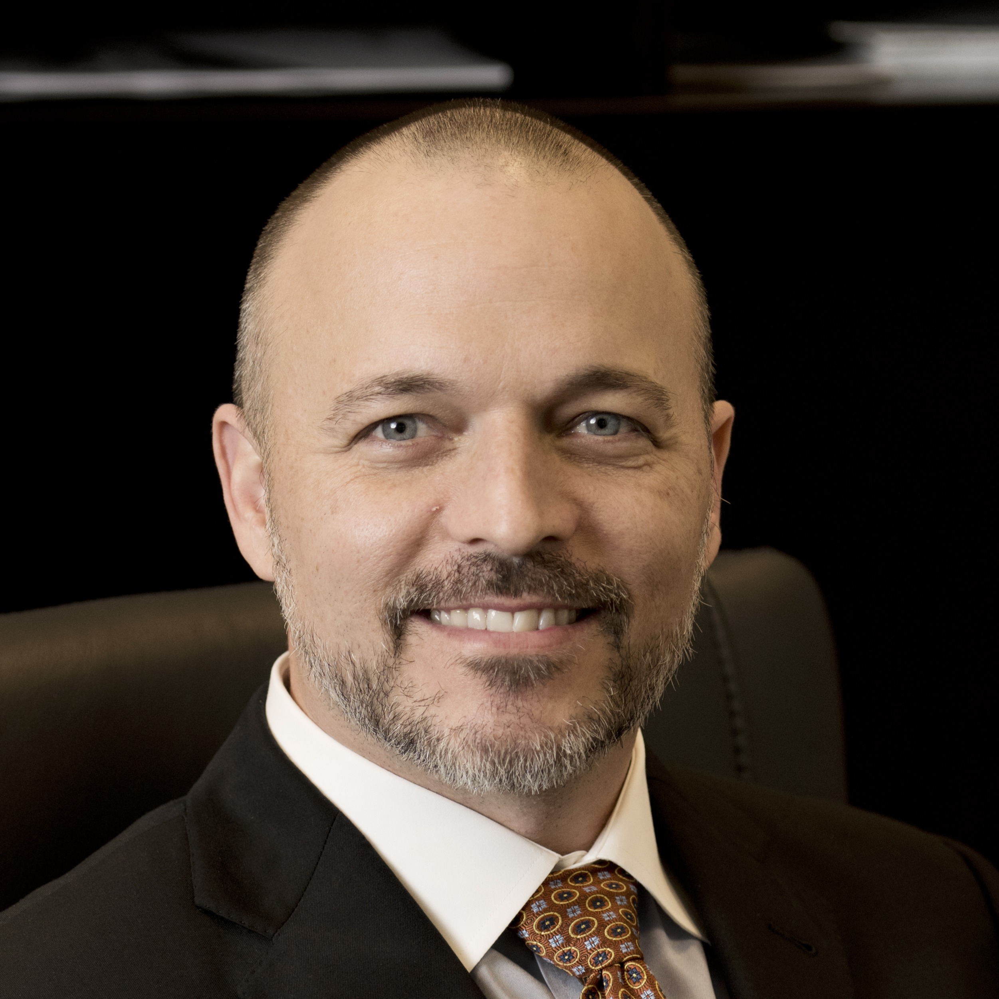
Practice Management / Business Operations Quick Hits
Revenue Cycle Management: benefits verification, prior authorizations, and more
Research trials in ophthalmology
Discussions on real estate: rent vs own
Benefits of cross-training staff
Revenue Cycle Management
Practice Management / Business Operations Quick Hits
Ashley Nahrwold
The Retina Institute/ Retina Consultants of America
Research trials in ophthalmology
Kevin Quinn
Retina Consultants of America
Discussions on real estate: rent vs own
Jeff Brockette
Texas Retina Associates
Benefits of cross-training staff
Kristin Yockus
Retina Consultants of America
Andy Laverghetta
SouthEastern Retina Associates
Notes:
15 minute sessions on four areas important to practice management
“Speaking on Revenue Cycle Management, please welcome from The Retina Institute, Ashley Nahrwold
“Covering clinical research in ophthalmology, from Retina Consultants of America, Kevin Quinn”
“Then, we have a discussion on real estate considerations – should you rent or own. from Texas Retina Associates, Jeff Brockette.”
“To conclude this session, we’ll discuss the benefits of cross-training your staff. Joining us for this topic are, from Retina Consultants of America, Kristin Yockus, and from SouthEastern Retina Associates, Andy Laverghetta.”

Slide 3
Ashley Nahrwold
The Retina Institute/ Retina Consultants of America
Notes:
Practice Management / Business Operations Quick Hits
(FOUR 15 MINUTE SECTIONS)
1) Ashley Nahrwold, The Retina Institute/ Retina Consultants of America

Slide 4

Building a Revenue Cycle That Gets It Right—Every Time
Ashley Nahrwold, BA, COA
Revenue Cycle Director &
Independent Consultant
2025 SPN Vision Exchange
Speaker is being compensated for their presentation today by the group purchasing organization affiliated directly or indirectly with AB Specialty Solutions, LLC (the “GPO”). However, neither the GPO nor any pharmaceutical company has influenced the content of this presentation, nor has the GPO independently verified the presentation for accuracy.
Notes:
Hi, I’m Ashley Nahrwold. I’ve spent over 20 years in ophthalmic practice management, starting my career in the clinic and working in every role—from scribe to surgical assistant to director. That hands-on experience, combined with a focus on team development and workflow optimization, has allowed me to lead high-performing teams, streamline processes, and drive measurable growth across multiple retina practices. Today, I’m going to share how the right people, processes, and technology can create a revenue cycle that maximizes reimbursement and keeps your practice running efficiently.

Slide 5

Confident Reimbursement
Notes:
Raise your hand if you are a physician, CEO, or Executive in your practice. Keep your hand up if you are 100% confident that you are going to get paid for every injection that you give. This is a challenge we all share in some way and we’re in the right place to talk about it.

Slide 6
Why It’s Complicated
Practice | Payer | Patient | Pharma
Payer Contracts | Payer Coverage Policies | Insurance Eligibility | FDA Approved “On Label” Diagnoses
Credentialing and Billing – Group vs. Individual MD | Prior Authorization Requirements | Plan Specific Drug Benefit Coverage | Dosing frequency
Drug Acquisition, Cost and Margins | Step Therapy Requirements | Specialty Pharmacy Requirements | Copay Assistance Options
Inventory Management | Specialty Pharmacy Requirements | Out of Pocket Cost | CPT Billing Code
Communication | PCP Referral Requirements | Severity of Disease / Urgency to Treat | New Indications
Notes:
Obtaining prior authorization is not enough. All of these items factor into whether or not a claim will be paid. Even with strong processes, moving targets create risk.

Slide 7
Complexity Drivers
Patient
Active insurance verification
Plan specific drug benefits
Out-of-pocket costs, copay assistance
Drug
Paid
Contracted rates
Acquisition cost
ASP updates
Provider credentialing
Coverage policies
Prior authorization requirements
Step Therapy
Claim setup nuances
Practice
Payer

Slide 8
Drug & Payer Alignment
FDA approved diagnoses are not universal across all branded anti-VEGF drugs
Traditional Medicare will cover all FDA approved diagnoses
Commercial payers may develop their own coverage policies that may not be inclusive of all FDA approved diagnoses / ICD-10 codes
If an established drug receives FDA approval for a new indication, verify payers update their coverage policies to include the indication

Slide 9
Drug Approval Process
A strong revenue cycle needs to expand across multiple departments and functions within your practice and account for all variables that could prevent or delay receiving full reimbursement for every service performed and drug injected.
Integrating these key variables at the front end of the drug approval process strengthens accuracy, efficiency, and overall revenue cycle outcomes.
Notes:
So how do we stay confident? We develop a drug approval process. In the next few slides, I’ll walk through the organizational structure and workflows that have proven successful in two large retina practices—strategies that not only streamlined operations but also doubled EBITDA and transformed overall performance.

Slide 10

Injection Status
The drug approval process should confirm all essential factors are in place to guarantee full reimbursement before each injection.
The method of communicating the drug approved back to the physician is called the Injection Status.
Notes:
My team and I took all these complicated variables and developed a comprehensive drug approval process that we label “The Injection Status”.

Slide 11
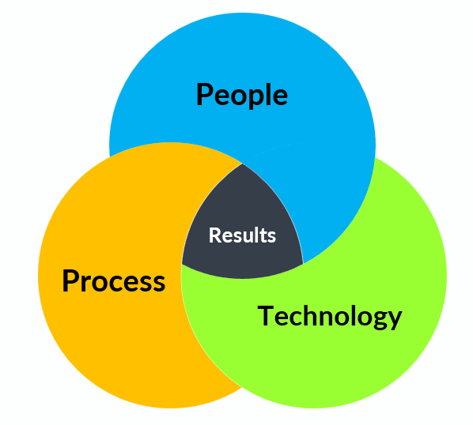
Building Confidence
Right information, right place, right time
Solid, repeatable processes
Technology that supports (not complicates) workflows
And most importantly, the right team executing each step consistently
Notes:
Building confidence within an organization requires the harmonious interaction of three key elements: people, processes, and technology. This is the foundation for achieving consistent and reliable results.

Slide 12
Sample Practice Case Study
11 physicians
8 clinic locations
Projecting approximately 95,000 clinical encounters by the end of 2025
Projecting approximately 36,000 billable anti-VEGF injections by the end of 2025
Anti-VEGF drug mix
  Branded / Biosimilar ~ 80%
  Avastin ~ 20%
Payer mix by primary payer
  43% Traditional Medicare
  34% Medicare Advantage
  19% Commercial
  3% Medicaid
  1% Veterans Plans
32 RCM FTEs + 2 Supervisors, 1 Director (~3 FTEs per MD)
Number of FTEs needed will vary by provider count, patient volume, payer mix, drug utilization and automated technology

Slide 13
Organizational Structure
Credentialing Specialist
Patient Access Supervisor
Billing Supervisor
Develop
Organizes payer contracts, responsible for payer and provider enrollments and recredentialing
Revenue
Cycle
Director
Supervises staff performing pre-visit and patient facing functions.
Supervises staff performing post-visit and insurance facing functions.
Number of FTEs needed will vary by provider count, patient volume, and automated technology
Notes:
Both supervisors are able to cover any role during times of high volume or low staffing.

Slide 14
  Patient Access Team
Financial Clearance Specialist | Prior Authorization Specialist | Patient Assistance Specialist | Drug Analyst | Patient Collections Specialist
Insurance Eligibility Verification | PCP Referrals | Drug Benefit Investigations | Injection Statuses | Patient Accounts Receivable
Overall Benefits Review – Copay, Coinsurance, Deductible | Clinical Visit Authorizations | Co-Pay Assistance Enrollment | Orders & Maintains Specialty Pharmacy & Charity Care Drug Inventory | Patient Statements
Cost Estimations | Drug Prior Authorizations | Drug Out-of-Pocket Cost Estimations & Financial Counseling |  | Payment Plans
Pre-Visit Financial Counseling |  | Co-Pay Assistance Claims & Accounts Receivable |  | Collection Agency
 |  | Review Patient Drug AR |  | Patient Refunds
3 FTEs – each FTE covers 3-4 MDs | 3 FTEs – each FTE covers 3-4 MDs | 4 FTEs – Divided by function but cross trained to cover all | 3 FTEs – 2 dedicated to pre-visit injection statuses, 1 dedicated to SP & CC | 4 FTEs – Divided by patient last name
Notes:
Primary duties for each role

Slide 15
  Billing Team
Coding & Documentation Specialist | Claims & EDI Analyst | Payment Posting Specialist | Accounts Receivable Representative | Denial Management Analyst
Audit Clinical Chart Documentation & Coding | Works rule breaks in charge rules engine | ERA & lockbox payment posting into PM | Clearinghouse Rejections | RCM Reporting
Drug Inventory to Billing Reconciliation | Push charges into PM | Balance & reconcile to bank deposits | Mail Paper Claims | Create new charge rules & claim edits based on denials
Audit Surgery Operative Note & Coding | Kept Appts with No Charges / Missing Charges Report | Insurance refunds | Appeal Denials | Denial feedback loop to clinic
Charge Submission from EHR | PM System Claim Edits |  | AR Follow Up
4 FTEs | 1 FTE | 3 FTEs | 5 FTEs | 1 FTE

Slide 16
Outsourcing Revenue Cycle Functions
Any function in the revenue cycle can be outsourced
Maintain at least one in-house resource to oversee third-party work
Provide proper training, knowledge transfer and co-develop policies and procedures that work for your practice and the third-party
Track performance and outcomes
Treat your vendor as a true partner – an extension of your team
Whether in-house or outsourced, set your team up for success
Notes:
Outsourcing can be very effective, but success depends on oversight and partnership. Provide training, monitor results, and hold the team accountable. Whether in-house or outsourced, your goal is to set everyone up for success while maintaining quality, compliance, and efficiency.

Slide 17
Process: Build a Strong Foundation
Create guides for stable variables
Monitor closely for changes and updates
Build into systems and automate knowledge
Practice | Payer | Pharma
Contracted payers and network participation Provider credentialing status and expirations Insurance plans accepted by the practice Drug costs – invoice, rebates, net cost recovery | Coverage policies Prior authorization requirements Step therapy requirements PCP referral requirements Drug reimbursement amounts / Quarterly ASP changes | On-label diagnosis codes (covered indications) by drug Drug dosing schedules and frequency Copay Assistance options available by payer type, drug and diagnosis. Include eligibility criteria.

Slide 18
Quick Guide for Clinic
Combine all fundamental data gathered for the practice, payers, and pharma to create a master Insurance Drug Coverage Guide that will be utilized in clinic to select a covered drug at decision to treat.
This does not approve a same day injection. Best practice is to have the patient return for injection unless clinically urgent. The Insurance Drug Coverage Guide is a tool to avoid requesting a drug that will not be approved. Example: Request for branded drug for a payer that has strict step therapy requirements.

Slide 19
Communication: Clinic to Revenue Cycle
Return to clinic plans should indicate which drug has been selected to treat the patient
1
Determine how drug requested will be communicated to the staff obtaining prior authorization
2
Consider drug specific appointment scheduling events to identify, report and generate tasks for upcoming planned injections
3
Determine how staff will communicate back to the clinic when a drug is approved – Injection Status
4
Develop protocols for how often drug approvals are re-verified to ensure reimbursement continues for the duration of treatment
5

Slide 20
Create Processes to Manage Variable Factors
Insurance eligibility verification confirms if a patient’s insurance plan is active
Most automated electronic eligibility returns the patient’s status as of the date eligibility was ran, not by a future appointment date
Most employer sponsored plans will be active until the end of the calendar month even if the plan is terminated
State Medicaid and Managed Medicaid plans are renewed monthly based on patient’s eligibility. Some states will change the patient’s Managed Medicaid plan throughout the year
Many patients do not know what insurance plan they have, their covered benefits or their cost share (copay, deductible and coinsurance)
Develop a practice protocol for who will be responsible for insurance eligibility verification, when the verification will occur and when it will be rechecked on each patient

Slide 21

Financial Clearance Functions
Insurance eligibility verification – primary and secondary insurance verified 3 business days prior to appointment for every patient before every visit
Confirm practice and provider are in network with patient’s insurance plan
Benefit review – complete once annually for all plans and update as needed
Cost estimations – complete as needed based on patient’s insurance plan benefits and planned services
Pre-visit financial counseling – complete each visit when patient’s out of pocket cost exceeds their office visit copay. Prepare patient to pay at check in for planned services

Slide 22
Drug Approval Workflow
This workflow is based upon all patients being checked in with correct and verified insurance attached to their chart. This workflow also assumes PCP Referrals are on file for required plans.
Patient is seen in clinic and needs anti-VEGF injections.
Physician should utilize the Insurance Drug Coverage Guide to determine which drug choice is appropriate for the patient’s diagnosis and primary insurance payer.
Chart notes are typically required to be sent with prior authorization requests. The exam impression should clearly state the diagnosis and medical need for injection treatment. The return to clinic plan should specify the drug selected by the physician.
Patient should sign the corresponding authorization (PAN) form to run a detailed insurance benefit investigation through the drug company’s provided service.
Check out staff should schedule the patient’s return appointment using the appropriate drug specific appointment event.

Slide 23
Drug Approval Workflow
Prior to next visit (injection visit):
Obtain prior authorization from the patient’s insurance for the drug requested.
Run the benefits investigation through the drug company portal.
Enroll the patient in copay assistance if applicable and eligible.
Complete Financial Counseling with the patient for out-of-pocket cost. Prepare the patient to pay at check in of the injection visit.
Three business days prior to the return visit, re-verify the patient’s insurance to confirm it is still active.
Two business days prior to the return visit, confirm patient’s payer/diagnosis/drug combination clears all check points and provide the appropriate Injection Status for this appointment.

Slide 24
Prior Authorization Functions
PCP referrals & visit authorizations – review payer specific report of appointments scheduled the previous day and obtain referral or authorization prior to each visit based on payer requirements
Injectable drug authorizations – review report of appointments scheduled the previous day for drug specific events and obtain authorization for drug requested.
Note: CPT 67028 for administration may also need prior authorization.

Slide 25
Patient Assistance
Pre-Visit Functions
Drug benefit investigations - review report of upcoming appointments scheduled for drug specific events and review the detailed benefit investigation returned from the drug company.
Copay assistance enrollment – the benefit investigation results will include the patient’s drug benefits (if deductible applies and percent cost share of coinsurance). Enroll patients as needed based on their individual scenario.

Slide 26
“Based on the knowledge of the fundamentals, the Patient Access Team believes if this drug is injected the practice will be reimbursed 100%.”
2 business days prior to appointment, the Billable Drug Analyst reviews a report of appointments scheduled for drug specific events and assigns an Injection Status based on the confirmation of data gathered by the team. The Injection Status is attached to the appointment in a field that will be communicated to the clinic on the day of service.
Example Injection Status: IVE OD for AMD H35.3211
Injection Status Granted

Slide 27
First Injection Approval TIME
Monday
Patient examined, drug selected, return appointment scheduled for 1 week.
Drug authorization signed and electronically sent to the drug company.
Tuesday
Benefit investigation results available.
Prior authorization requested.
Wednesday
Insurance eligibility re-verified.
Prior authorization approval received.
Copay assistance enrollment completed.
Financial counseling performed.
Thursday
Injection status documented on appointment
Following Monday
Patient receives injection in the office.

Slide 28
Same Day Injections
There will be times where the patient clinically cannot return in 1 week for injection and will need to be treated same day.
We call this a Verbal Injection Status.
During certain scenarios patients will be approved for a one time buy and bill drug based on the knowledge we have of that payer’s fundamentals.

Slide 29

Subsequent Injections
Functions that should be repeated every visit for appointments scheduled with drug specific events:
Review report of expiring prior authorizations and/or remaining visits/units
Insurance eligibility verification for primary and secondary payers
Review patient’s accounts receivable / confirm reimbursement for previous injections
Copay assistance grant balance
Confirm no change with drug / diagnosis code combination compared to prior authorization approval
Injection Status approved and attached to appointment for subsequent injection visit

Slide 30
Closing the Loop: Post-Visit Processes
After the visit, our Billing Team audits all clinical charts prior to charge submission. A component of this audit is to compare the drug and ICD-10 code documented in EHR to the injection status and to the drug dispensed from inventory. Any discrepancies are tasked back to the physician to review.
We utilize the customized coding-based rules engine to automate any payer specific claim nuances.

Slide 31
Technology Toolkit
NextGen PM
Nextech Intellichart Pro EHR
Phreesia – Eligibility & benefits, pre-registration, electronic communication with patients, collecting payments, electronic statements, automated payment plans, etc.
SamaCare – Electronic Prior Authorizations
PX Connect – PAN signature & submission for benefit investigations
Drug company hub portals
Policy Reporter – Payer policy changes (includes email notifications)
RCx Rules Engine
Waystar Clearinghouse
Cubixx Drug Inventory
Notes:
Tips: Get creative with the resources you already have. We rarely see worker’s comp patients, so we use the Case Management section of NextGen PM to document our injection statuses which can then be attached to the insurance and appointment. We also send the Case Description through the interface to display in the patient’s chart in Nextech for the physicians and scribes to see.

Slide 32
Continuous Change = Continuous Monitoring
If any of the following variables change, the drug approval process should be restarted:
Payer coverage policy, prior authorization requirements, step therapy requirements
Patient’s insurance payer or plan benefits
Patient’s eligibility or need for copay assistance
Drug change requested by physician
Diagnosis change – slight changes in diagnosis or disease stage may require a new or amended prior authorization

Slide 33

Optimizing the Workflow
Keep data organized
Maintain current guides for the fundamentals
Provide clear protocols and guidelines to staff
Track near-misses, denials, reimbursement problems and adjust protocols accordingly
Leverage technology for automation
Be creative to implement new workflow or utilize existing technology in new ways
Ongoing feedback and training
Notes:
The confidence to treat comes from process maturity, not luck. The strongest revenue cycle teams blend people, process, and tech seamlessly.

Slide 34
Thank You

