Slide 1



Notes:
“For our final session of the day, we wanted to conduct a panel discussion on some of the topics most important to practice efficiency an effectiveness.
We’re planning on covering a wide range of topics, from patient assistance, to physician recruitment, to the adoption of AI, and more.
At this time I’ll ask the panel to join me on stage, and we’ll have everyone introduce themselves as we get started…”

Slide 2
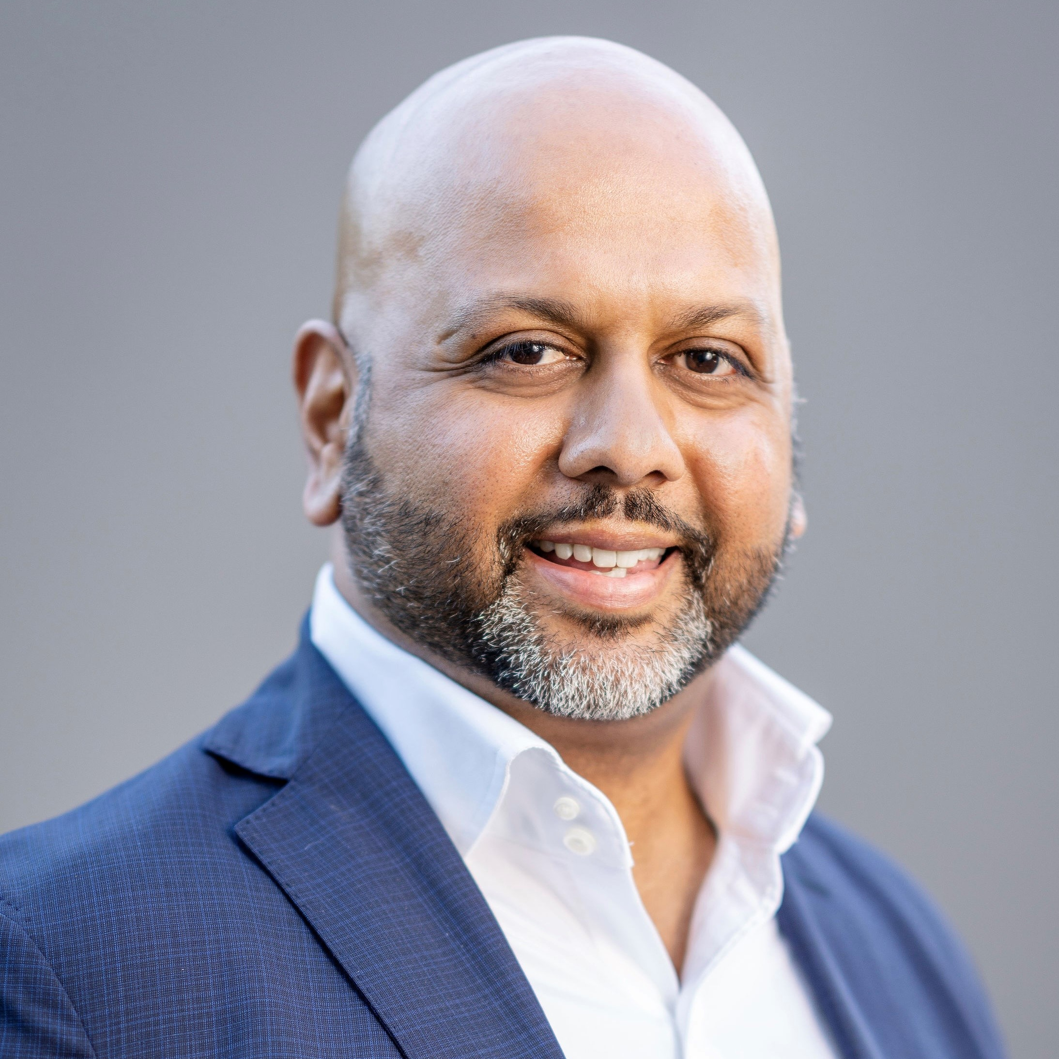
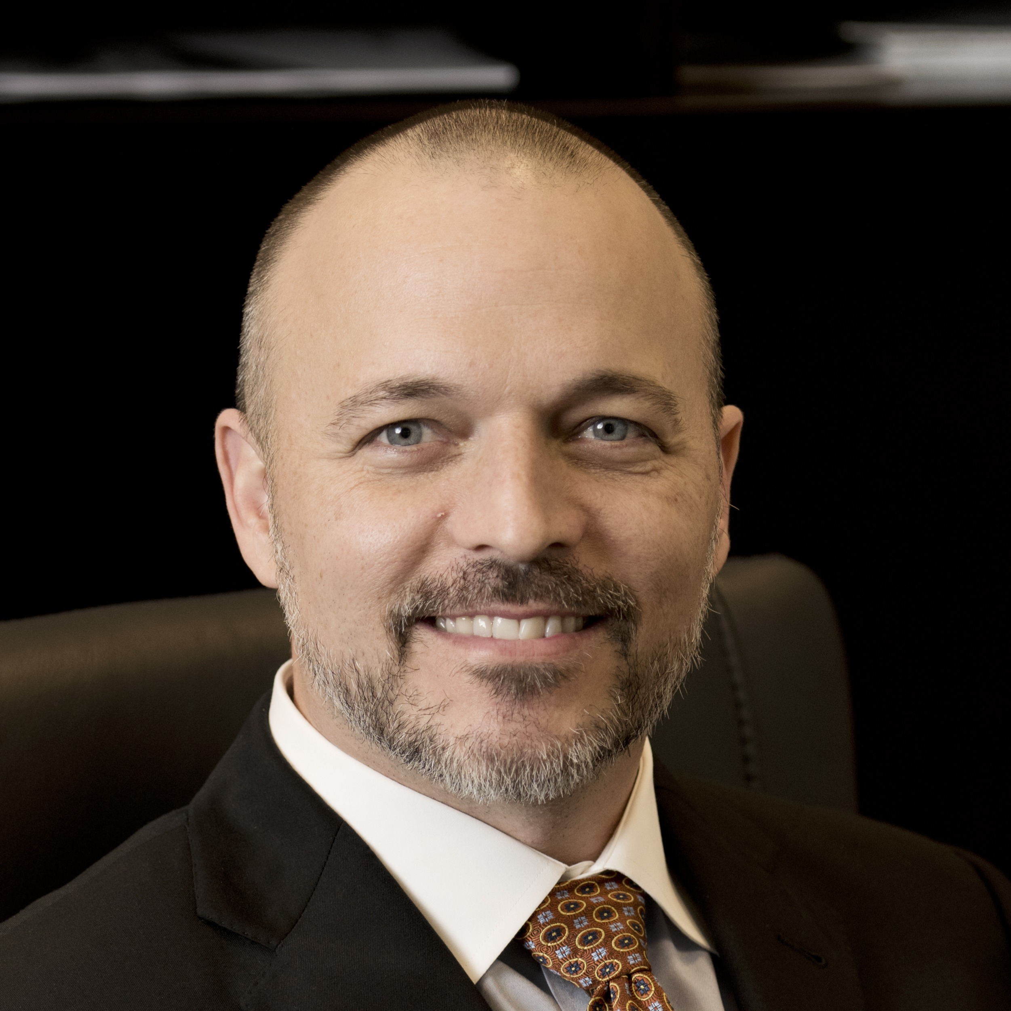
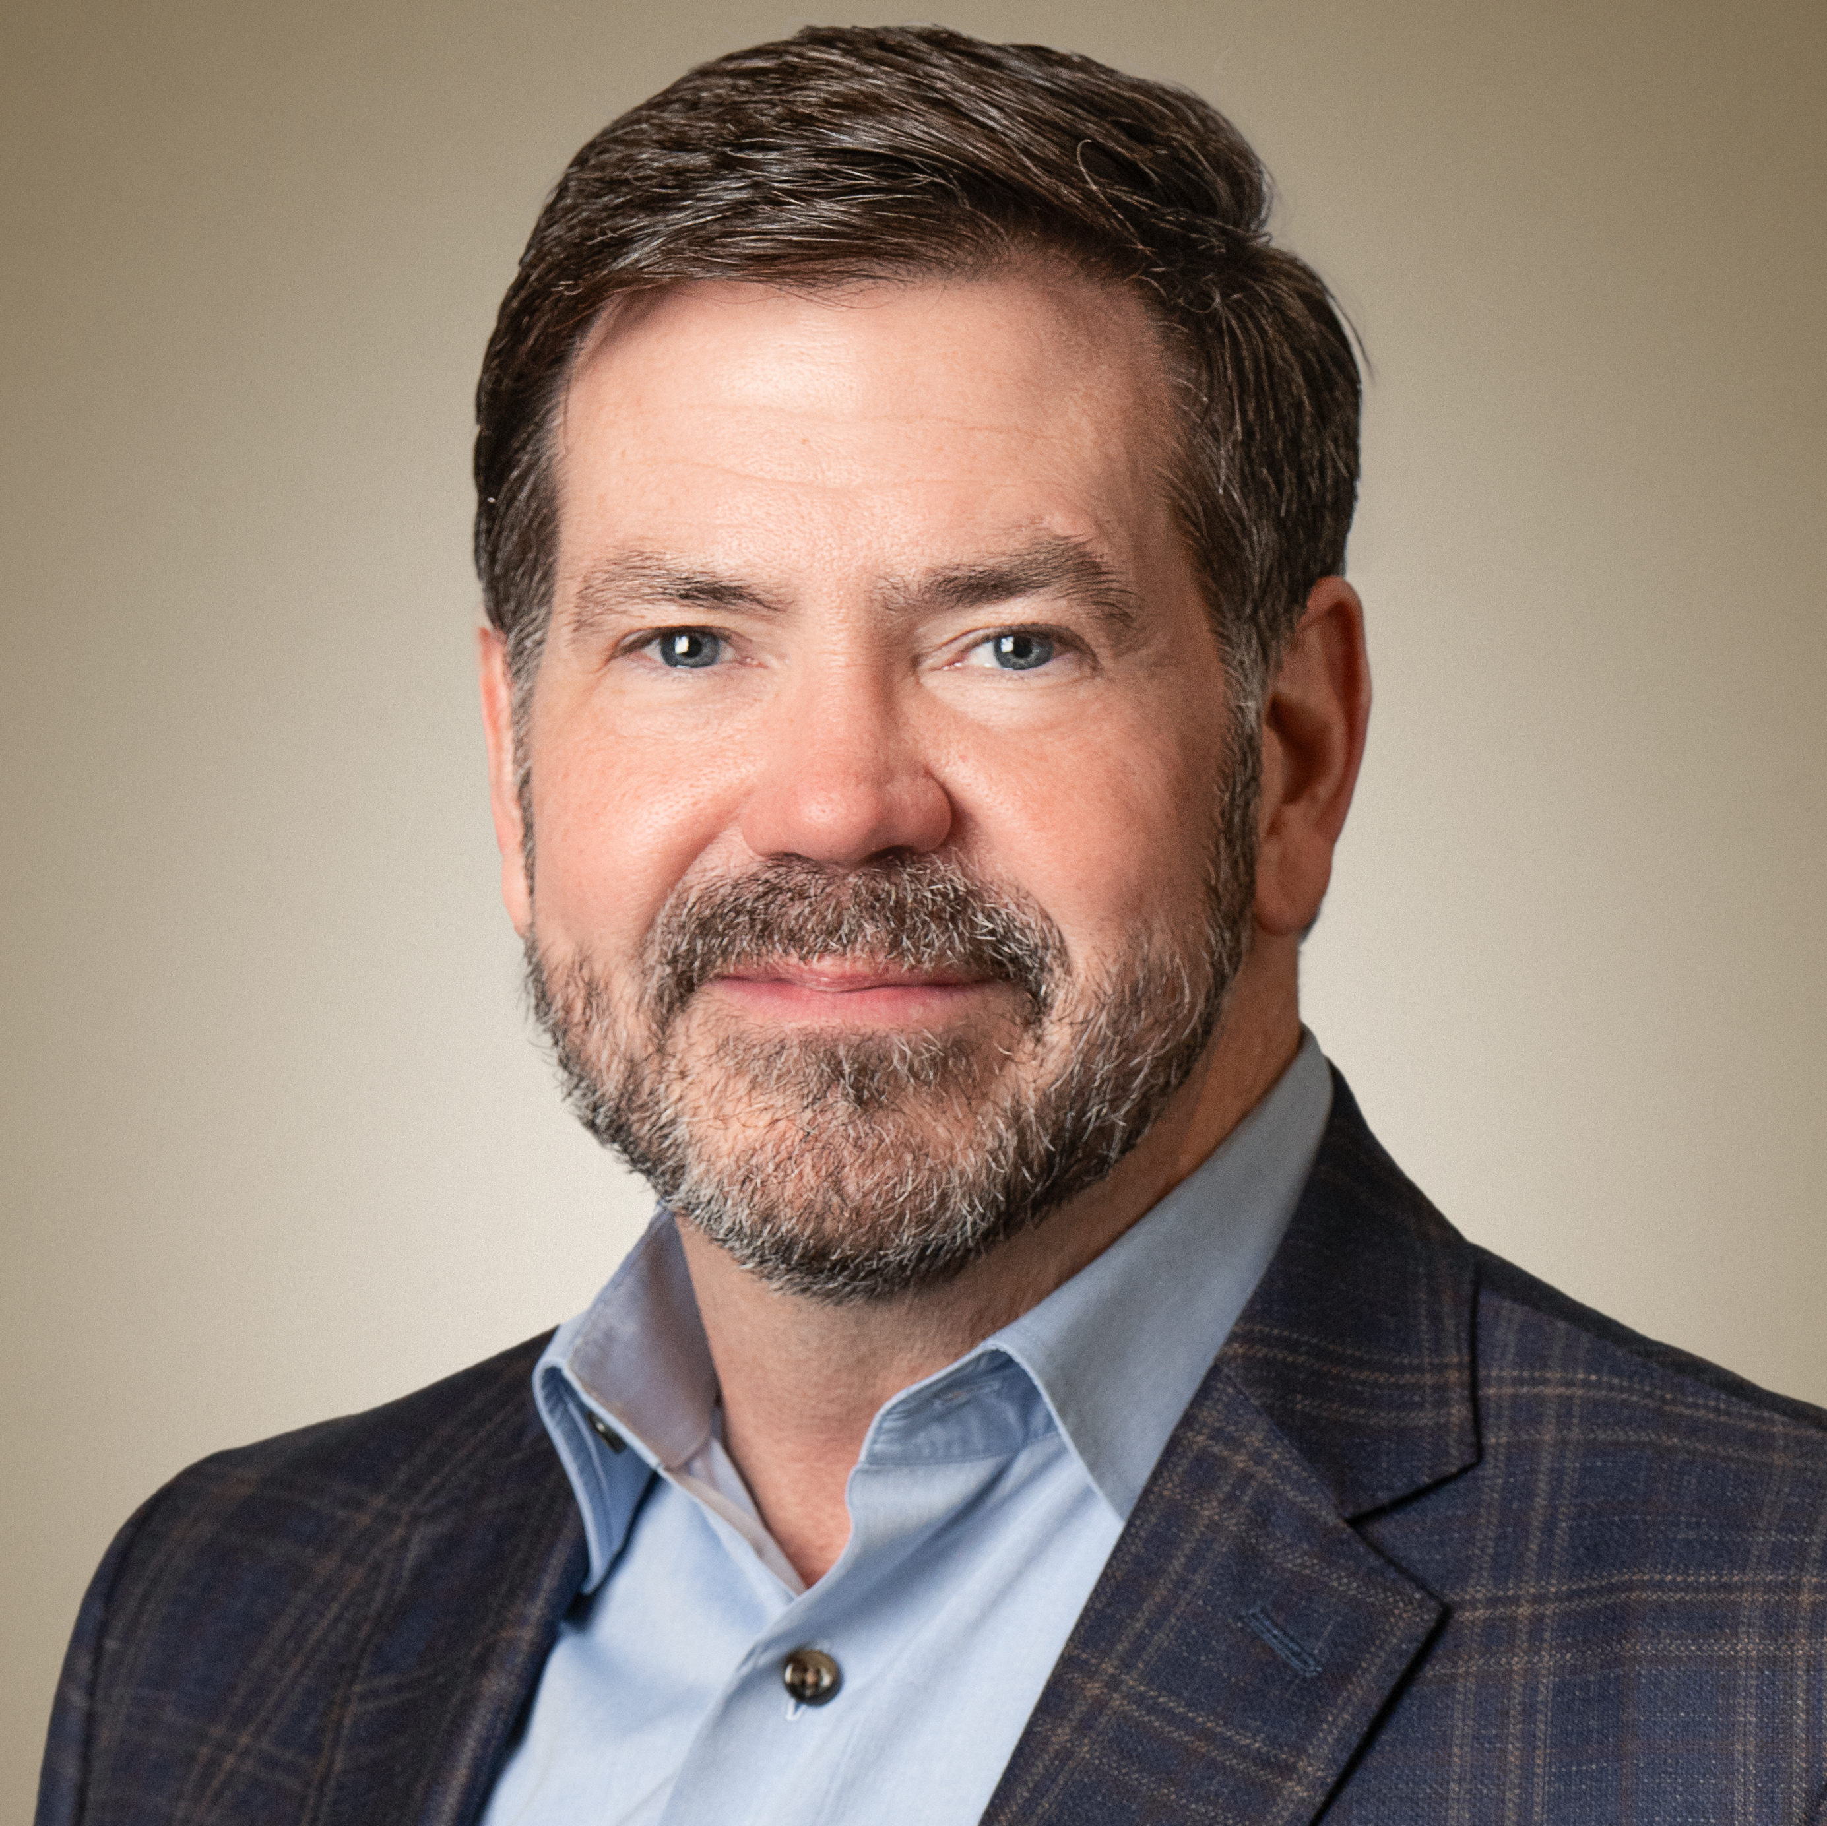
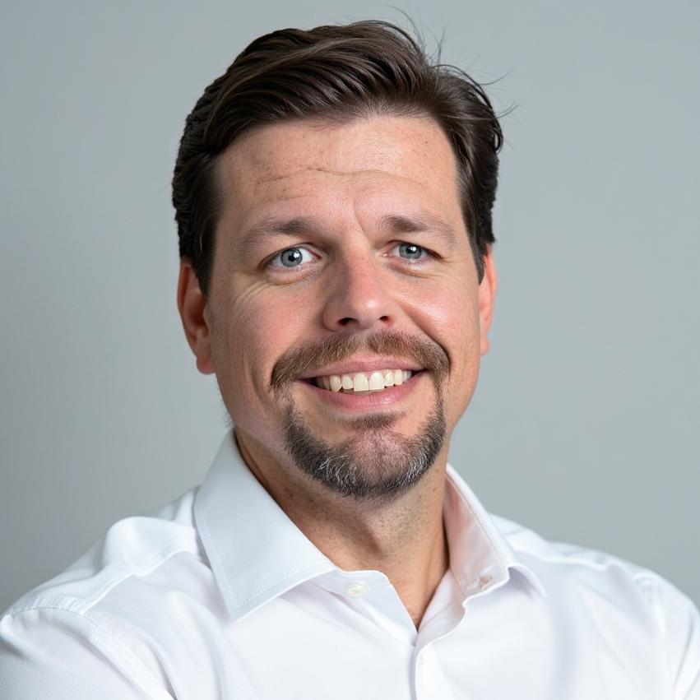
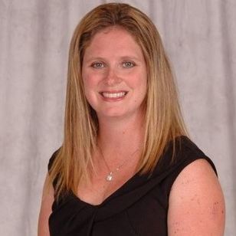
Aamer Hayat
Northern California Retina
Vitreous Associates
Andy Laverghetta
SouthEastern Retina Associates
Jeff Brockette
Texas Retina Associates
Eli Tallman
EyeSouth Partners
Sherri White
Retina Associates of Western NY

