Slide 1




Slide 2

What we heard from you
Reimbursement, Practice Management Solutions, and Biosimilars are three things you want to learn more about from the GPO
        Hopefully all were adequately covered during today’s event
        We’ve continued our partnership with Elizabeth Cifers to provide reimbursement updates in her newsletter
        We’ve entered into a partnership with John Kitchens, MD, and RetinUP to discuss these topics, and more, on his podcast series
You’re interested in getting assistance with payer relations and strategy
        We continue to work on payer negotiations, and have partnered with PayrHealth – a payer / provider relationship manager - who you heard from earlier today
Vast majority want to incorporate practice management discussions into future GPO events
        We’ve amended to agenda to include numerous sessions on various practice management initiatives; recordings of these session will be made available to the entire GPO membership in the coming weeks

Slide 3

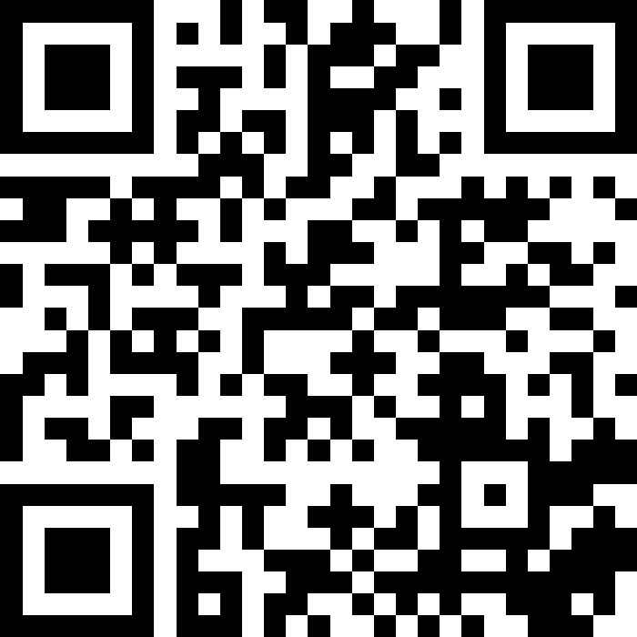
Join at
slido.com
#SPN

Slide 4
1 of 8
What topics are you most interested in learning more about through the GPO? (choose up to 3)
Biosimilars
Reimbursement Updates
Practice Management Solutions
GPO Contract Opportunities
Payer Relations
Legislative / Policy Updates

Slide 5
2 of 8
What services and solutions are you most interested in obtaining through Cencora?
Inventory management
Formulary decision support
MIPS support
Clinical research
Data aggregation
Business analytics (InfoDive)
Contract performance tracking (GPOConnect)

Slide 6
3 of 8
What do you want to see most at future GPO events?
More time dedicated to contract performance
More time to engage directly with pharmaceutical manufacturers
More time to hear about practice management solutions from service partners
More time to network and engage with peers in practice
More clinical content
More practice management / operational content
I am satisfied with the current event structure

Slide 7
4 of 8
Please rate your comfort level using biosimilars in your office
I am very comfortable using biosimilars right now
I am somewhat comfortable using biosimilar right now
I am not comfortable using biosimilars right now
I have no plans to use biosimilars in my practice

Slide 8
5 of 8
If you’re not using, or minimally using biosimilars, what is the reason?
Clinical
Reimbursement
Insurance limitations
Out-of-pocket expense
Cost (WAC)

Slide 9
6 of 8
How has the Good Days funding situation affected branded/biosimilar drug utilization in your practice in 2025?
Significantly
Moderately
Minimally
Not at all
Unsure

Slide 10
7 of 8
What is the biggest obstacle your practice will face in 2026? [Please rank 1-5, with 1 being the greatest obstacle]
Foundation support
Physician recruitment
Payer/Insurance step therapy
Employee turnover
Increasing patient clinic volumes

Slide 11
8 of 8
In general, what % of potential Geographic Atrophy patients are you treating with either Syfovre or Izervay in your practice?
None
< 25%
25-50%
50-75%
75-100%
Unsure

