Slide 1

Shane Dixon PA-C, MBA, CCOA
Vice President, Vision Strategic Advancement
& Business Development

Slide 2



Notes:
Rick Lozano, Sr. Vice President, Specialty GPOs

Slide 3
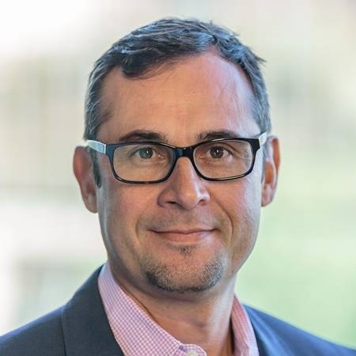
Rick Lozano
Sr. Vice President, Specialty GPOs
Notes:
Rick Lozano, Sr. Vice President, Specialty GPOs

Slide 4

Specialty GPO networks
Notes:
I am thrilled to be here with all of you today. I understand that being away from your families requires commitment, and the travel chaos from the past week has made it even more difficult.
Thank you
I am Rick Lozano . . .

Slide 5
Cencora is a leading pharmaceutical solutions company centered on improving the health of people and animals around the world
46,000+ team members
Diverse expertise all focused on improving global health
50+ countries
with a local presence
SP-110851
1,300+ global
locations
Growing knowledge of market-specific healthcare environments
$230+ billion revenue
#10
on the Fortune 500 list
Delivering a range of services to address specific, local needs
Growth aligned with our customers’ long-term success
Recognized for breadth and scale
Notes:
I want to begin by highlighting Cencora as a global organization. We take great pride in our growth and impact. With over 46,000 employees across 50 countries and 1,300 locations, our reach and scale are significant.
My accountability at Cencora is across all GPO specialties. And I haven’t seen growth like we have seen in Vision in all my years in the industry.
Why does this matter? It matters because our investments in innovation and solutions.
At Cencora, we offer various channels to support access to care, delivering a range of services. At the heart of all our efforts is our purpose: to be united in our responsibility to create healthier futures.
Cencora global org
Reach, scale, investments
Accountability to offer tools to help make decisions
Grounded in our Purpose
I want to start by giving you all exposure to Cencora as a Global Organization
We are extremely proud of the growth and the impact we have.
We are a global company, with over 46K employees, 50 countries and 1,300 locations
When I look at this ...the reach and scale come to mind...and why does it matter?
It matters because these investments in innovation and solutions have a direct impact on the community that you all serve and your ability to stay viable and serve the patient
As your partner we have an accountability to make sure you have all the tools to make these lifesaving decisions
At Cencora we have many different channels to support access to care...that deliver a range of services- and at the center of all these entry points of care- is our purpose to be united in our responsibility to create healthier futures

Slide 6




Specialty care doesn’t stand still.
Neither do we.
We're in a new era of healthcare, advancing at record speeds, producing remarkable breakthroughs, and harnessing our collective industry insight and ingenuity.
This modern era is extraordinary — but can be challenging to navigate alone.
We believe
in creating a better future for community care
by enabling practices through deep partnerships,
to support patients with access to the most innovative and cost-effective care, close to home.
Notes:
Acknowledge the complexities and headwinds physicians are facing
You need be focused on the right things and that is the patient
The market is changing and Cencora must evolve as well; if we look the same in five years, we will have failed.
We need to advance the GPO model, and we are making significant capital investments in specialty to ensure your success.
•Next-generation GPO look like?
Recently, we announced a $1 billion investment into the U.S. supply chain to ensure access, secure supply, and affordability.
We're also investing in MSO models to support initiatives that positively impact communities, including ancillary services like clinical trials, infusion services, and patient assistance programs.
Acknowledgement of complexity
We want you Focused on the right things
How we look today will not be what we look like in 5 years
Must evolve the GPO model/next gen GPO
Last week - $1B investment in US supply chain that will help us ensure our support of access, secure supply and affordability
MSO models
Ancillary services - GPO connect investment, clinical trials, revenue cycle managemen
I want to acknowledge that there are so many complexities and headwinds that you all are having to navigate
Instead of being focused on the care of your patients- we know you are having to think about:
Policy changes- physician reimbursement
Managing a product portfolio- with new products and categories- (Biosimilars)
What technology and tools do you need to invest in
If you sit back and think about what your practice looked like 5 years ago and the decision you had to make.... they don’t even compare to the decision of today... Cencora - also must change- We know that if we look the same in 5 years that we do now, then we will have failed
We must evolve the gpo model…and Cencora is making capital investments in specialty…it is so important we are making the right investments for each of you being successful
What does the Next Gen gpo look like?
For several decades, our company has been growing, evolving, and building a comprehensive portfolio of solutions to address customers’ most urgent challenges and help navigate the ever-changing specialty physician landscape.
Couple of quick examples of the investments we are making
You saw last week we announced our investment of $1 billion into the US Supply Chain.
The investments are to make sure that we support:
Access, secure supply, and affordability
We’ve seen the trend of investing in MSO models
This is an important strategy of ours as well. It allows us to support and back initiatives that have a positive impact on all communities
additional ancillary services (clinical trials and research, infusion services, patient assistance/reimbursement programs, etc.).
GPO Connect investments: We will continue to focus on our Customer Experience; enhancing reports, automation, and the onboarding experience – through GPO connect Investments

Slide 7

Cencora is well positioned now and in the future to continue growing our Vision platform, through 3 key strategic priorities
Continue to invest in practice management platform
Enable customers for emerging technologies
Rapidly and proactively evolve our
GPO model
Explore strategic investments
Explore Clinical Trial Offering
Continue to drive multi-specialty, particularly Vision
Ensure we are solving our customers biggest product challenges- operational excellence
Provide resources and education on emerging services and technologies
Introduce new services and programs through value-added partnerships
Iterate on a win-win approach for membership
Strategic partnerships
Evolve contracting
Technology & Data Driven offering
Address gross to net in drug classes
Notes:
As we position ourselves to support you, we want to make sure that we are engaged in active listening and active learning from our customers.
Our focus will be in three key strategic areas:
Practice management systems and ancillary services
Enabling technology that supports your decisions
Evolve the GPO
I hope the next two days are productive and I will throw it to Shane

Slide 8
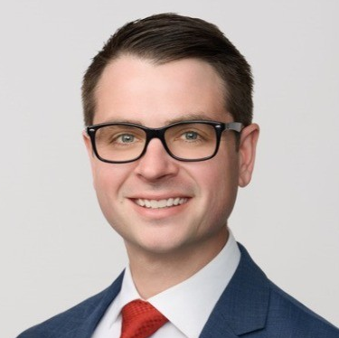
Phil Bruce
Vice President & General Manager, SPN

Slide 9
Specialty GPO networks
Specialty Practice Network

Slide 10
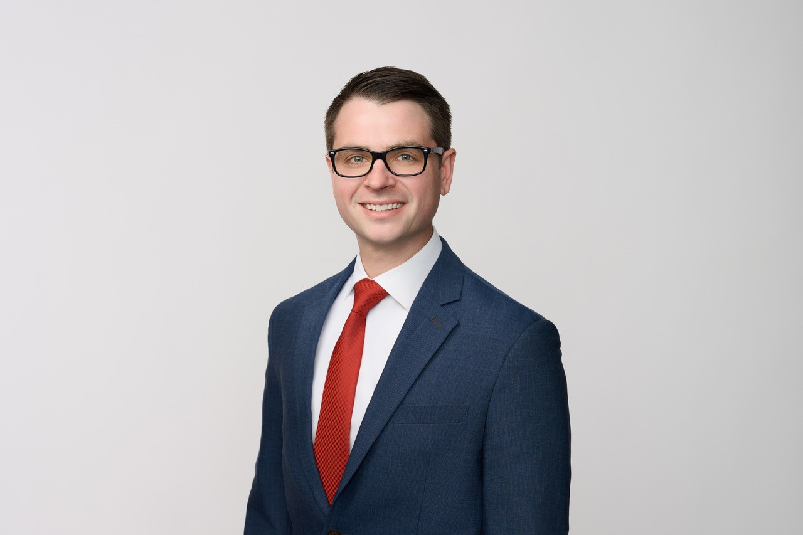
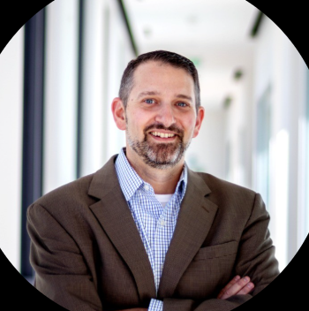
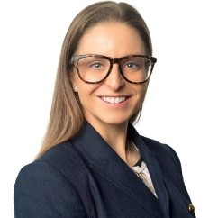
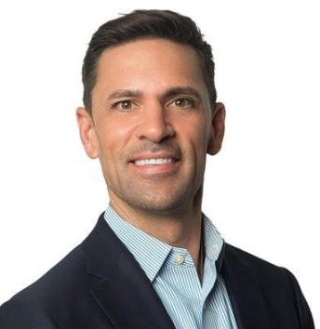
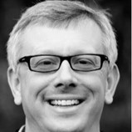



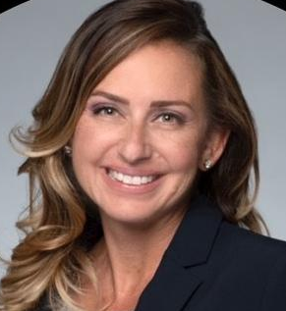


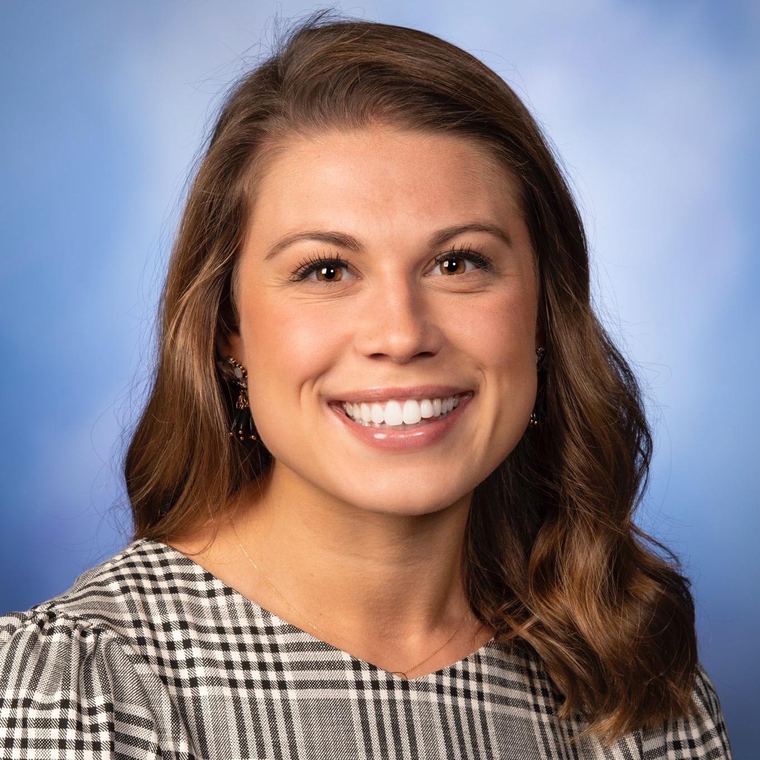

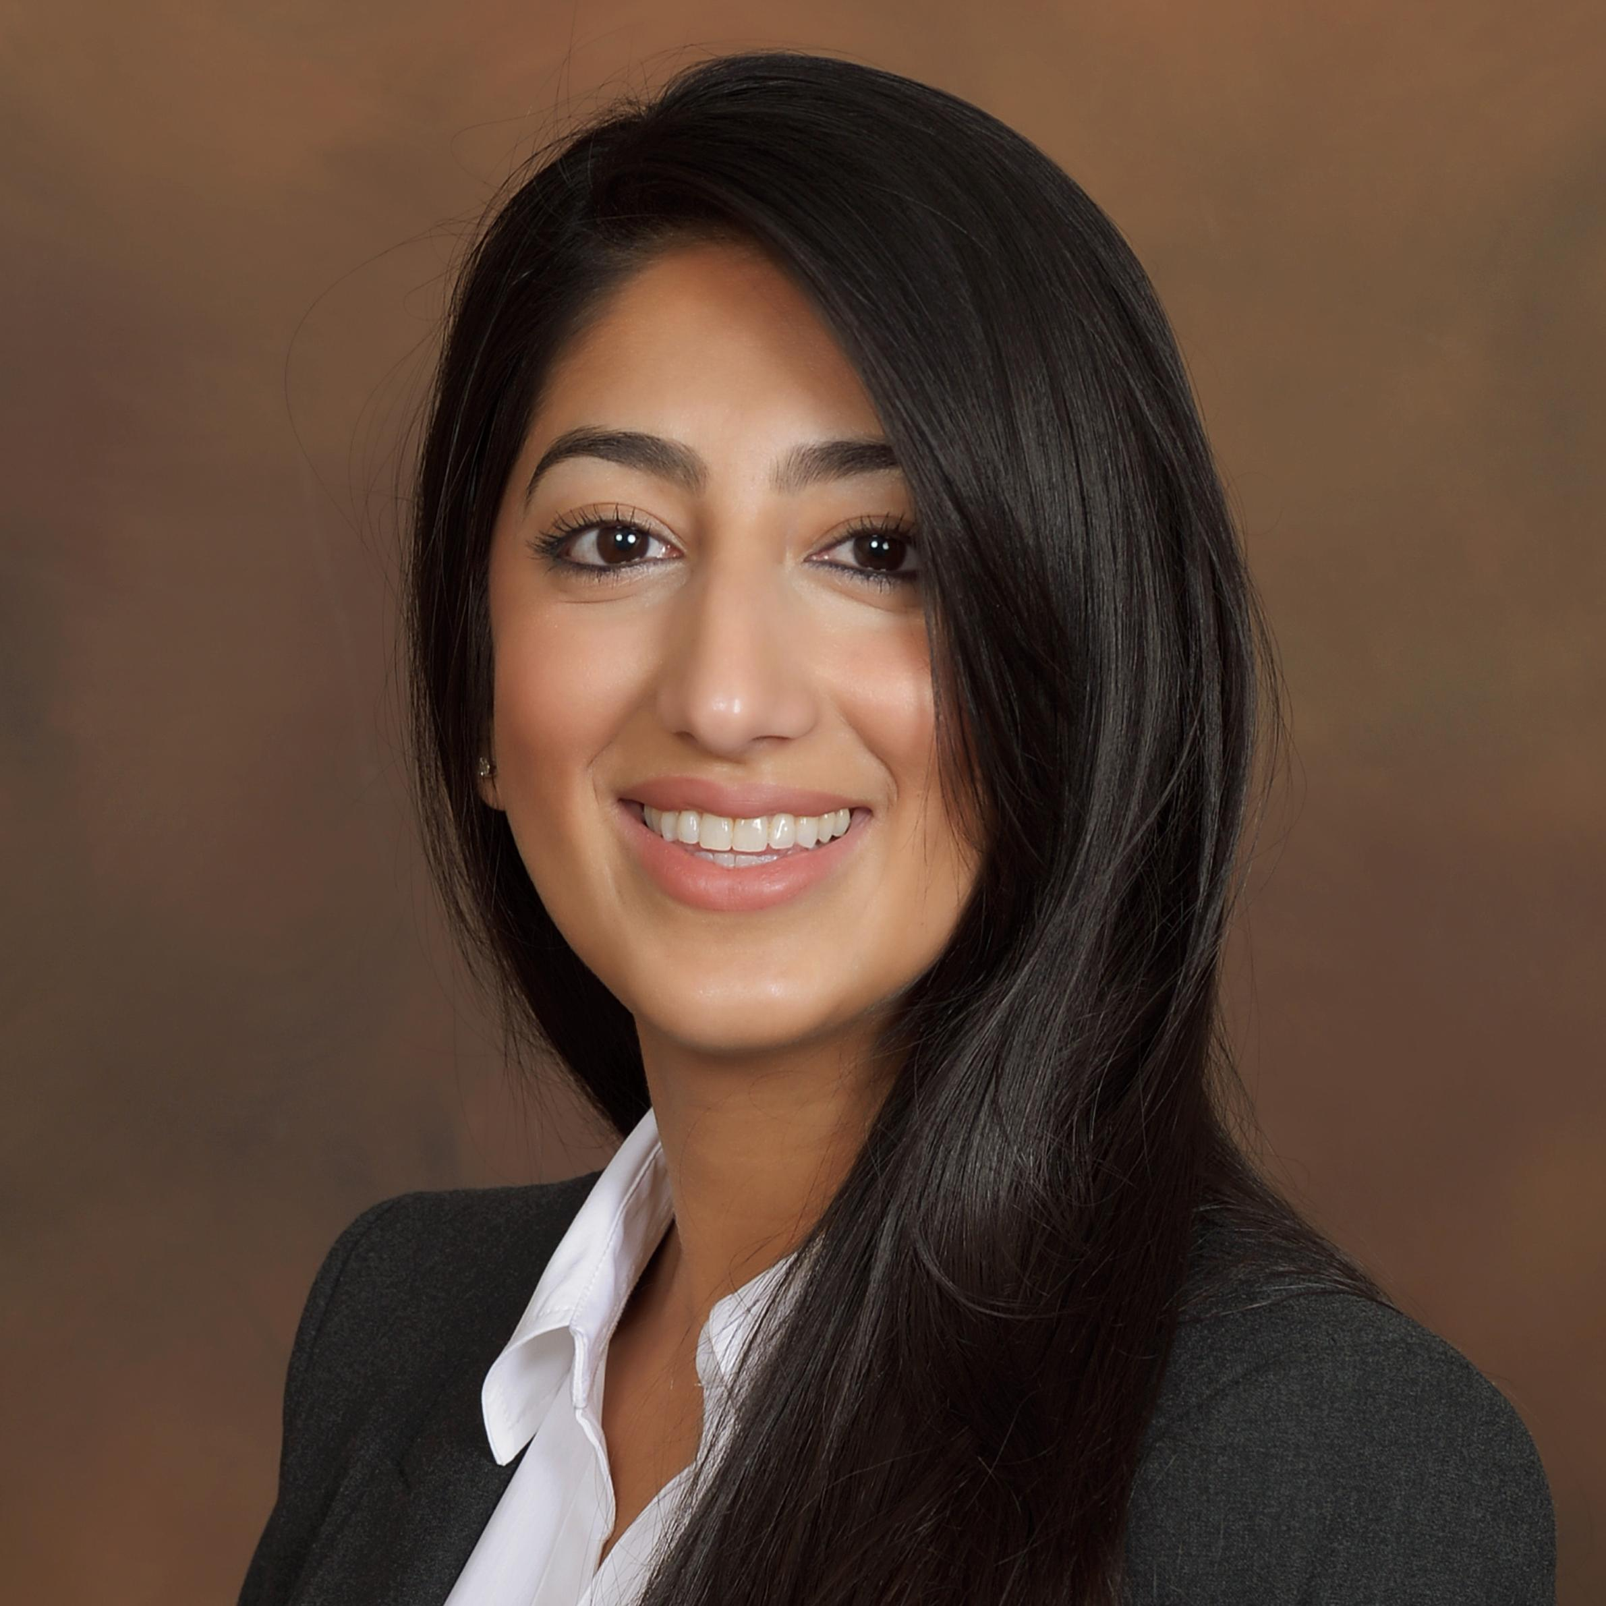
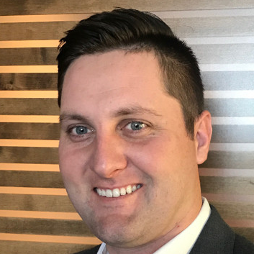
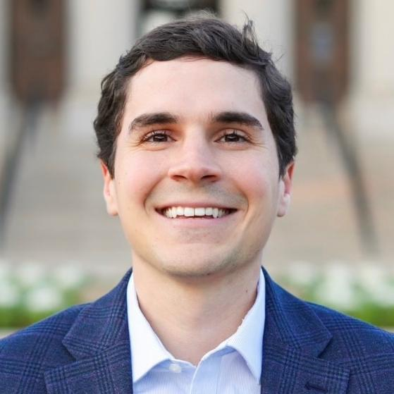
Specialty Practice Network GPO Sales
Philip Bruce
VP, GM Multispecialty GPO Sales
Matthew Letow
VP, Multispecialty Corporate Accounts
Kortney Cooper
VP, Strategic Advancement & Business Development
Jason Fox
VP, National Sales
Shane Dixon
VP, Retina Strategic Advancement & BD
Meghan Galligan
Sr. Director, Corporate Accounts
Steve Reichenbach
Corporate Account Director
Jessica Cooley
Director, GPO Sales
Stacey Neumann
Corporate Account Director
Ashley Wills
Corporate Account Director
OPEN
Regional Acct. Manager
Halle McCleave
Regional Acct. Manager
Zach Horstman
Corporate Account Director
Shaima Azeem
Strategic Acct. Manager
Tyler Lakey
Strategic Acct. Manager
Luke Lucido
Strategic Acct Manager
Notes:
Phil Bruce

Slide 11



Vision focus size & scope
16 SPN contracted products
Beovu® brolucizumab-dbll | Bevacizumab compounded | Byooviz™ ranibizumab-nuna | Eylea® aflibercept
Eylea HD 8mg® aflibercept | Iheezo™ chloroprocaine HCI ophthalmic gel | Iluvien® fluocinolone acetonide intravitreal implant | Izervay™ avacincaptad pegol intravitreal solution
Lucentis® ranibizumab | Ozurdex® dexamethasone intravitreal implant | Pavblu™ aflibercept-ayyh | Syfovre™ pegcetacoplan injection
Susvimo® ranibizumab injection | Triesence™ Triamcinolone acetonide injectable suspension | Vabysmo® faricimab-svoa | Xipere® triamcinolone acetonide injectable suspension
Vision Practice Network
1,033
practices
3,437
sites of care
85
LPP members
25
LPP+ members

Slide 13



















Thank you to all of our sponsors

Slide 14
Special thanks to our premium sponsors

Slide 15
7:00 – 7:30am | Breakfast – Landmark CD
7:30 – 8:00am | Exhibits / Networking - Landmark CD
8:00 - 8:15am | Welcome, Program Overview & Cencora Unified Vision | Rick Lozano Phil Bruce, and Shane Dixon, PA-C, MBA, CCOA
8:15 – 8:45am | Market Economics & Legislative Update | David Senior, SVP, Biopharma Intelligence, Cencora
8:45 – 9:20am | Coding, Billing & Reimbursement Updates | Elizabeth Cifers, Elizabeth Cifers Consulting, LLC
9:20 - 9:40am | Strategies in Payer Contracting | Armando Cardoso & Scott Dewey, PayrHealth
9:40 – 10:10am | Break / Exhibits / Networking
10:10 – 10:35am | Update on Current Therapies: Biosimilars, Anti-VEGF, GA, and more | John Kitchens, MD, Retina Associates of Kentucky/EyeCare Partners
10:35 – 11:00am | Future Therapies in Retina: TKIs, cell & gene, etc | John Kitchens, MD, Retina Associates of Kentucky/EyeCare Partners
11:00 – 12:00pm | Practice Management / Business Operations Quick Hits Revenue Cycle Management Research trials in ophthalmology Discussions on real estate: rent vs own Benefits of cross-training staff | Ashley Nahrwold, The Retina Institute/ Retina Consultants of America Kevin Quinn, Retina Consultants of America Jeff Brockette, Texas Retina Associates Kristin Yockus, Retina Consultants of America Andy Laverghetta, SouthEastern Retina Associates
12:00 – 1:00pm | Lunch / Exhibits / Networking
1:00 – 1:45pm | News from Distribution, GPO, and Solutions | Jessica Cooley, Rich Griffith, and Jaime Knight
1:45 – 2:45pm | Practice Administrator Panel: Changing landscape with patient assistance Strategies for physician recruitment Utilizing artificial intelligence Ways to reduce staff turnover | Aamer Hyatt, Northern California Retina Vitreous Associates Andy Laverghetta, SouthEastern Retina Associates Jeff Brockette, Texas Retina Associates Eli Tallman, EyeSouth Partners Sherri White, Retina Associates of Western NY
2:45 – 3:00pm | Audience ARS, Closing Remarks, Event Takeaways, Next Steps | Shane Dixon, PA-C, MBA, CCOA and Chris Vorce

Slide 16

DAY 2
SATURDAY
Nov 15
Dallas, TX
TIME | TOPIC
7:00 – 7:30am | Breakfast – Landmark CD
7:30 – 8:00am | Exhibits / Networking - Landmark CD
TIME | General Session Landmark AB | SPEAKER
8:00 - 8:15am | Welcome, Program Overview & Cencora Unified Vision | Rick Lozano, Sr. Vice President, Specialty GPOs Phil Bruce, Vice President & General Manager, SPN Shane Dixon, PA-C, MBA, CCOA, Vice President, Vision Strategic Advancement & Business Development
8:15 – 8:45am | Market Economics & Legislative Update | David Senior, SVP, Biopharma Intelligence, Cencora
8:45 – 9:20am | Coding, Billing & Reimbursement Updates | Elizabeth Cifers, Elizabeth Cifers Consulting, LLC
9:20 - 9:40am | Strategies in Payer Contracting | Armando Cardoso & Scott Dewey, PayrHealth
9:40 – 10:10am | Break / Exhibits / Networking
10:10 – 10:35am | Update on Current Therapies: Biosimilars, Anti-VEGF, GA, and more | John Kitchens, MD, Retina Associates of Kentucky/EyeCare Partners
10:35 – 11:00am | Future Therapies in Retina: TKIs, cell & gene, etc | John Kitchens, MD, Retina Associates of Kentucky/EyeCare Partners
11:00 – 12:00pm | Practice Management / Business Operations Quick Hits Revenue Cycle Management: benefits verification, prior authorizations, and more Research trials in ophthalmology Discussions on real estate: rent vs own Benefits of cross-training staff | Ashley Nahrwold, The Retina Institute/ Retina Consultants of America Kevin Quinn, Retina Consultants of America Jeff Brockette, Texas Retina Associates Kristin Yockus, Retina Consultants of America Andy Laverghetta, SouthEastern Retina Associates
12:00 – 1:00pm | Lunch / Exhibits / Networking
1:00 – 1:45pm | News from Distribution, GPO, and Solutions | Jessica Cooley, Director of Vision Sales, SPN; Rich Griffith, Sr. Director, Business Development; Jaime Knight, Vice President, Vision Sales, Besse
1:45 – 2:45pm | Practice Administrator Panel: Changing landscape with patient assistance Strategies for physician recruitment Utilizing artificial intelligence Ways to reduce staff turnover | Aamer Hayat, Northern California Retina Vitreous Associates Andy Laverghetta, SouthEastern Retina Associates Jeff Brockette, Texas Retina Associates Eli Tallman, EyeSouth Partners Sherri White, Retina Associates of Western NY
2:45 – 3:00pm | Audience ARS, Closing Remarks, Event Takeaways, Next Steps | Shane Dixon, PA-C, MBA, CCOA, Vice President, Vision Strategic Advancement and Business Development; Chris Vorce, Sr. Director, Marketing, SPN

Slide 17

Housekeeping
Vision Exchange meeting app:
Meeting app:
    Scan the QR code to the right to download the meeting app.
    Additional information can be found on the card at your seat.
ARS:
    Audience response surveys will be conducted at the end of the day.
    Be sure to have your phones ready to scan the QR code to participate.

Slide 18

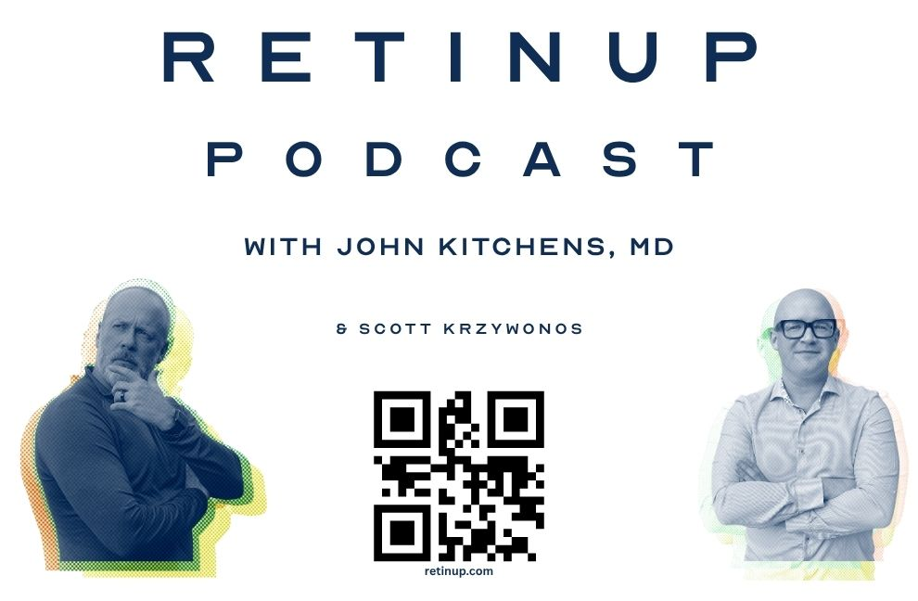
RetinUp podcast
Looking for honest conversations in retina that you don’t hear anywhere else? Subscribe to RetinUp with John Kitchens, MD, wherever you get your podcasts.
Subscribe and listen on your favorite podcast app.

