Slide 1



2024 SPN Vision
Exchange

Slide 2
Therapies for geographic atrophy
John Kitchens, MD

Slide 3
Disclosures

Slide 4
Speaker is being compensated for his presentation today by AmerisourceBergen.
However, neither AmerisourceBergen nor any pharmaceutical company has influenced the content of this presentation nor has AmerisourceBergen independently verified the presentation for accuracy.

Slide 5
Financial disclosures
Alcon - Speaker/Consultant
Allergan - Consultant
Alimera - Consultant
Apellis - Consultant
Bayer - Speaker/Consultant
Biogen - Consultant
B&L - Consultant
Genentech - Speaker/Consultant
Kodiak Bioscience -Consultant
Notal Vision - Consultant
Optos - Consultant
Oculus - Consultant
Outlook - Consultant/Stock ownership
Regeneron - Speaker/Consultant
Roche - Consultant
Zeiss - Consultant

Slide 6
What is geographic atrophy?

Slide 7
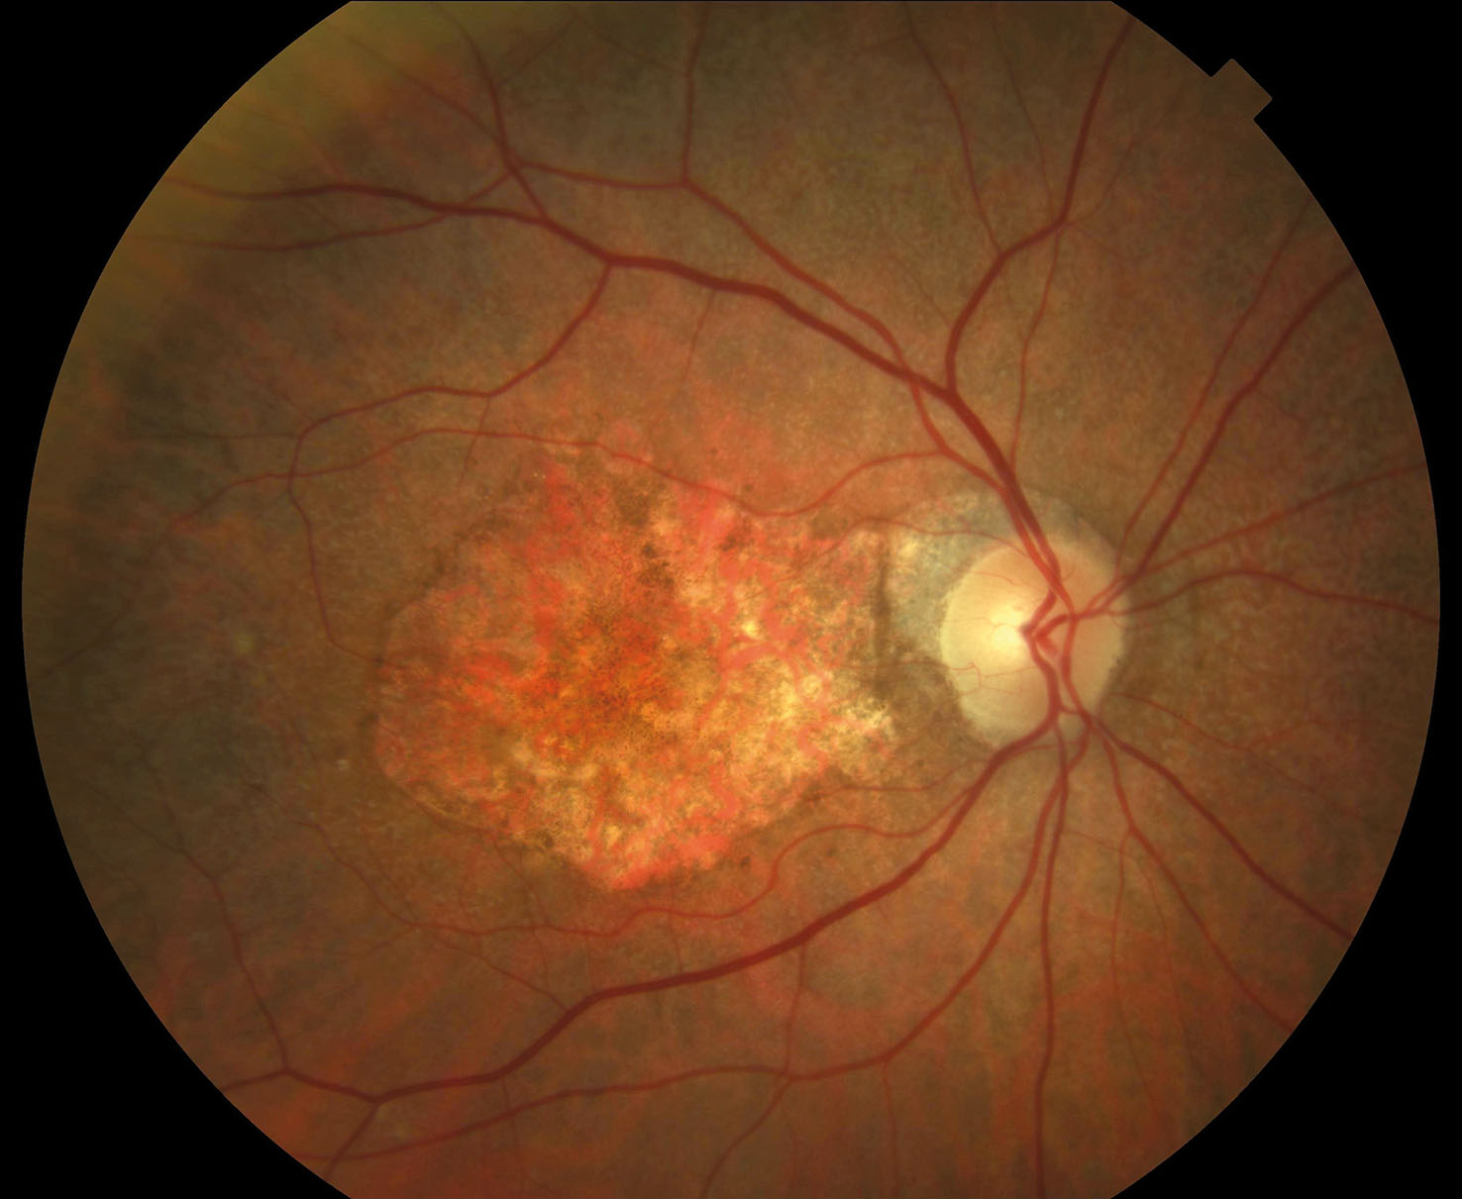
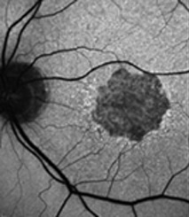
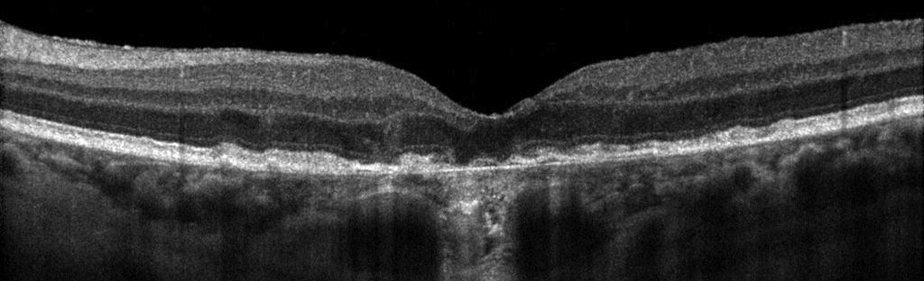

Slide 8
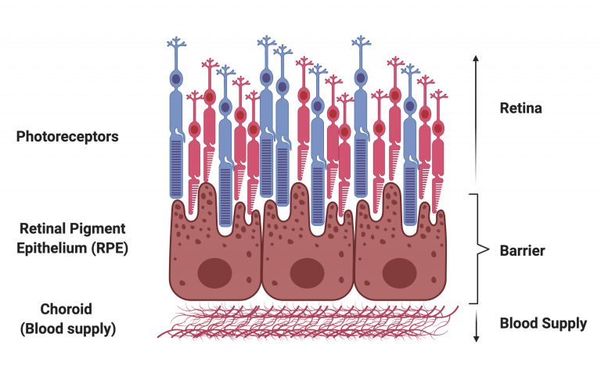

Slide 9
Regulates the transport of nutrients and waste products to and from the retina.
Contributes to outer segment renewal by ingesting and degrading the spent tips of photoreceptor outer segments.
It protects the outer retina from excessive high-energy light and light-generated oxygen reactive species.
Maintains retinal homeostasis through the release of diffusible factors.

Slide 10


Slide 11
Who develops GA?

Slide 12
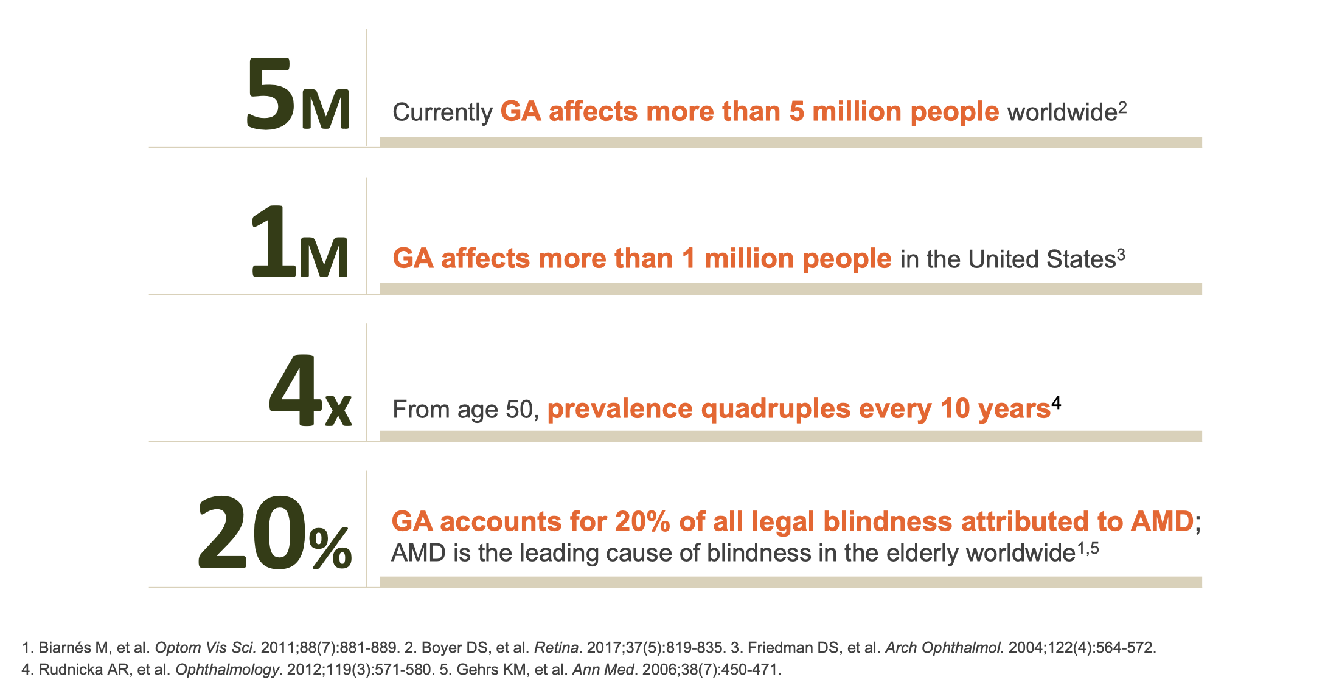

Slide 13
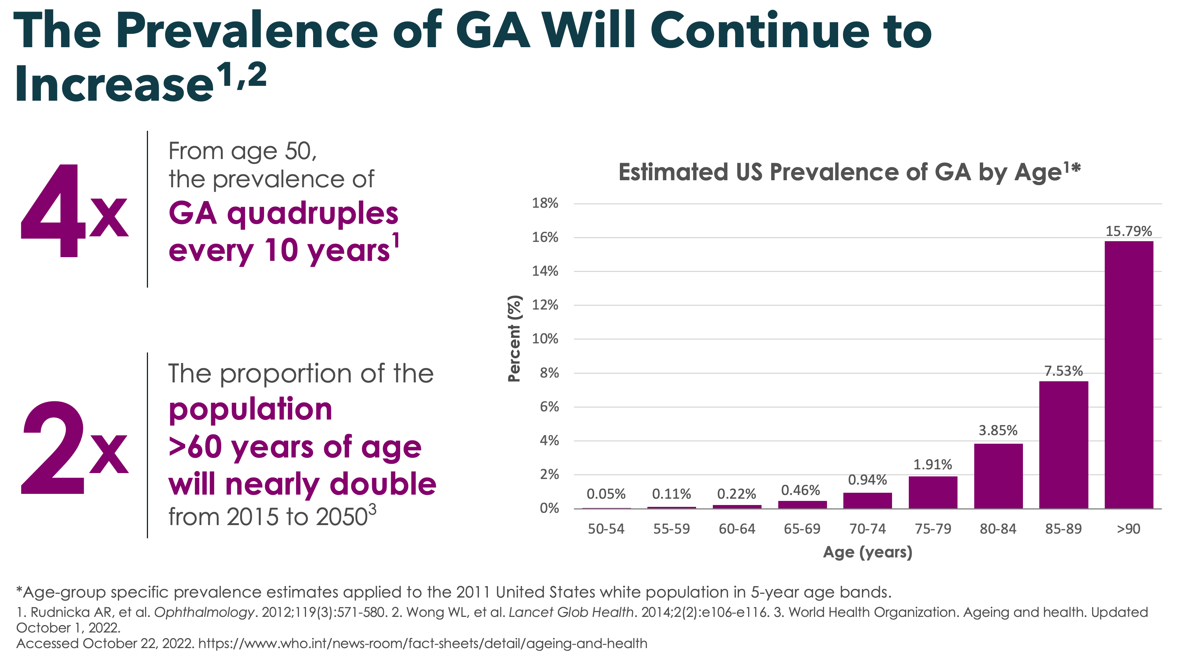

Slide 14
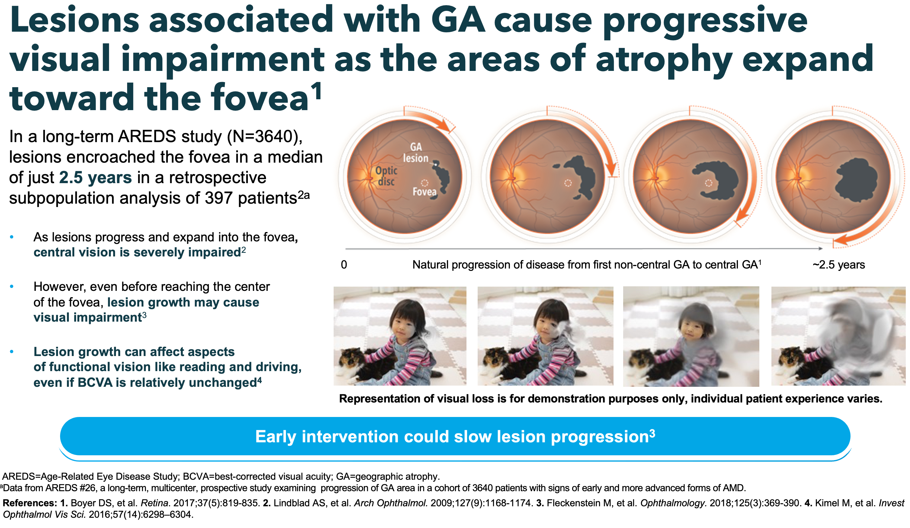

Slide 15
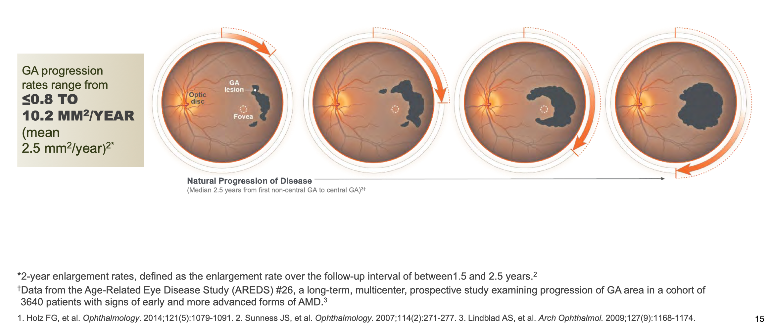
The average disk area measured with CSLO in normal Caucasian subjects ranges from 1.74 mm2 to 2.47 mm2
Notes:
https://www.ncbi.nlm.nih.gov/pmc/articles/PMC1850981/

Slide 16
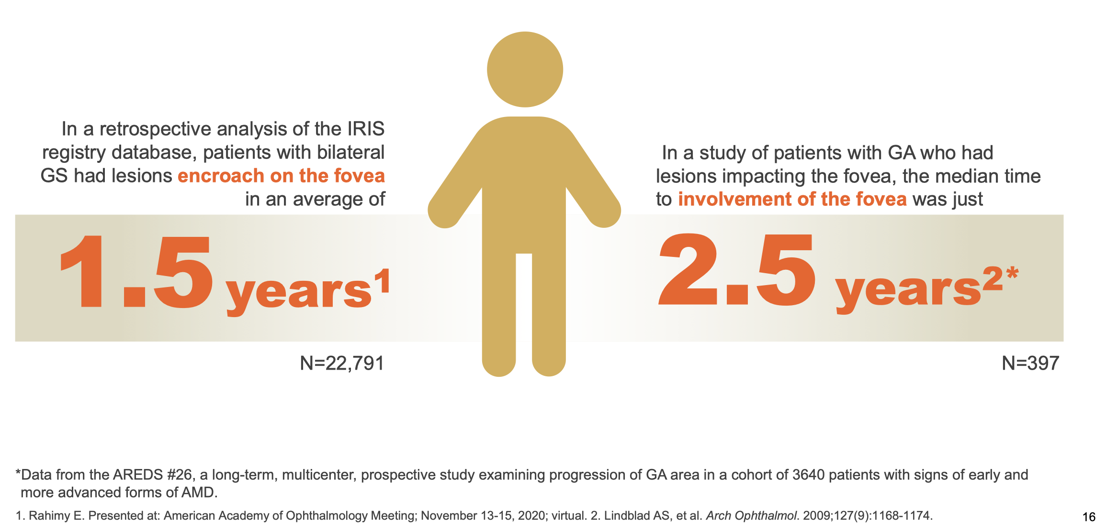

Slide 17
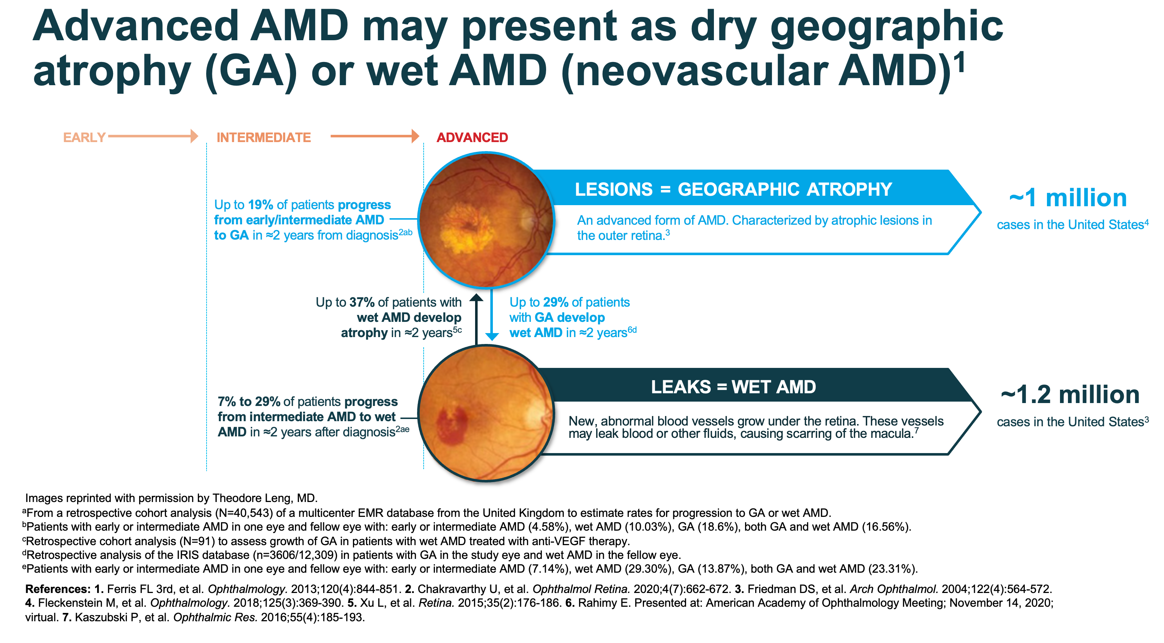

Slide 18
How does it impact patients?

Slide 19
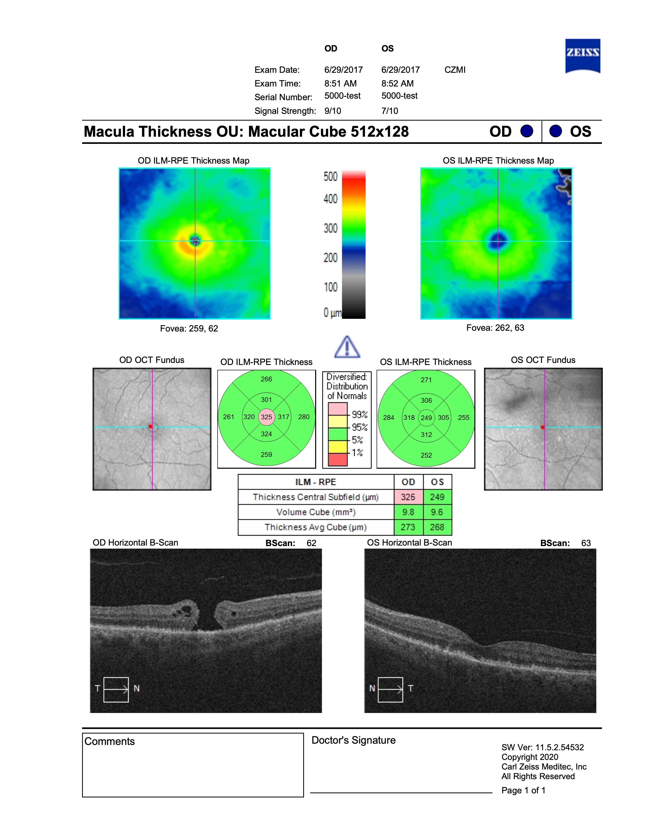
History
2017
Initial presentation in 2017
77 year old white male
CC: decreased vision OD
HX: s/p CEIOL OU
DX: Macular hole OD
Underwent successful surgical repair

Slide 20
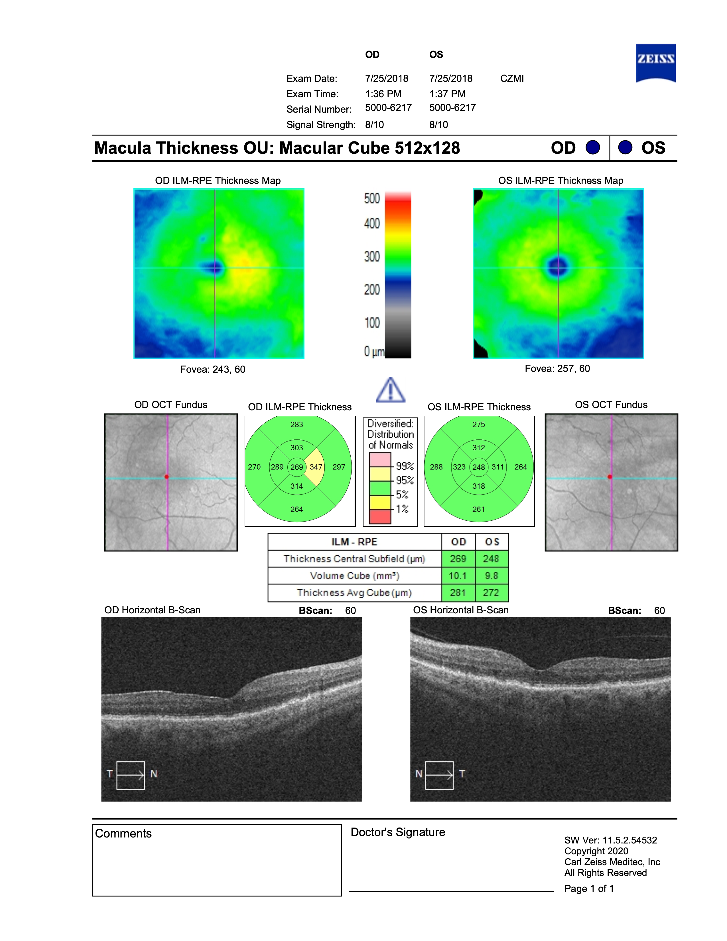
SUCCESSFUL MH REPAIR
ONE YEAR LATER

Slide 22
Six years later…

Slide 23
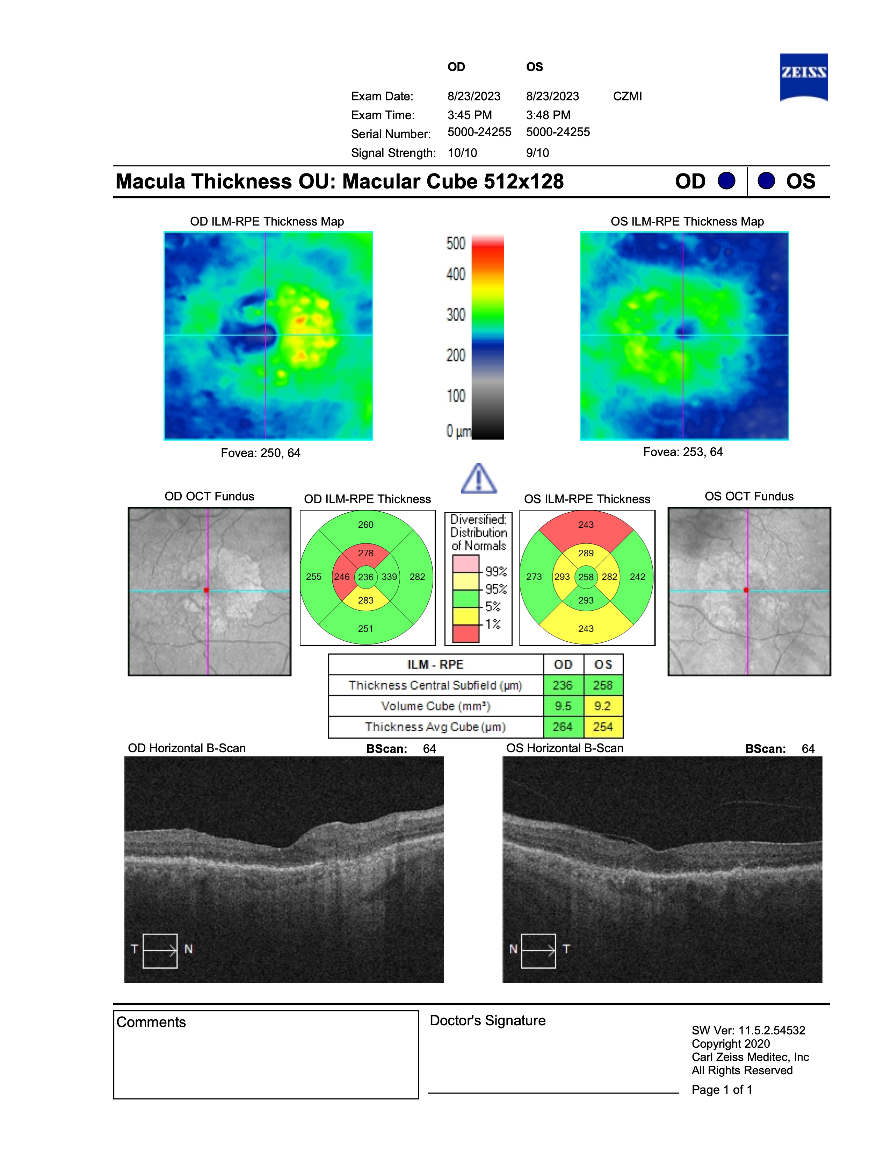
History
2023
Patient is now 83 years old
CC: “My eye doctor saw something wrong.”
Successful macular hole repair 6 years prior (OD)
Va: 20/50 OU

Slide 25
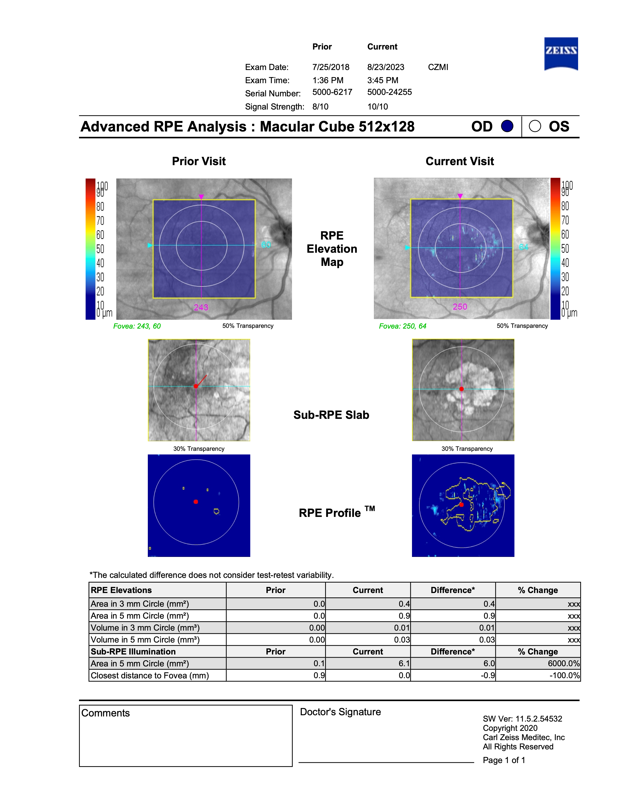
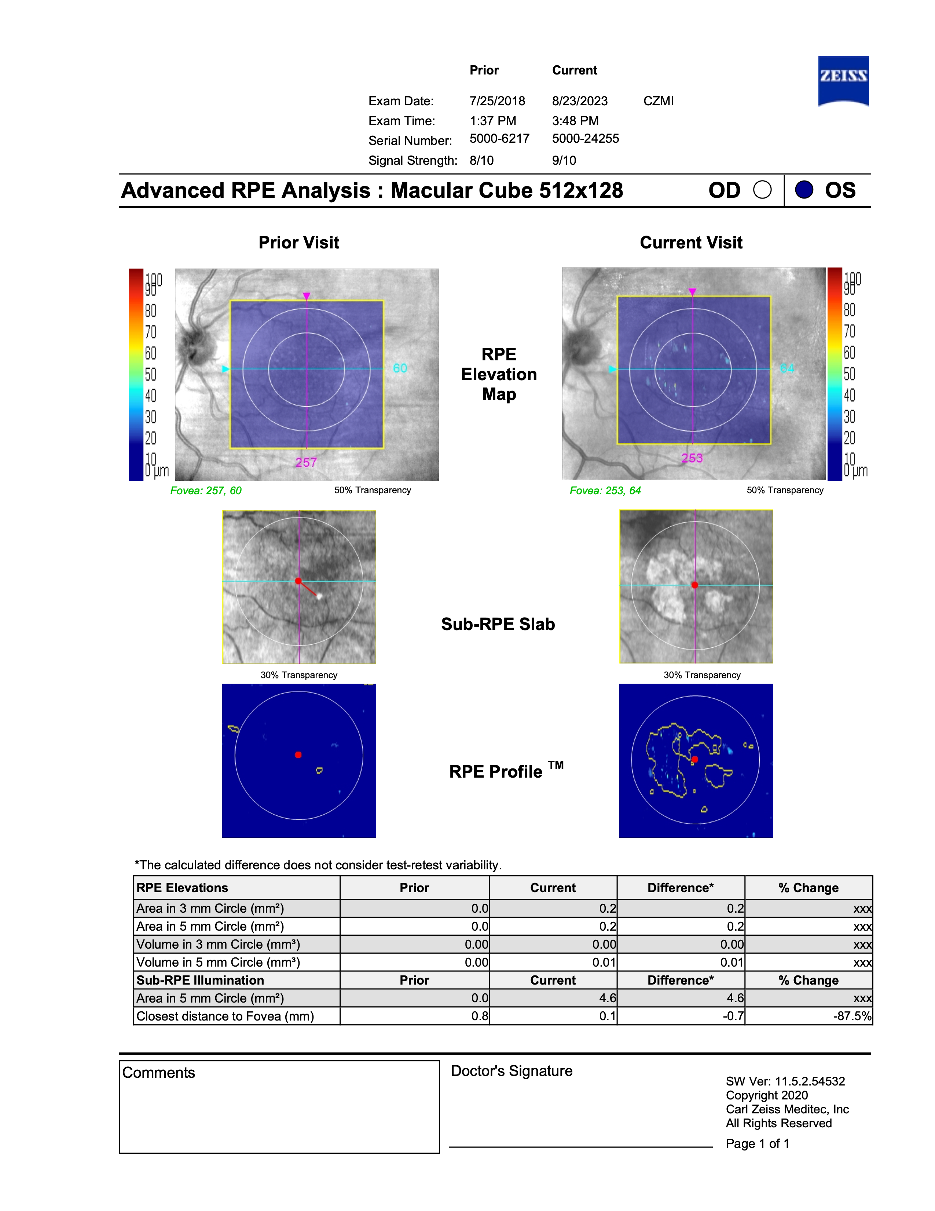

Slide 26
2017
2023
OD
20/50
OS
20/50

Slide 27
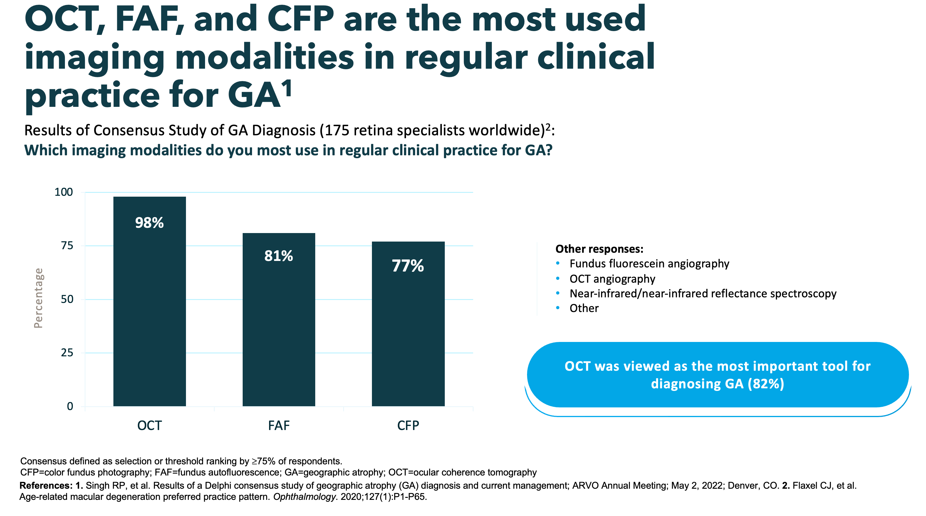

Slide 28
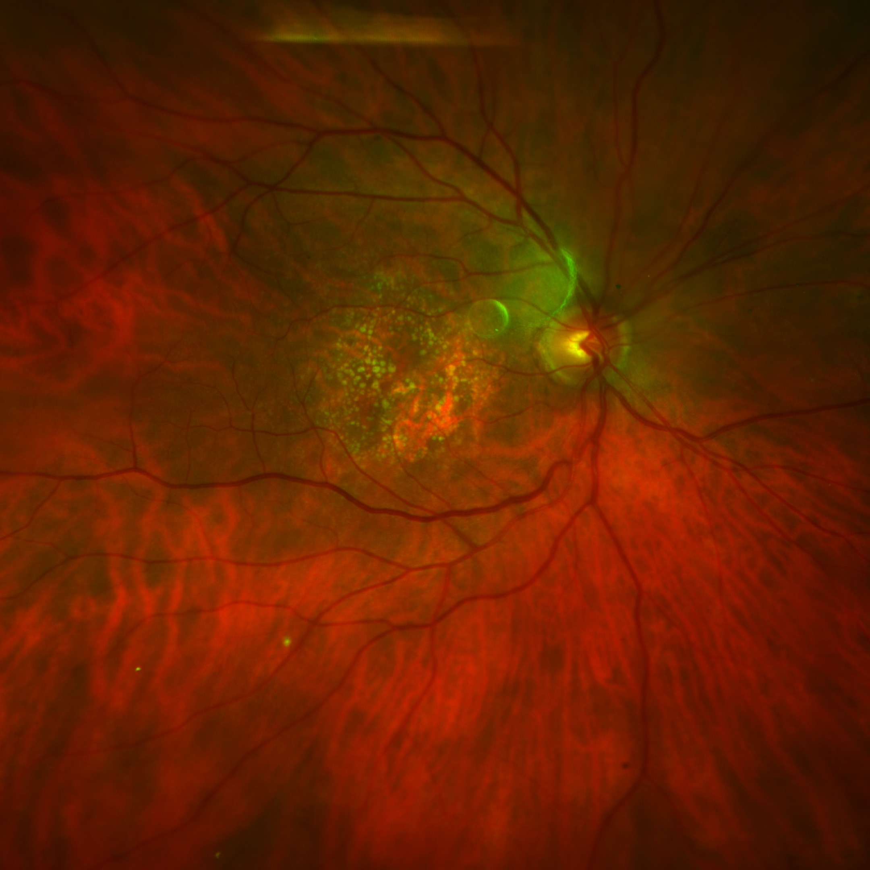
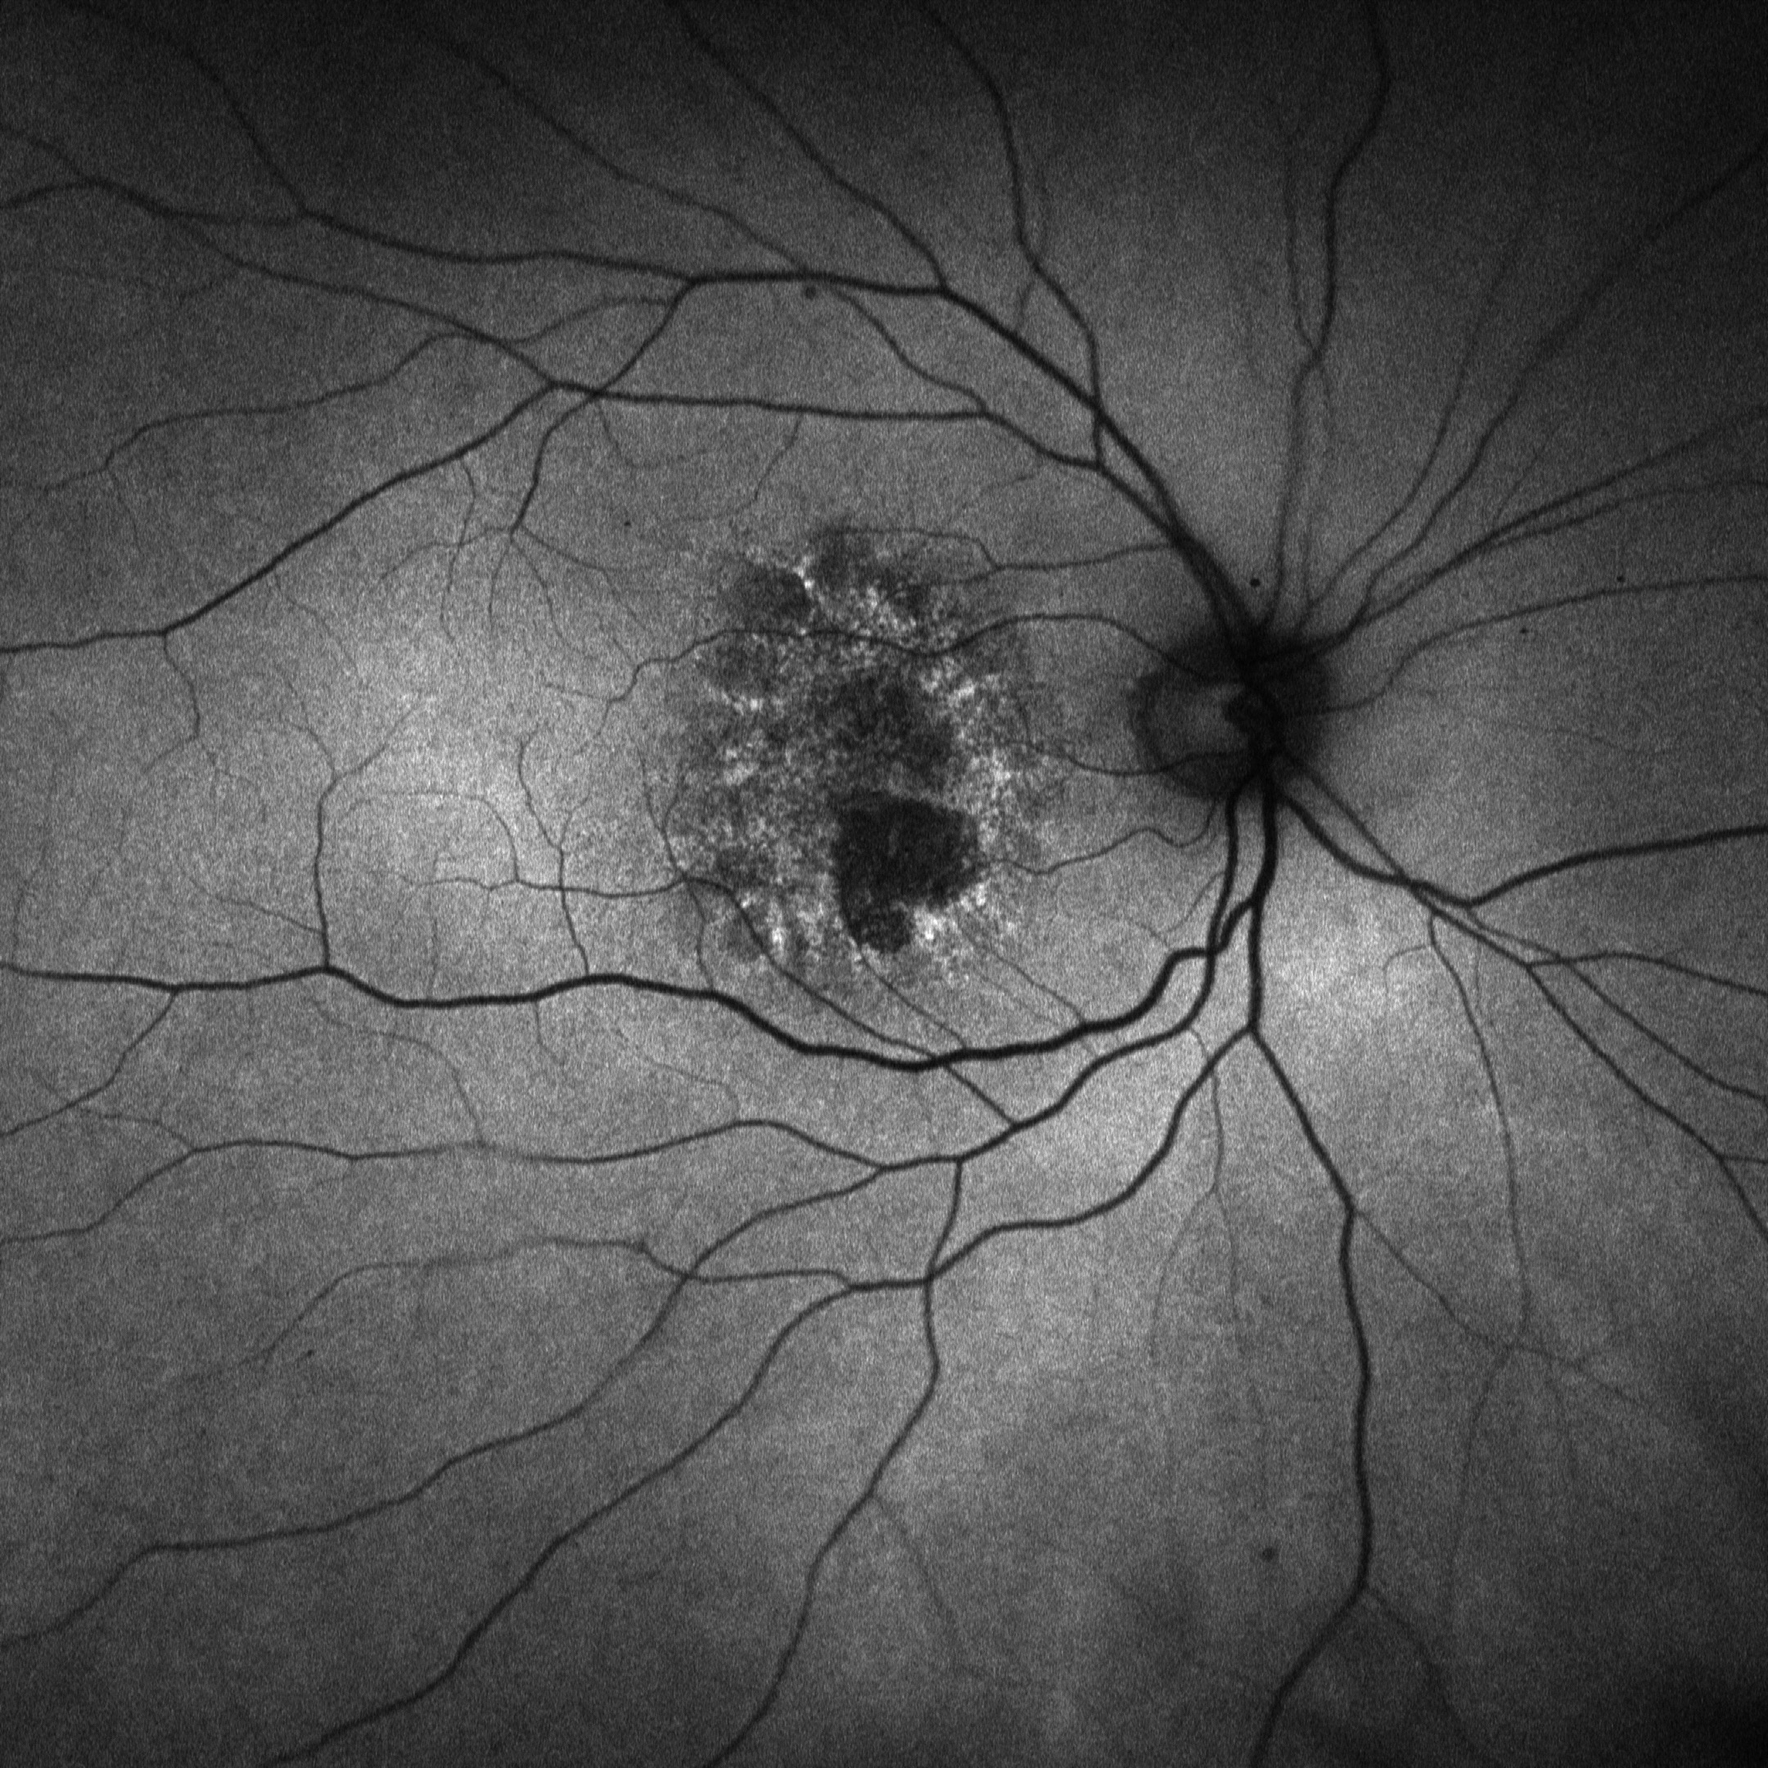

Slide 29
What can be done about it?

Slide 30
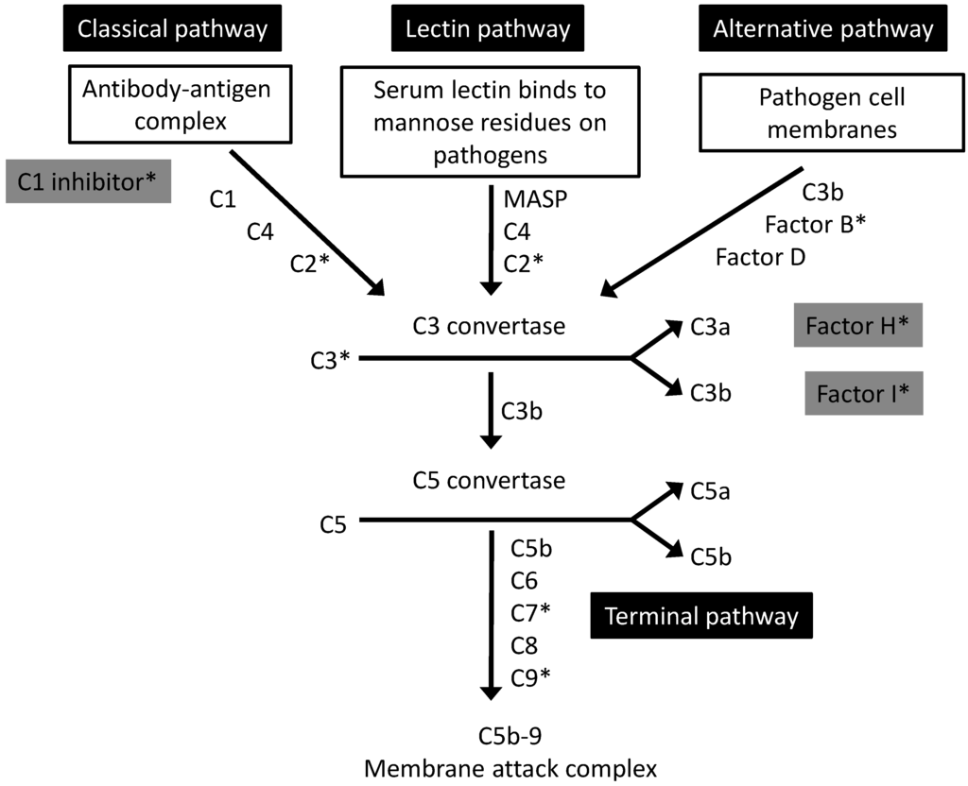

Slide 31
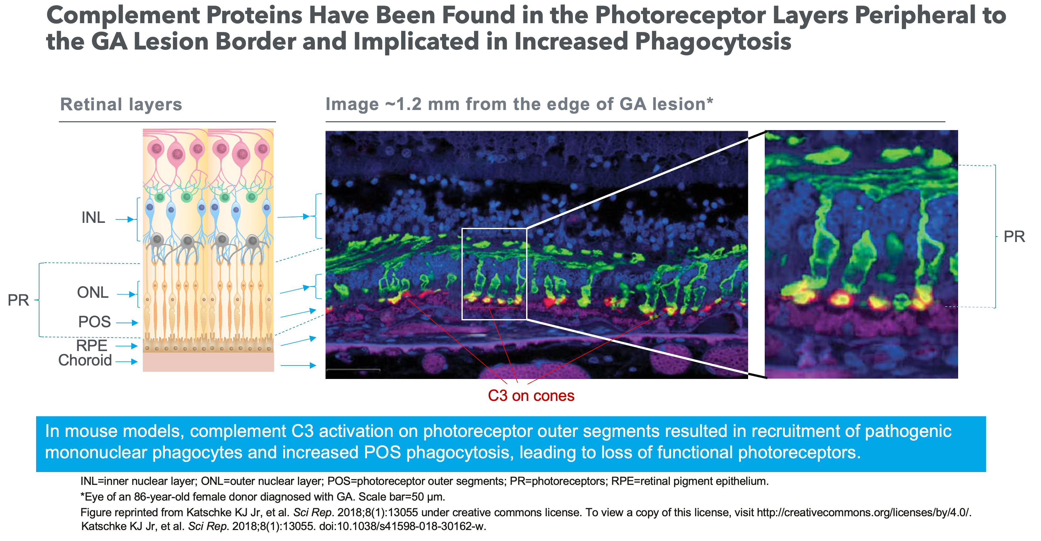

Slide 34
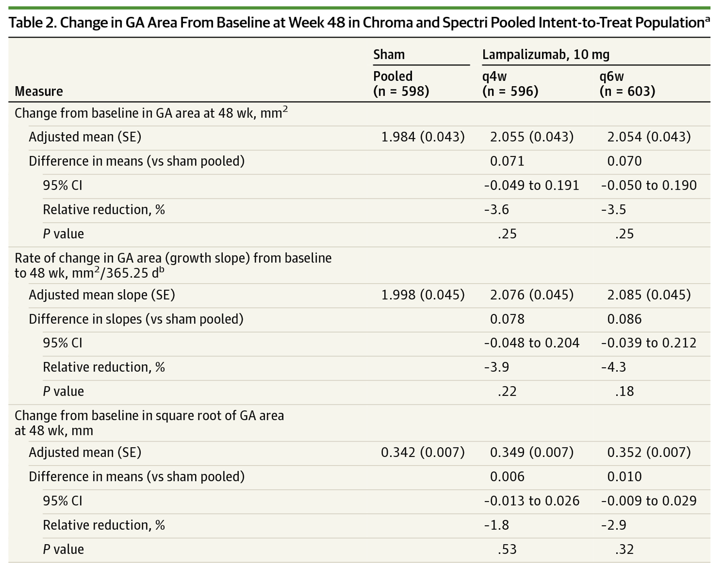
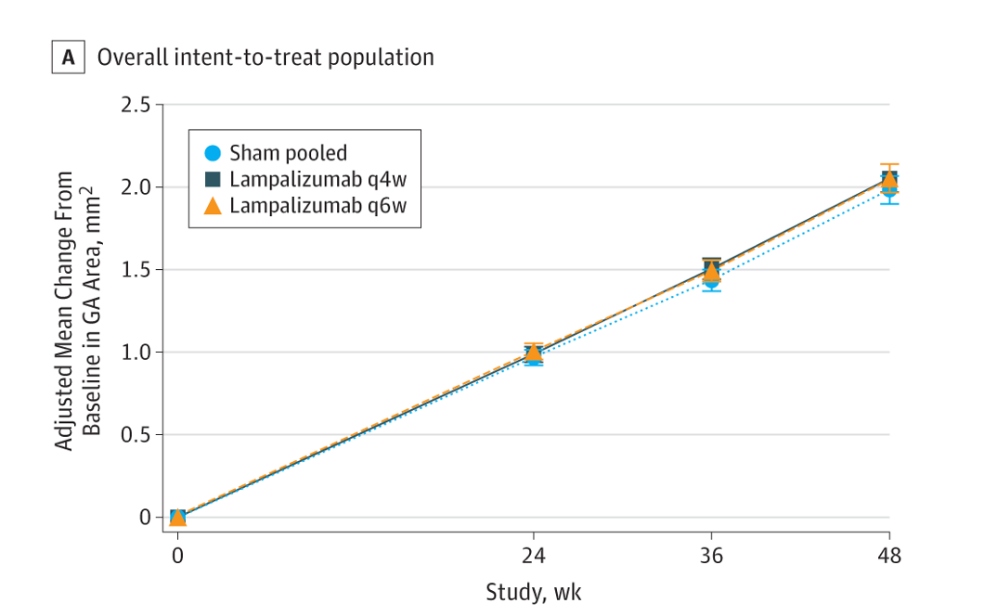
Lampalizumab: Chroma/Spectri

Slide 35
Pegcetacoplan (Syfovre)

Slide 36
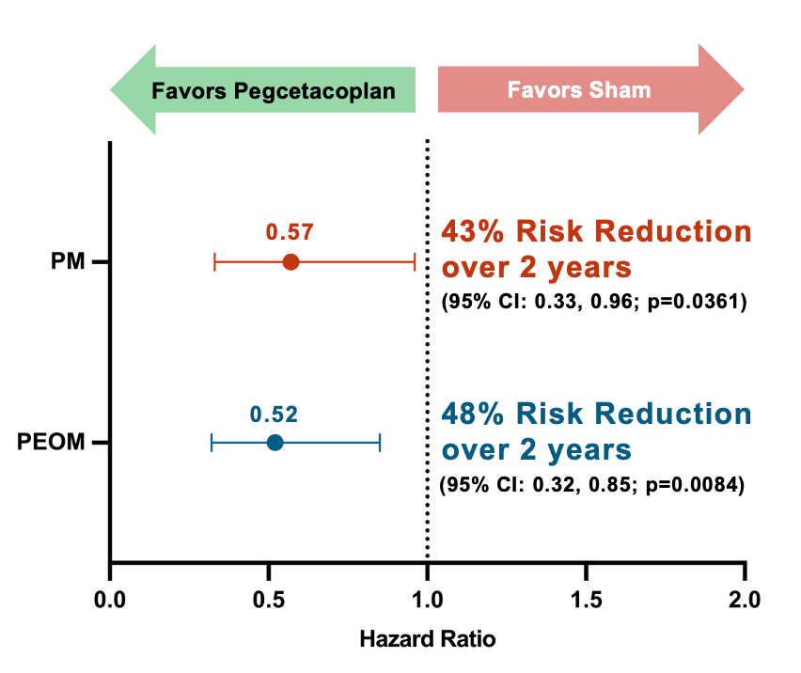
Pegcetacoplan
(Syfovre)
Derby & Oaks
  Largest clinical trials
  Included subfoveal & fellow eyes with wet AMD
  Extension study (GALE)
Approved in February 2023
Monthly or every other month
Inflammatory issues

Slide 37
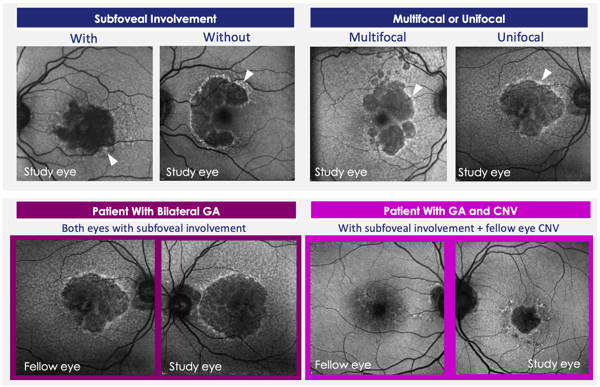

Slide 38
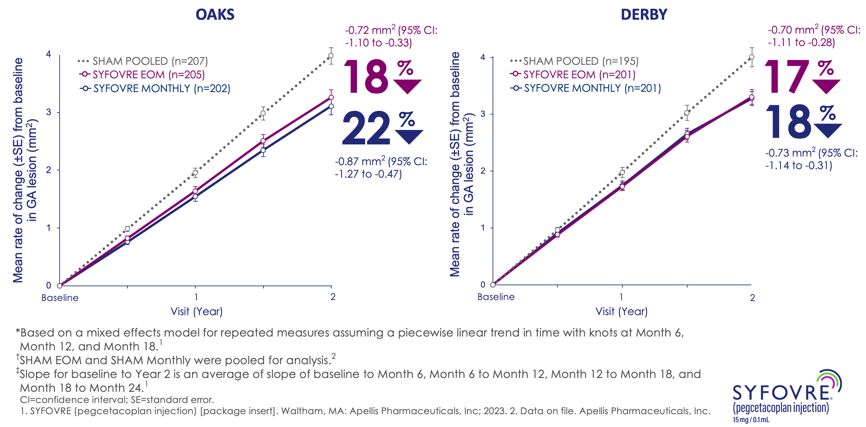

Slide 39
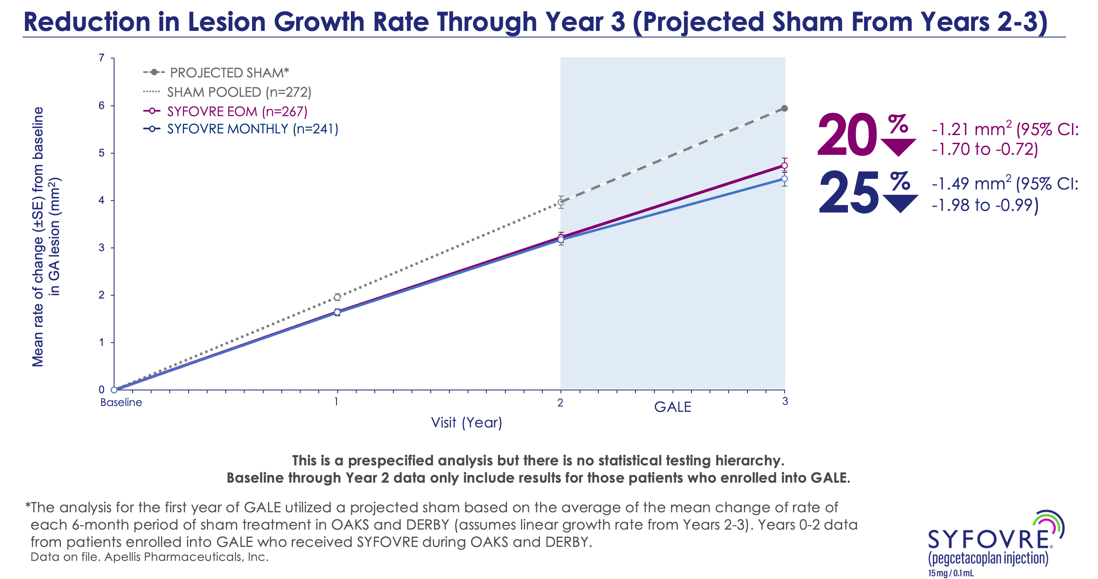

Slide 40
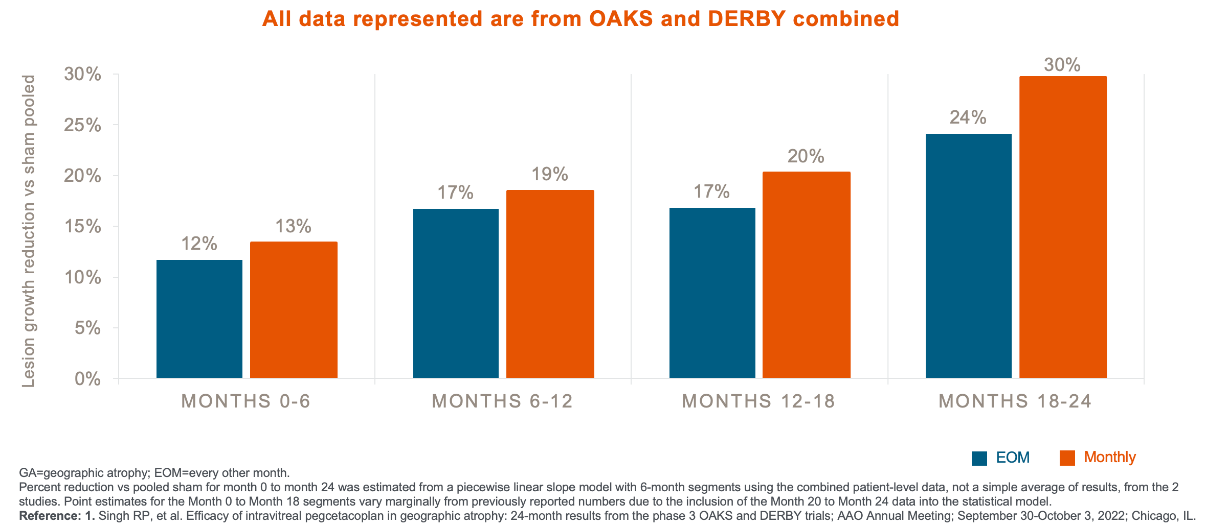

Slide 41
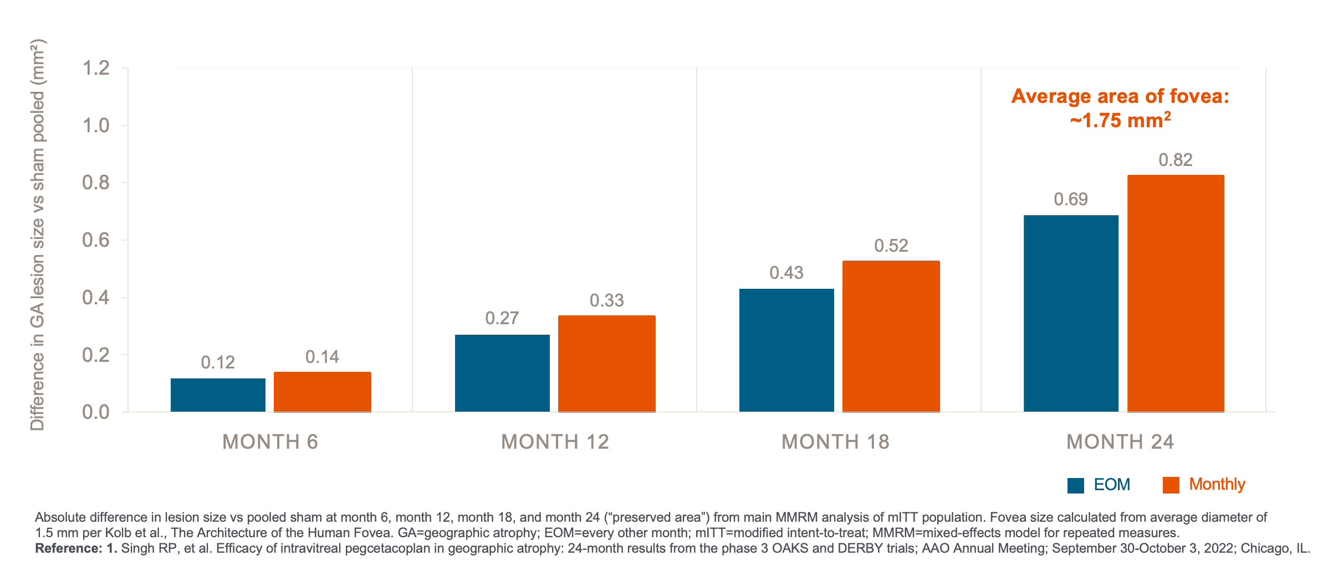

Slide 42
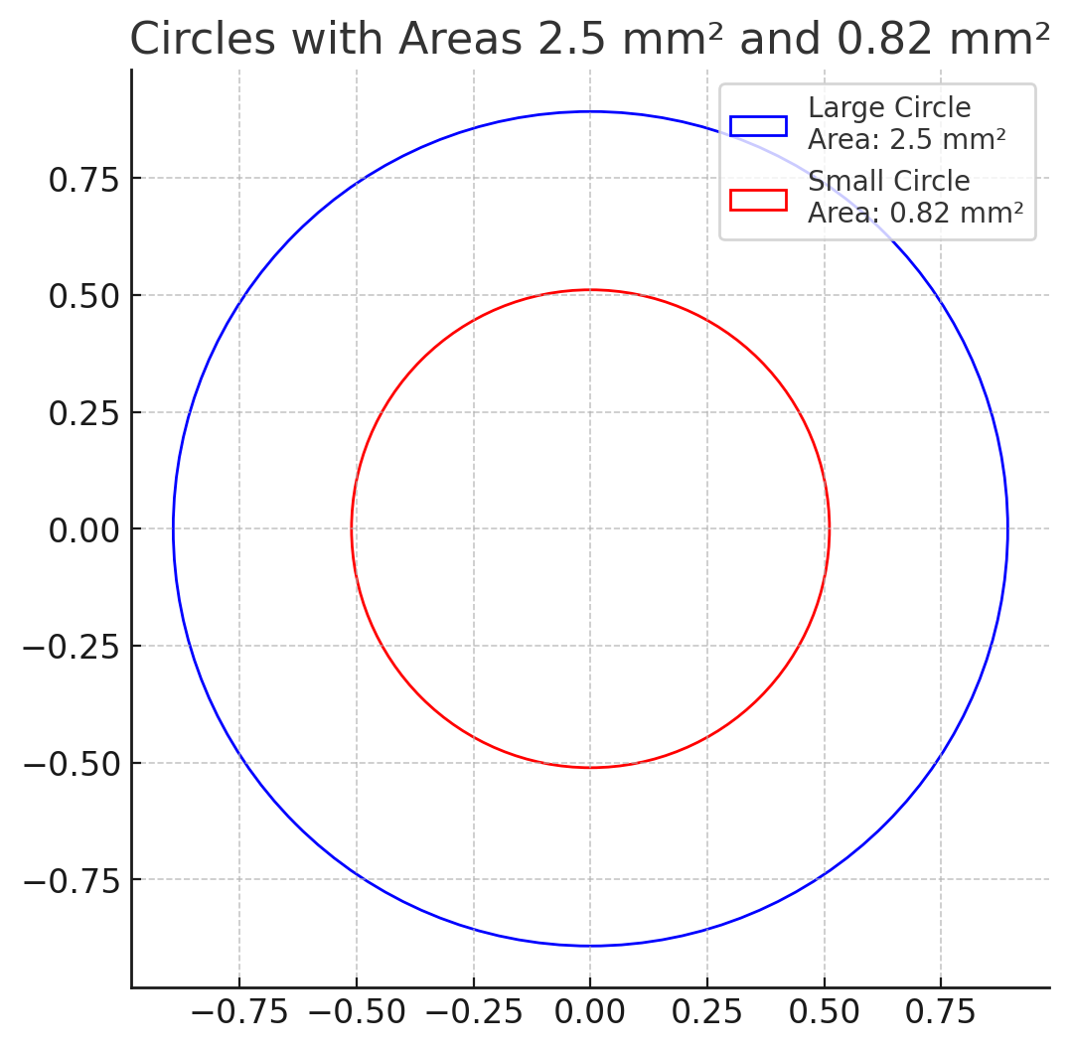
2.5mm²

Slide 43
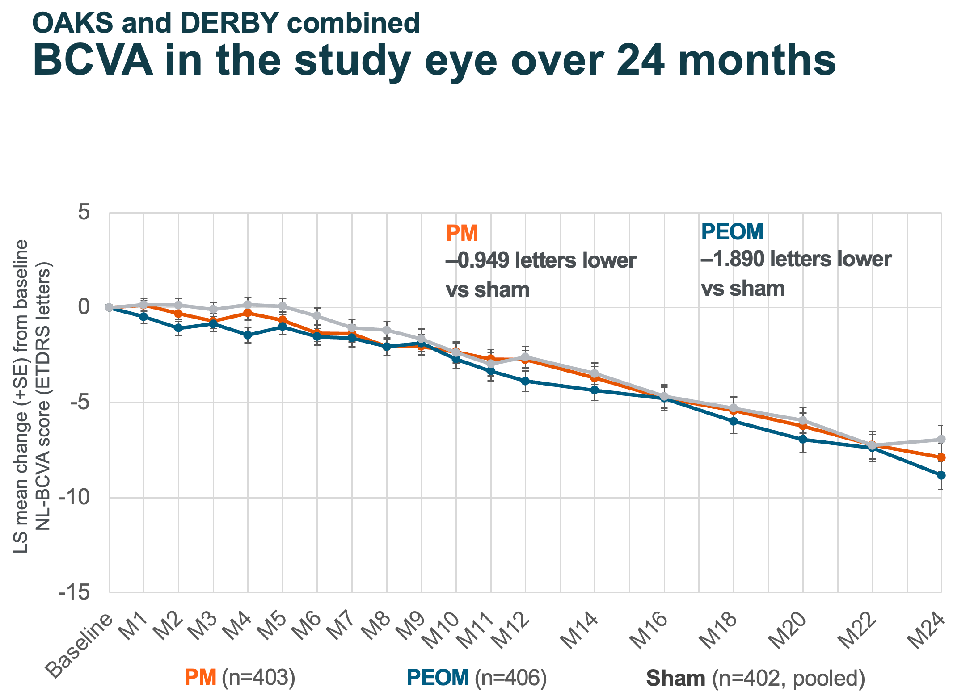

Slide 44
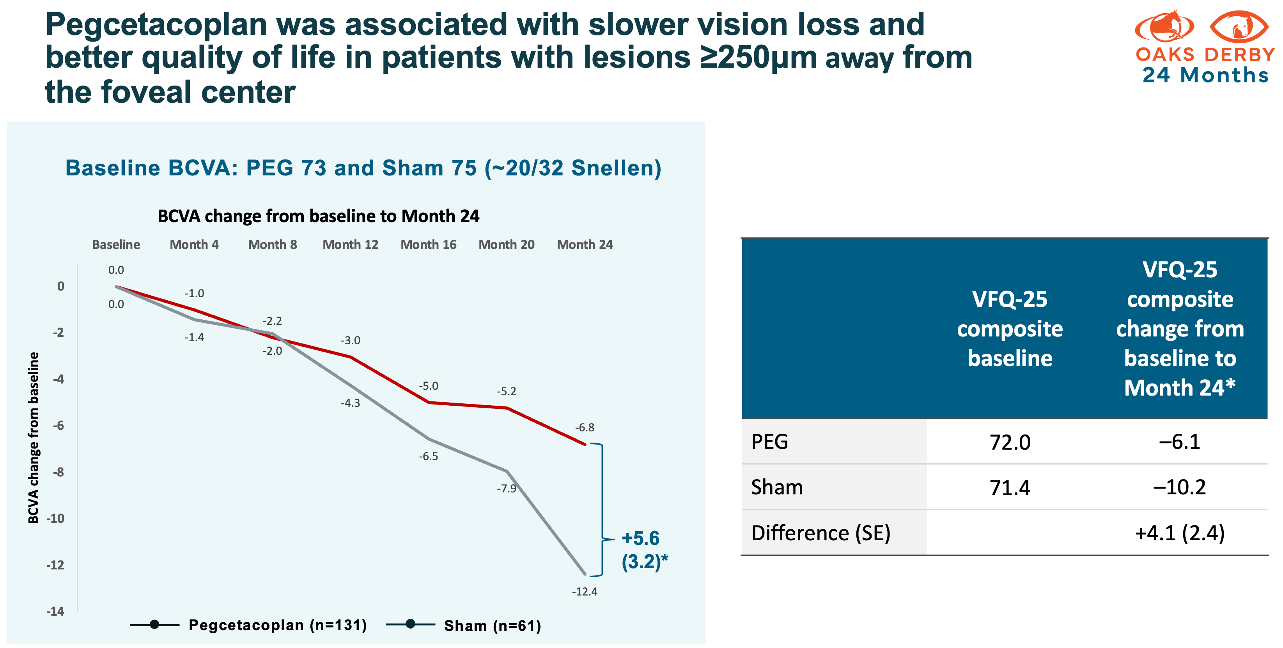

Slide 45
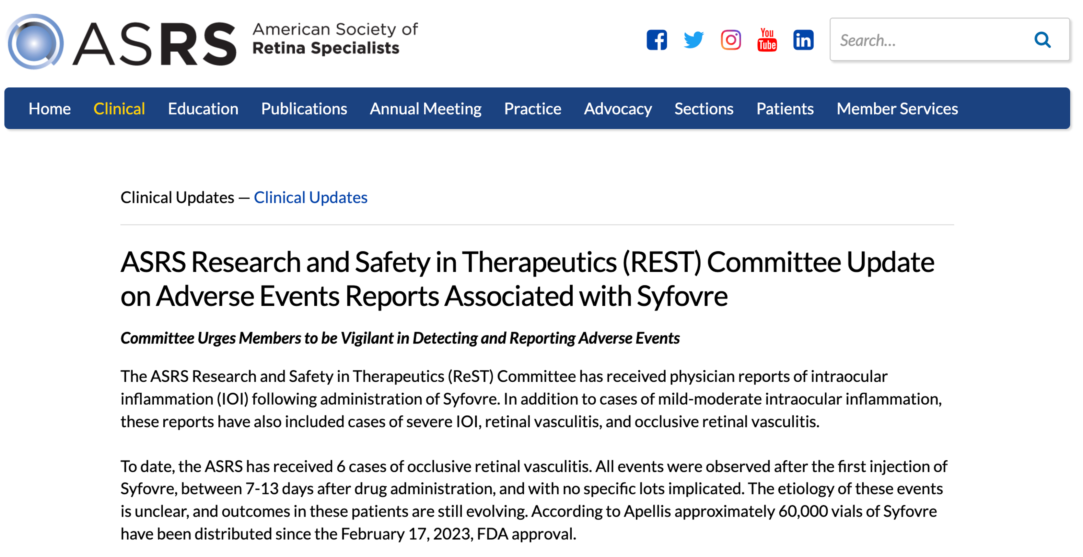

Slide 46
Avacincaptad pegol (Izervay)

Slide 47
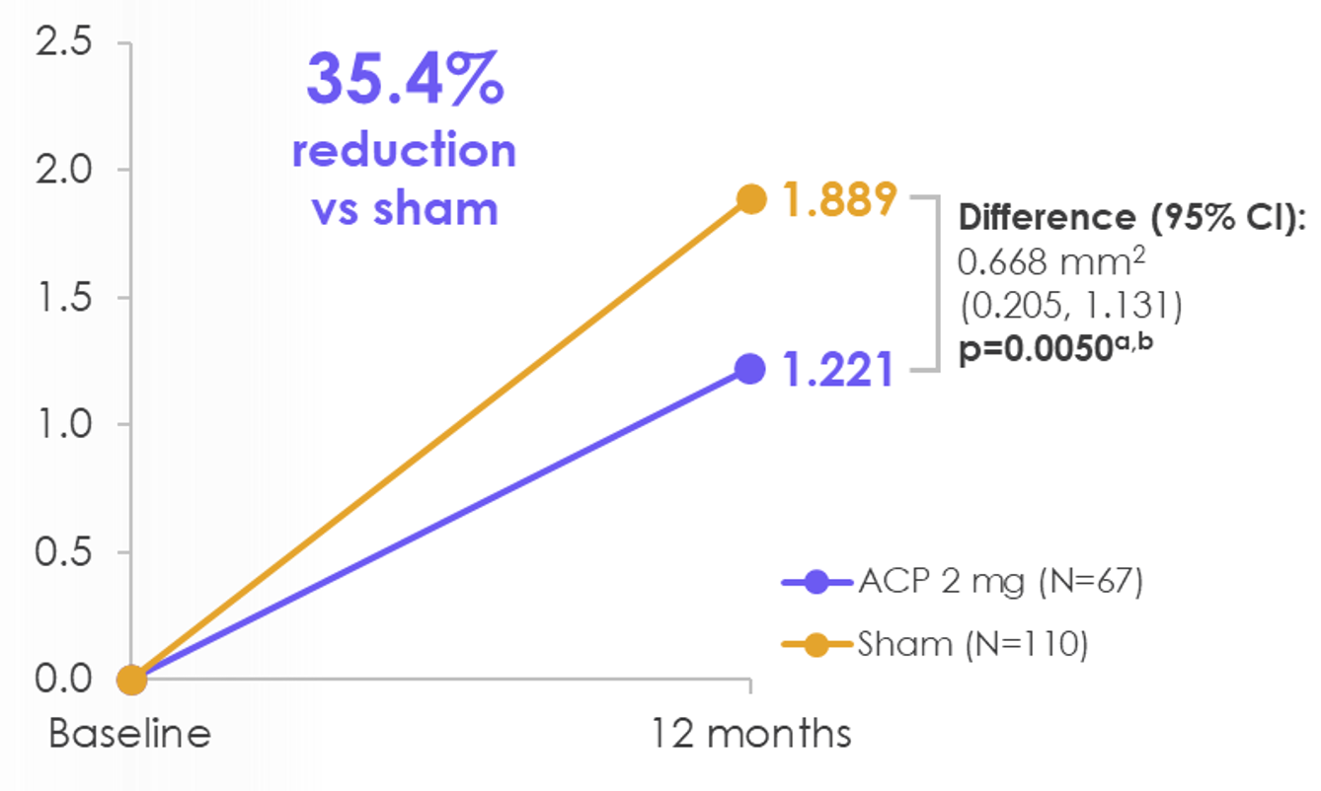
avacincaptad pegol (IZERVAY)
Gather 1/2
  Excluded subfoveal & fellow eyes with wet AMD
Approved in August 2024
Monthly in the first year*
Less viscous
Less inflammatory issues?

Slide 48
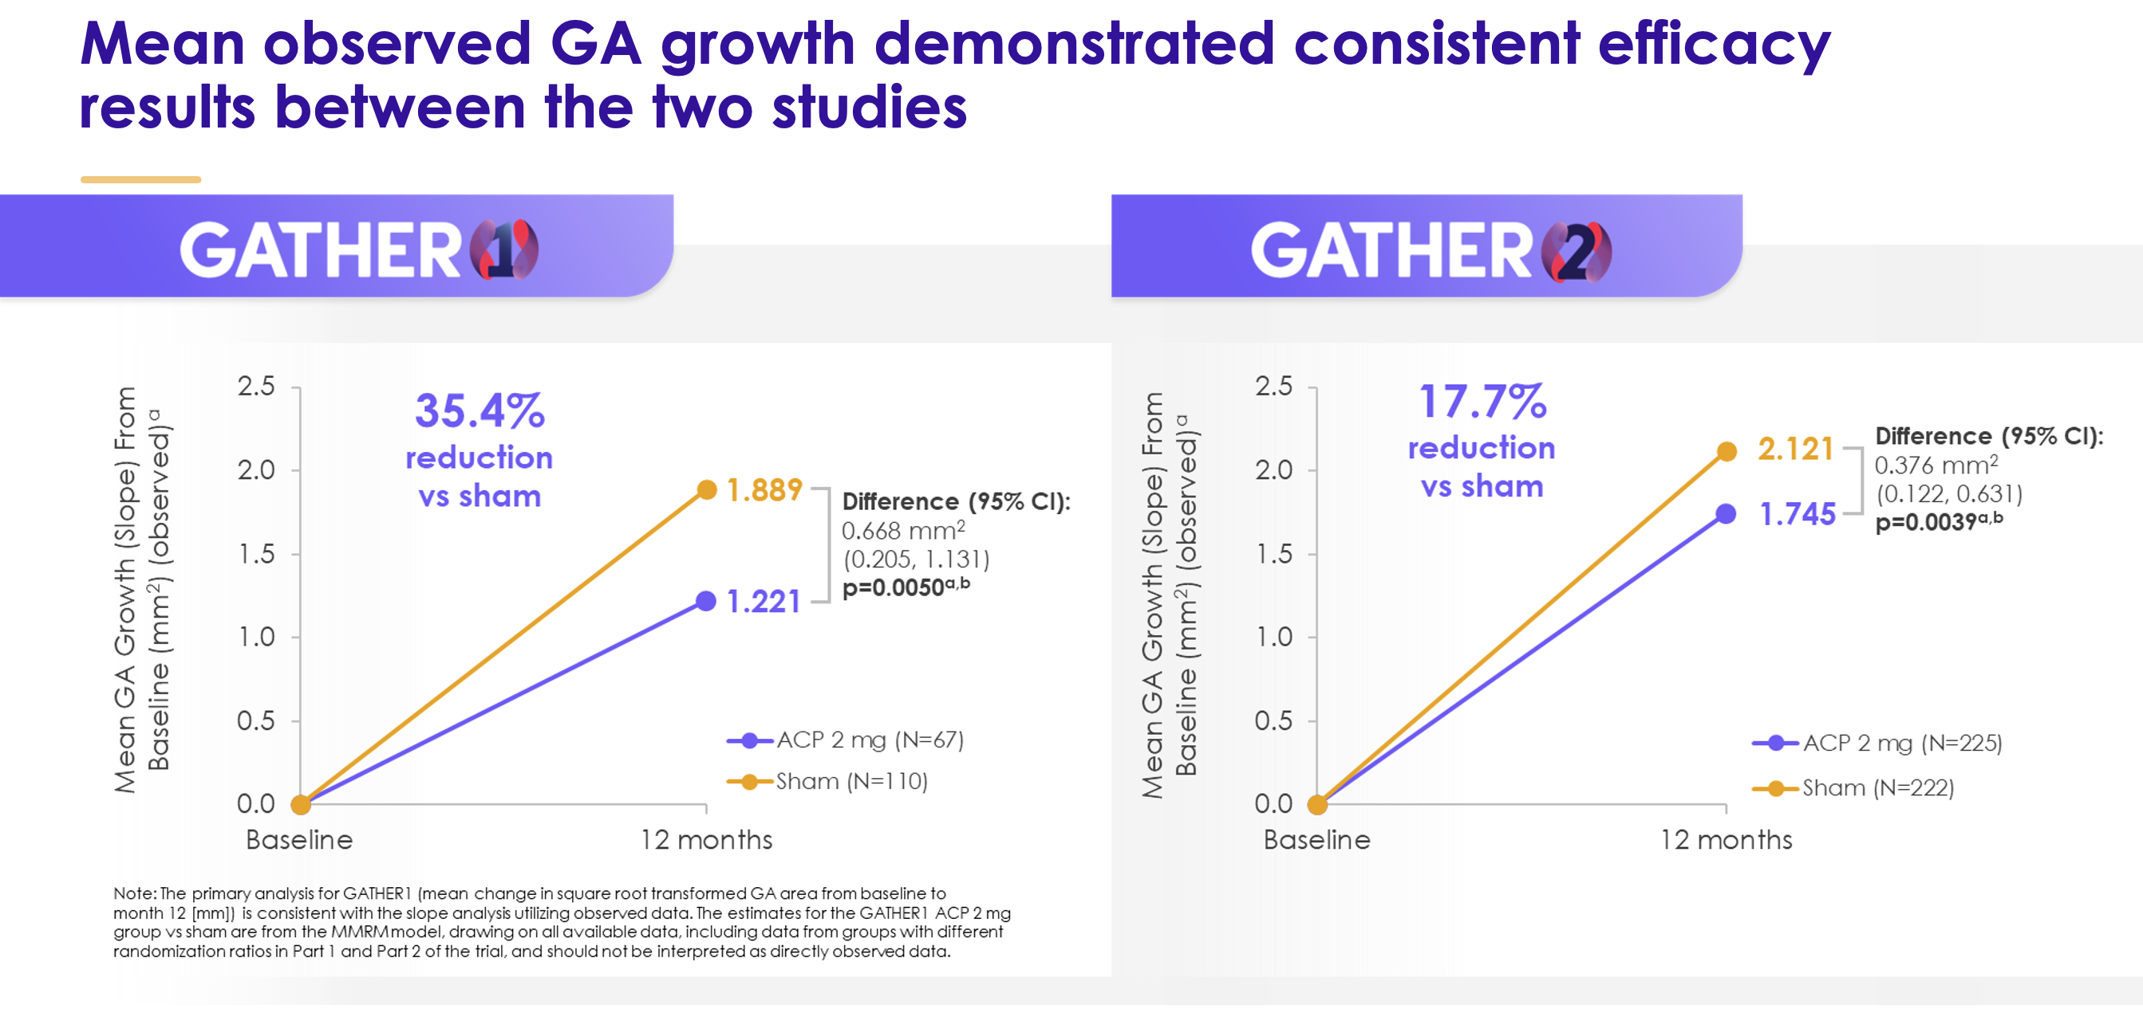

Slide 49
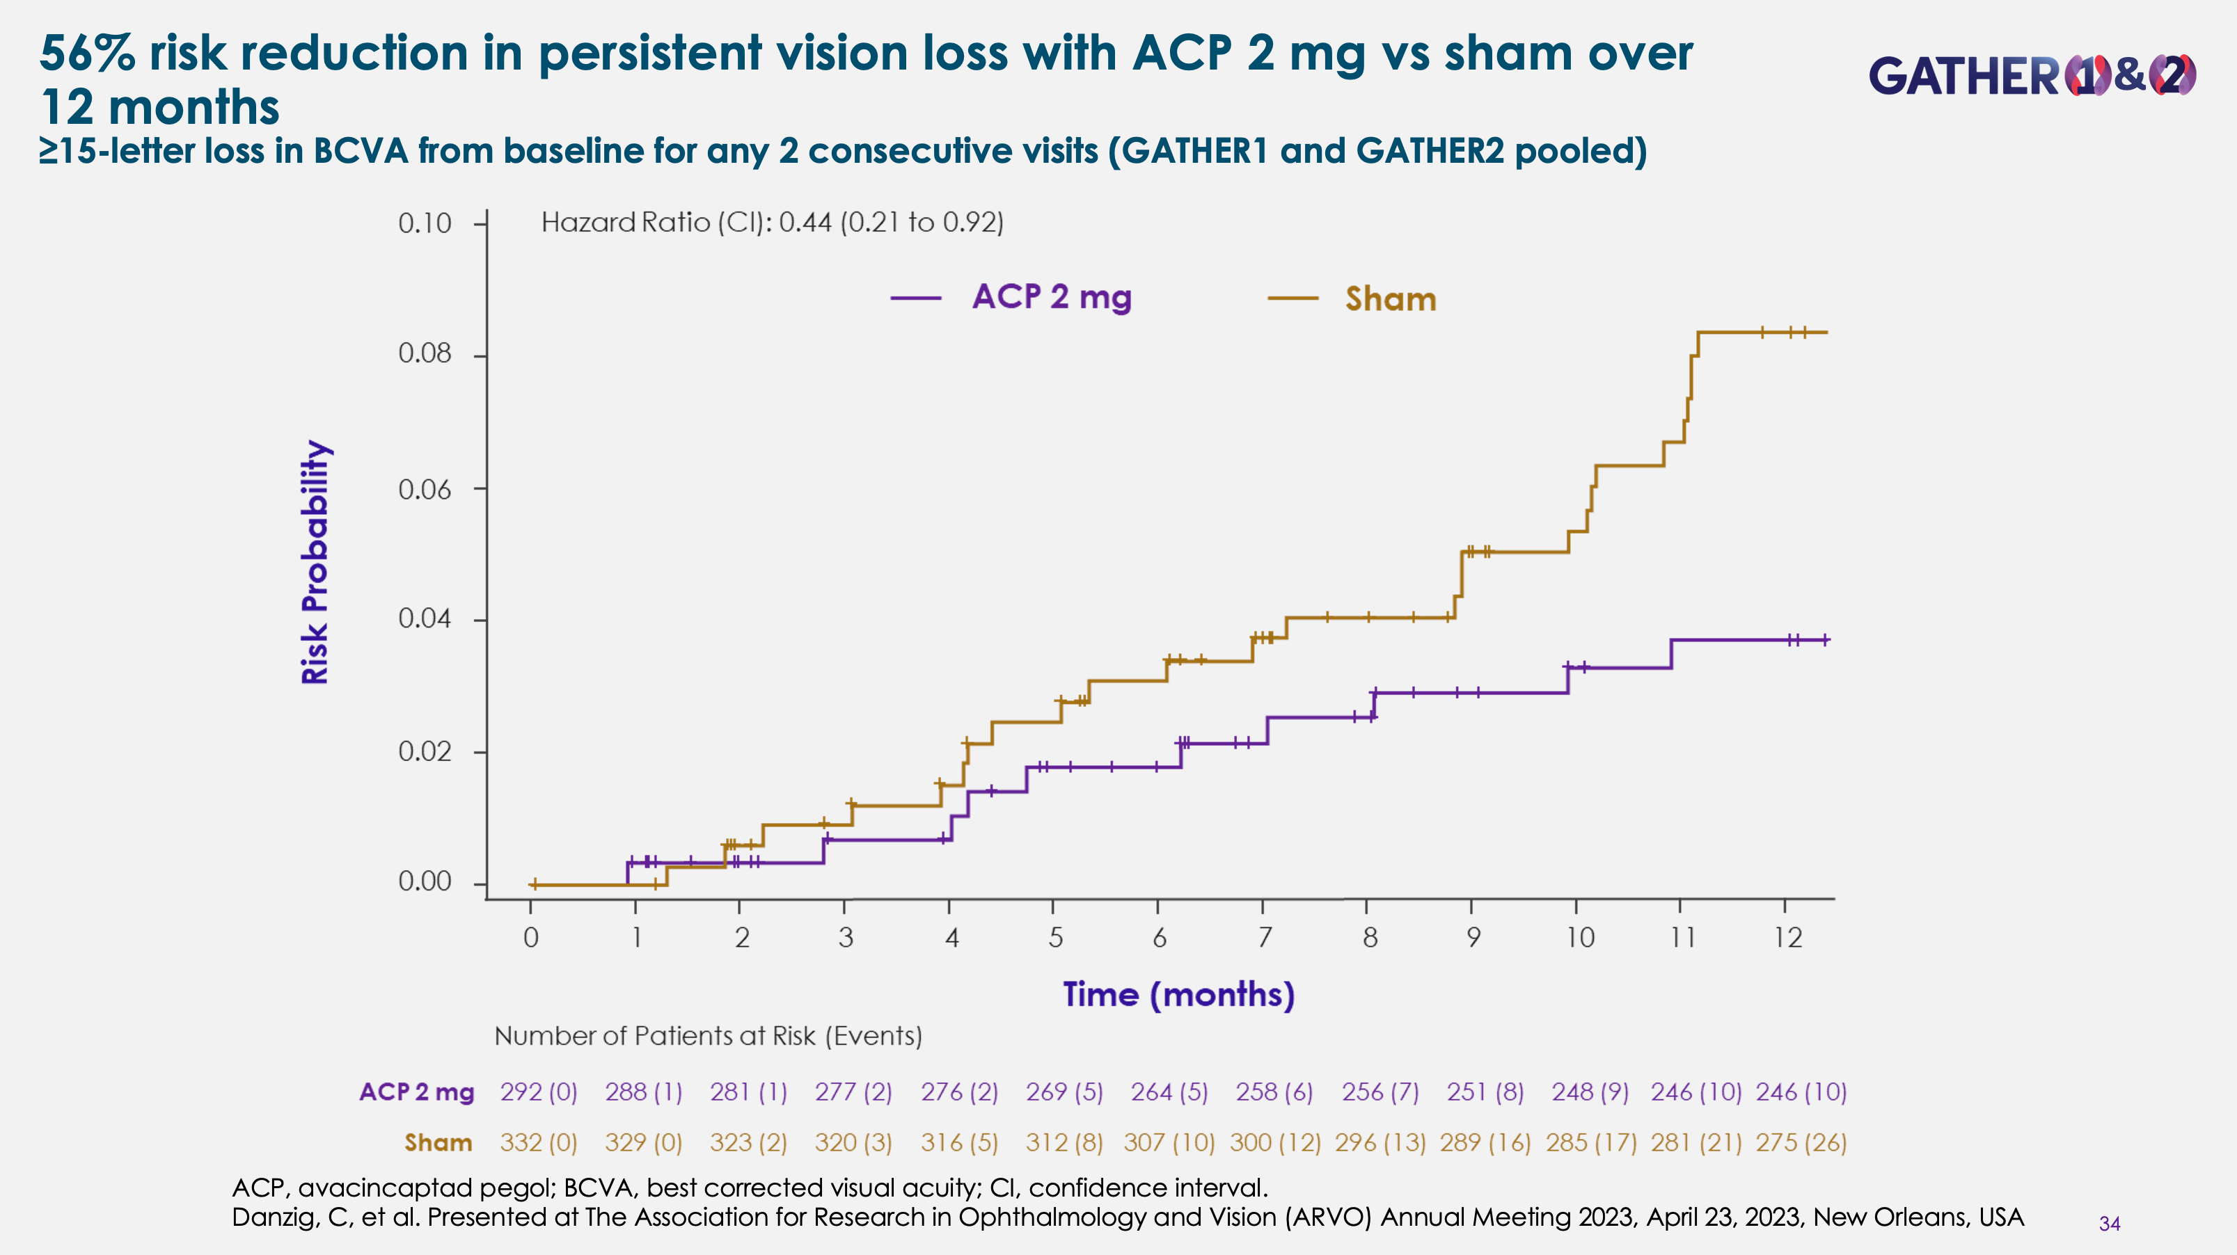

Slide 50
BUT…
YEAR TWO

Slide 51
So how do we decide?

Slide 52
History
2017
Initial presentation in 2017
77 year old white male
CC: decreased vision OD
HX: s/p CEIOL OU
DX: Macular hole OD
Underwent successful surgical repair

Slide 53
2017
2023
OD
20/50
OS
20/50

Slide 54
PATIENT STARTED ON ACP 2MG

Slide 55
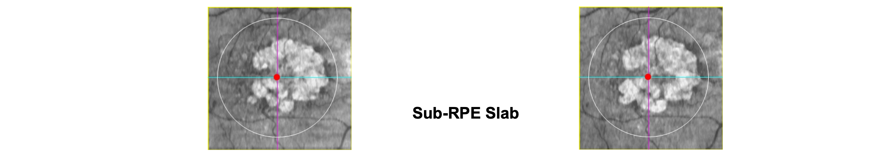
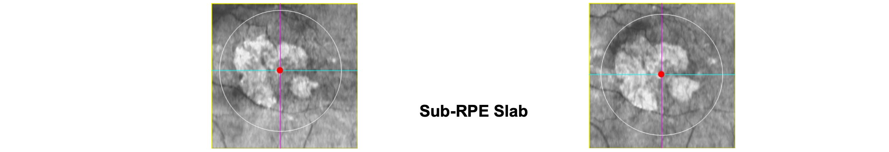
BASELINE (2023)
6 MONTHS OF ACP
OD
20/50
OS
20/50

Slide 56
Summary
Geographic atrophy (GA) is a significant cause of vision loss in older adults
Complement has been implicated in the development of GA
First two therapies approved for the treatment of GA since 2023
Frequent and continuous therapy required
Reduce the progression of RPE loss by approximately 20% at 2 years
Patients will still lose vision
Rare risk of inflammatory side effects

Slide 57
Thank you

