Slide 1



2024 SPN Vision
Exchange

Slide 2
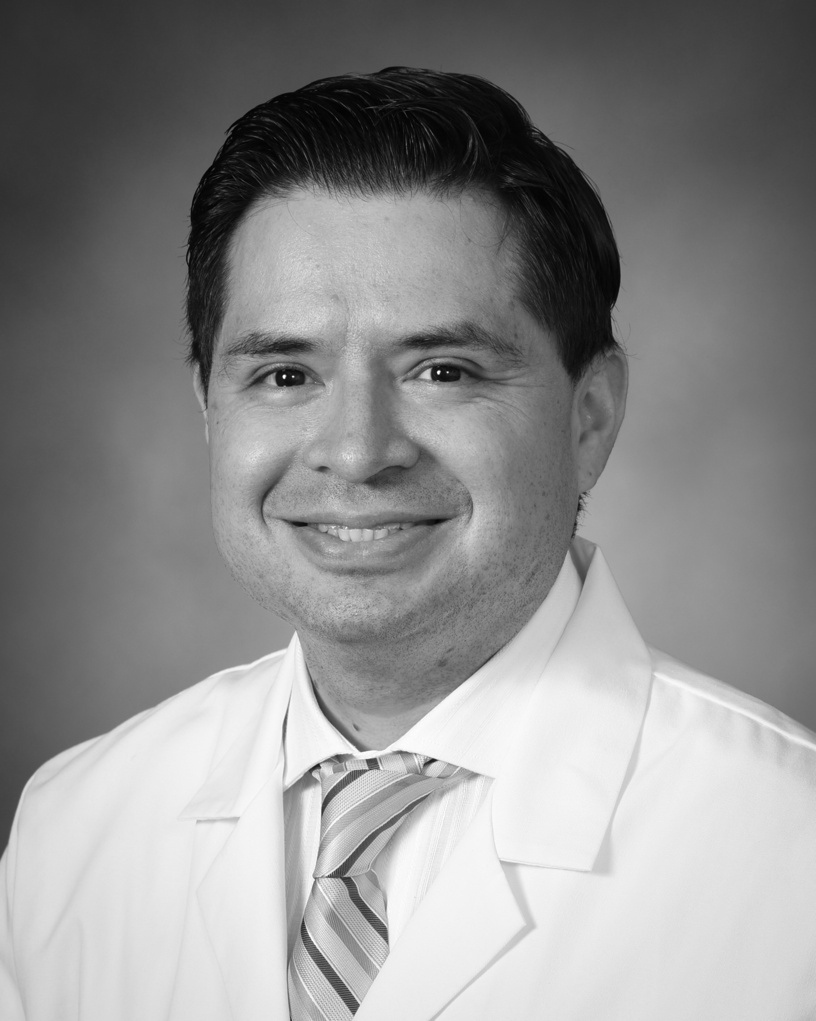
Dr. Ramiro Maldonado, a clinician-scientist and board-certified ophthalmologist at Duke University Eye Center, specializes in medical retina and Ophthalmic Genetics.
As the director of the Inherited Retinal Diseases Fellowship and Co-Director of the Center for Ophthalmic Genetics and the Duke Pediatric Retina Center, he leads pioneering clinical trials, including gene therapy trials.
His research focuses on developing diagnostic tools for pediatric retinal diseases, earning him recognition such as the Foundation for Fighting Blindness Clinical Innovation Award.
Dr. Maldonado has authored over 42 peer-reviewed publications, contributed to 5 book chapters, and plays an active role in organizing courses at major national meetings.
Dr. Ramiro Maldonado

Slide 3

Retinitis Pigmentosa & Gene Therapy:
An Overview
Ramiro Maldonado, MD

Slide 4
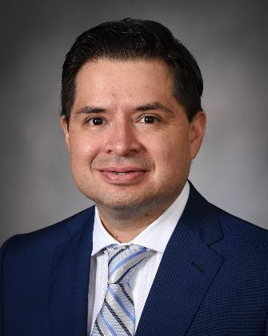

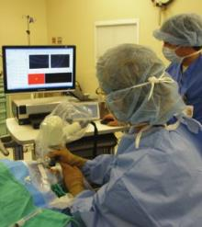
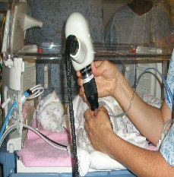
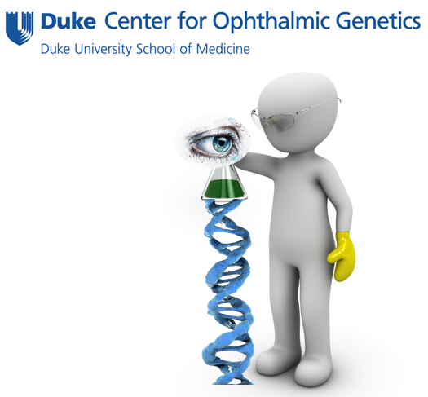



HELLO!
1st intra-op OCT
1st Handheld OCT
Ramiro Maldonado, MD
Co-Director Pediatric Retina
Retina Specialist
Ophthalmic Geneticist

Slide 5
Financial disclosures:
ProQR Therapeutics Consultant
PYC Therapeutics Consultant
Aldeyra Therapeutics Consultant
Duke Eye Reading Center Consultant
Speaker is being compensated for their presentation today by International Physician Networks, L.L.C. (“SPN”). However, neither SPN nor any pharmaceutical company has influenced the content of this presentation nor has SPN independently verified the presentation for accuracy.

Slide 6
Let me show you a patient problem….

Slide 7

42 y/o in the prime of his life…
Diagnosed with
Retinitis Pigmentosa…

Slide 8
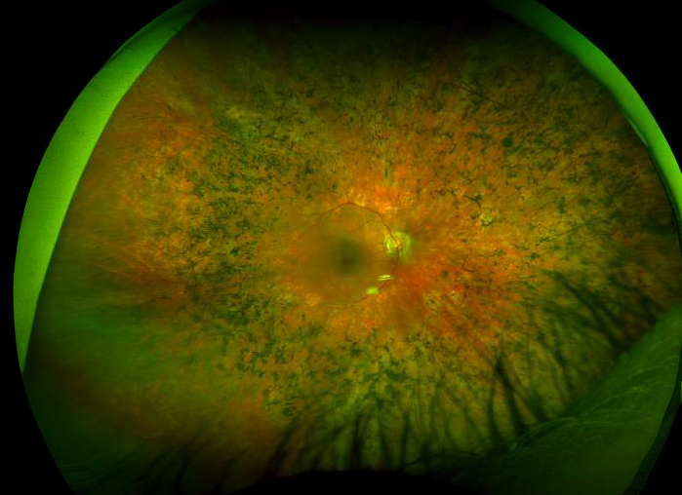
Pigmented retina

Slide 9
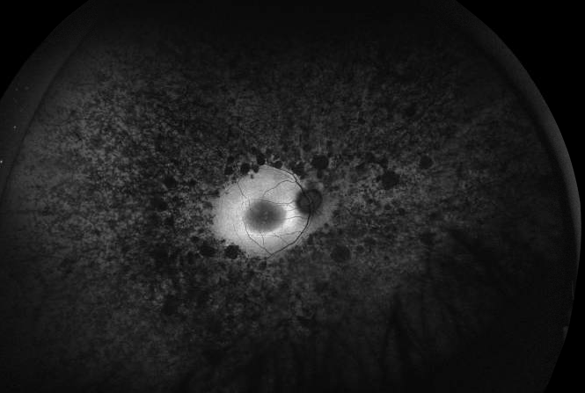
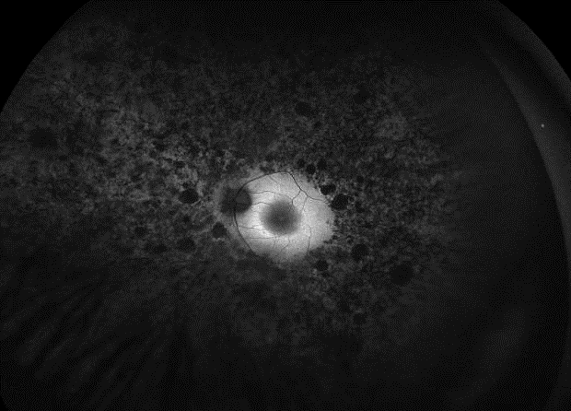
Significant extent of retinal degeneration

Slide 10
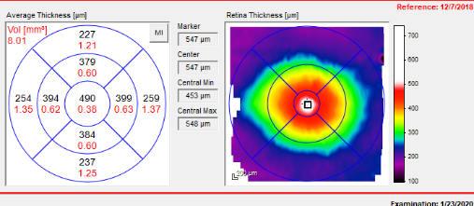
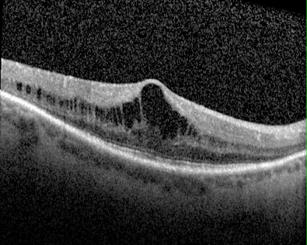
Living Histology

Slide 11
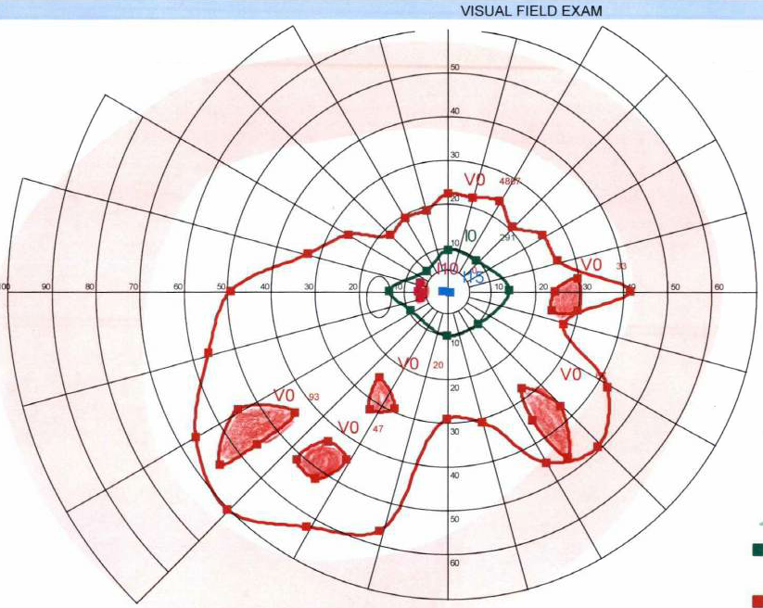
Constricted visual fields

Slide 12
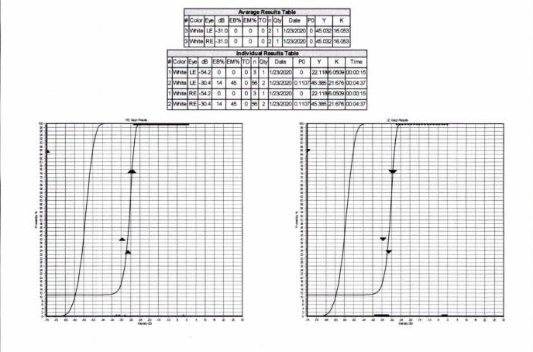
Minimum light stimulus perceived (FST test)

Slide 13

The big picture
IRDs
Inherited Retinal Diseases

Slide 14
6,800,000
People in the world with IRDs

Slide 15
300,000
People in the USA with IRDs

Slide 16
6,800,000 people
300,000 people
1
WORLDWIDE
In the US
FDA approved therapy

Slide 17
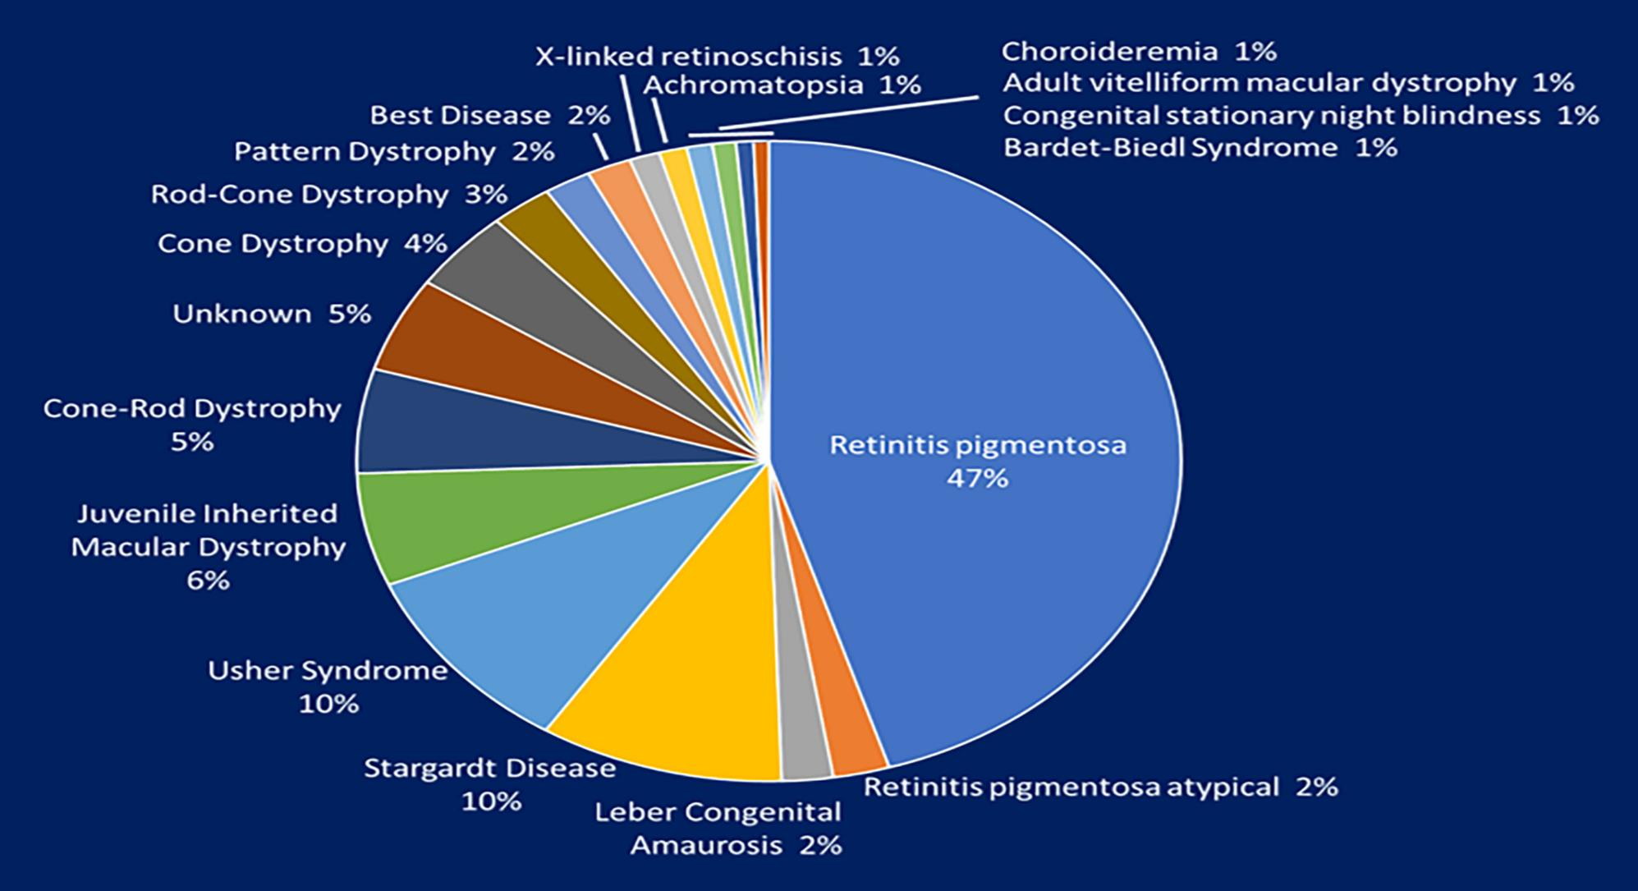

Want big impact?
USE BIG IMAGE
Moved the 350 to the side to highlight RP
American J of Med Genetics Pt C, Volume: 184, Issue: 3, Pages: 838-845, First published: 11 August 2020, DOI: (10.1002/ajmg.c.31825)
Notes:
Monogenic diseases

Slide 18
350
60
IRD-GENES
RP-GENES

Slide 19
Want big impact?
USE BIG IMAGE
RP inheritance patterns
60
RP-GENES

Slide 20
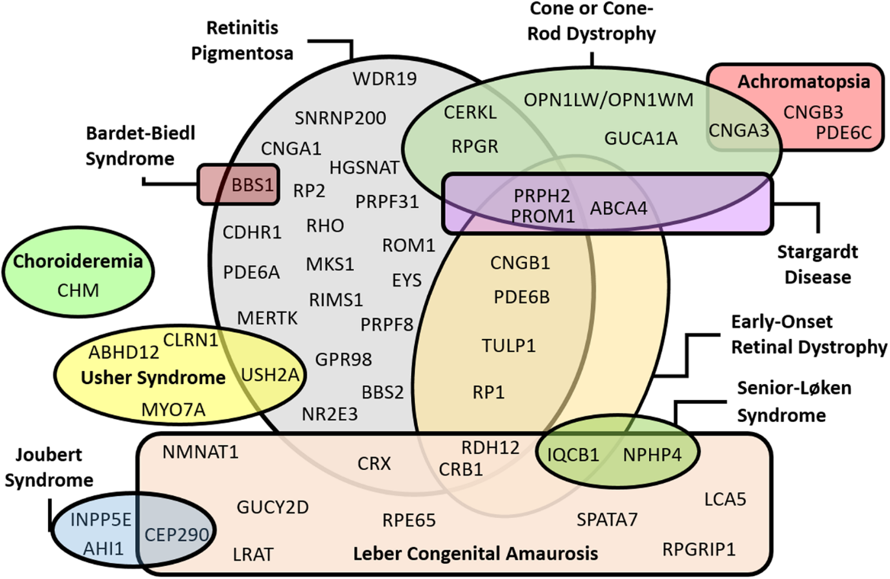
Genetic heterogeneity
One disease can be caused by multiple genes
Relative frequency of inherited retinal dystrophies in Brazil. Scientific Reports 2018.

Slide 21
Genetics is changing the naming of diseases

Slide 22
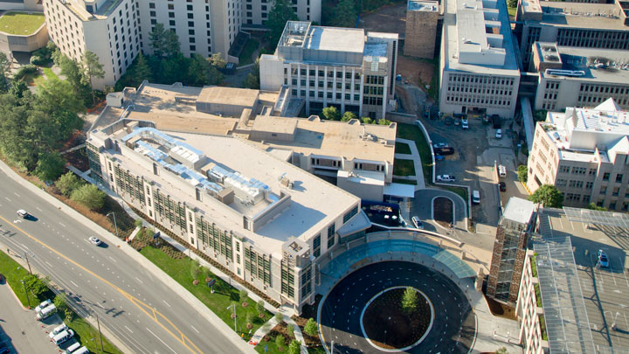

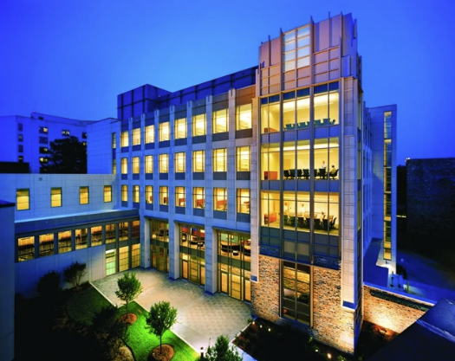
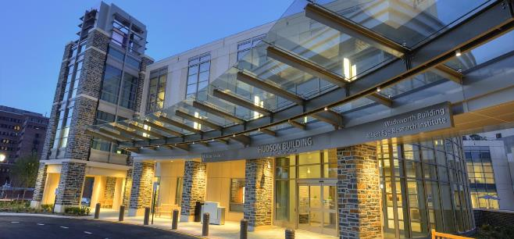
Research Building
Clinical Building

Slide 23
5,200 patients / year
Ophthalmic Genetics Service

Slide 24
Clinical and Research integration
Clinical Research
Patient
Care
Ocular
Immunology
IRB
Basic Science Research
CRU
Gene
Therapy
Diagnostic Tools
Development
Certified
Photographers
Research
Equipment
Clinical
Coordinators

Slide 25

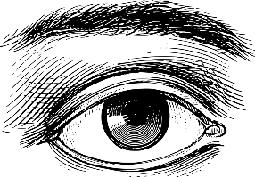



Want big impact?
USE BIG IMAGE
The patient’s journey
👤
Eye
Genetics
Service
+
Patient
with IRD
    Optometrist
    Pediatric Oph
    Retina Spec

Slide 26

Want big impact?
USE BIG IMAGE
Phenotyping
Non-Syndromic
Syndromic
Comprehensive Hx
Rod-specific
Cone-Specific
Optic Nerve
👤
A Dominant
A Recessive
X-linked
Mitochondrial
Pedigree

Slide 27
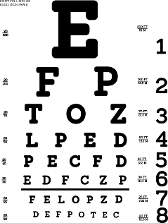

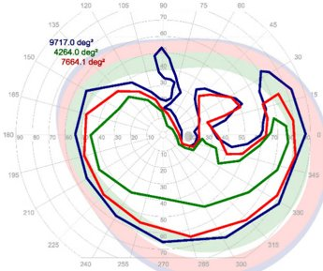
Want big impact?
USE BIG IMAGE
Phenotyping - basic
Visual Acuity
Color vision
Visual Field
👤

Slide 28
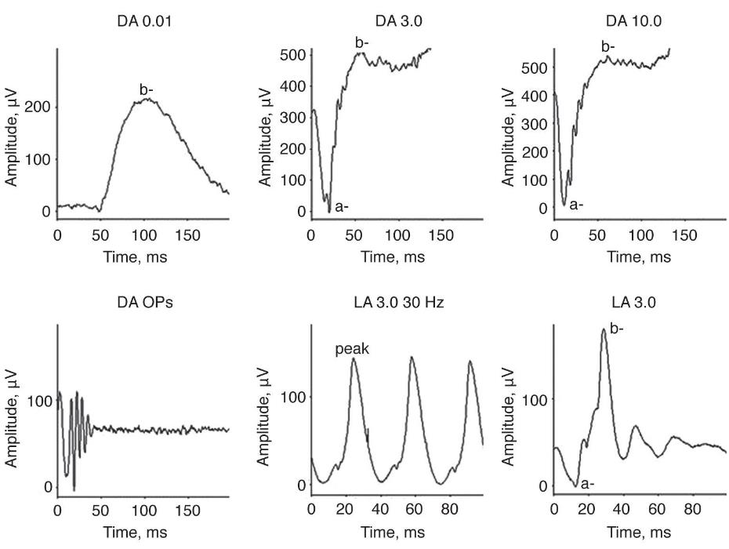
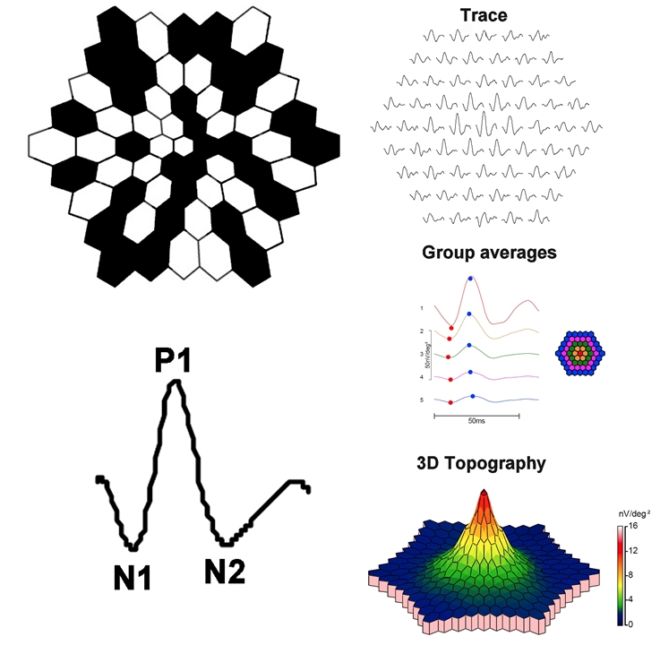
Advanced Objective functional outcomes

Slide 29
Pediatric Testing

Slide 30
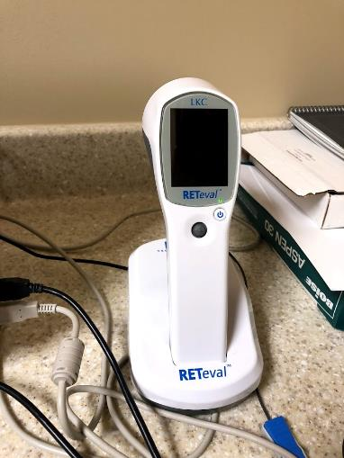
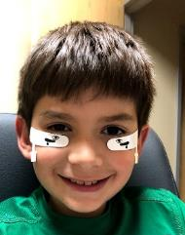
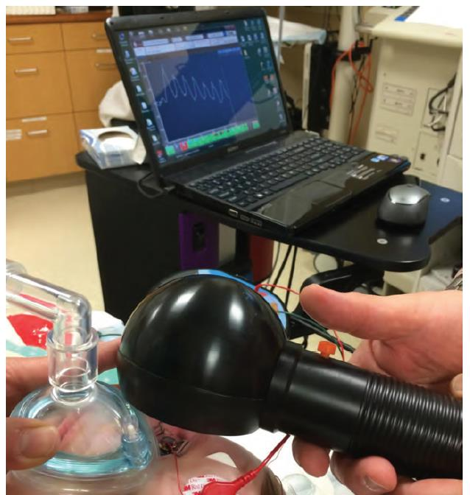
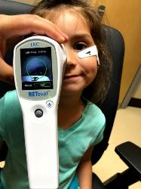
Hand Held ERG and ERG under anesthesia

Slide 31
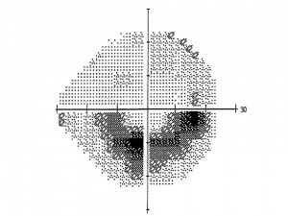

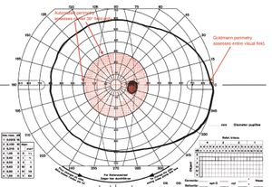
Perimetry

Slide 32
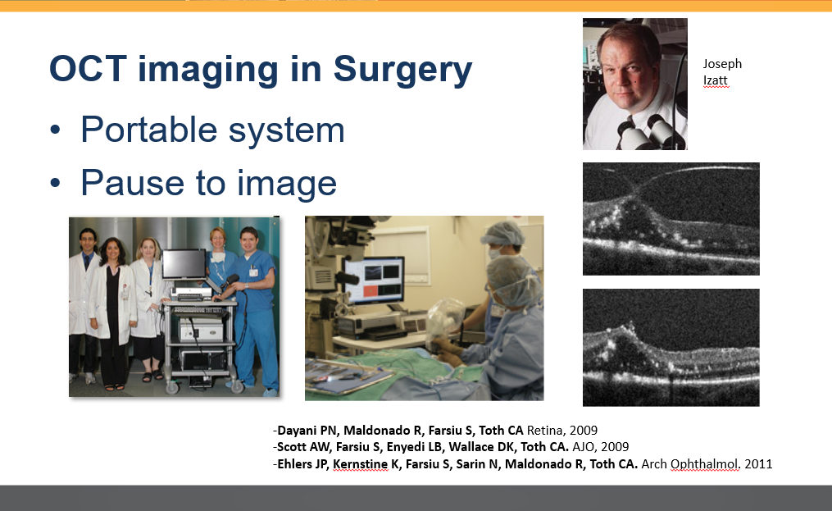

Title
Title

Slide 33
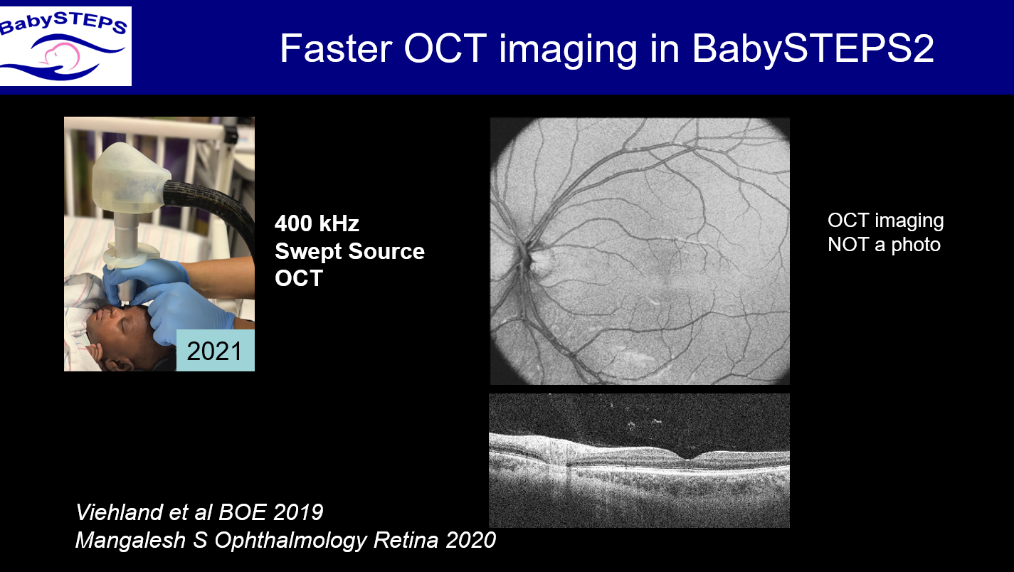

Slide 34
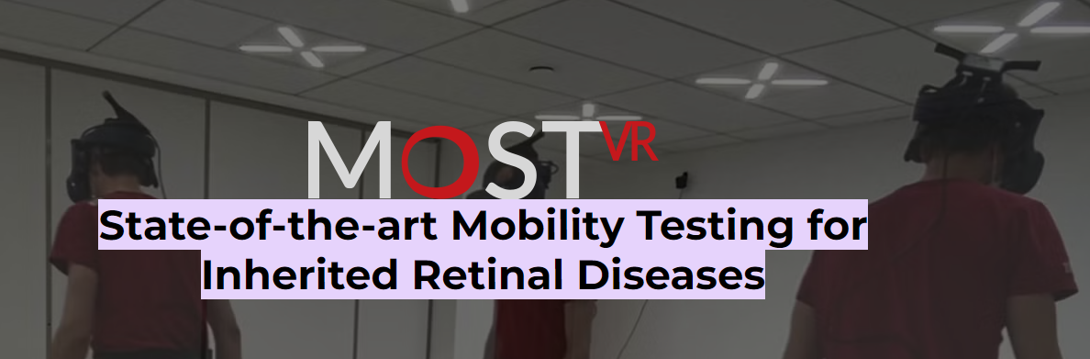

VIRTUAL REALITY TEST

Slide 35

Genetic testing is now Standard of care
Genetic Testing is now Standard of Care

Slide 36
For a long time…
There was NO HOPE for patients with IRDs

Slide 37
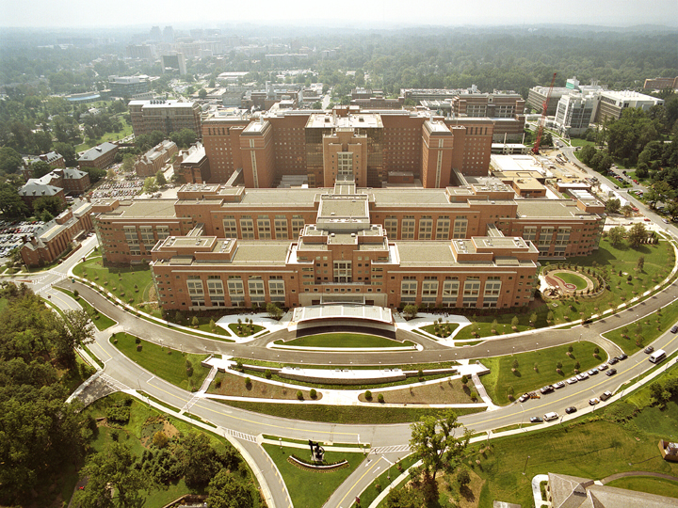


Slide 38

Gene therapy
Notes:
Es una realidad
Es el future. Representa la posibilidad de una cura y no solo de un tratamiento

Slide 39
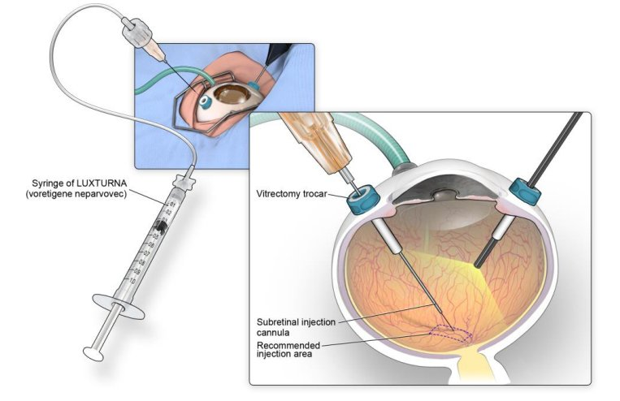

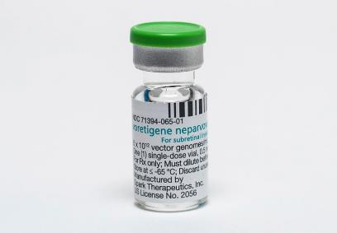
There is an FDA approved
Gene therapy

Slide 40

We do have treatments for IRDs!
It’s a new era

Slide 41

Beyond Luxturna

Slide 42
RPE65
RPGR
ABCA4
USH2A
RHO
CEP290
BEST1
Notes:
Es una realidad
Es el future. Representa la posibilidad de una cura y no solo de un tratamiento

Slide 43
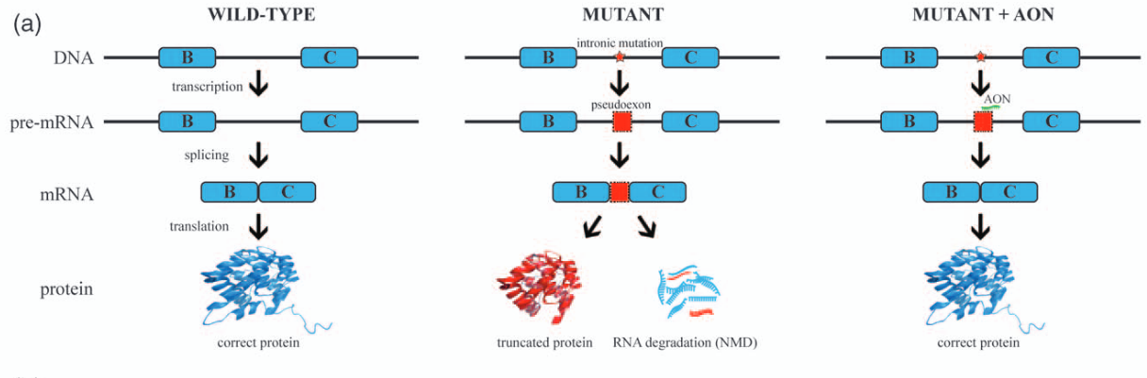
RNA therapy
Applications of antisense oligonucleotides for the treatment of inherited retinal diseases Rob W.J. Collina,b and Alejandro Garantoa,b

Slide 44
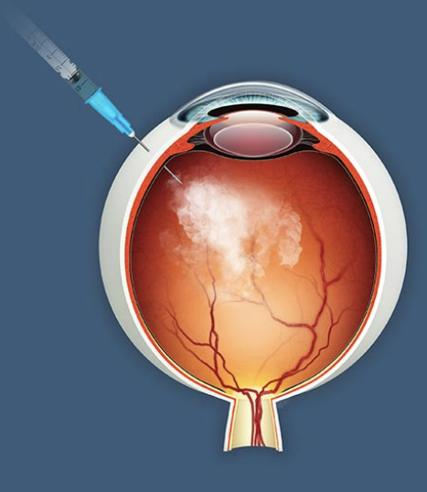
STEM Cells
Intravitreal Injection of Allogeneic Human Retinal Progenitor Cells (hRPC) for Treatment of Retinitis Pigmentosa: A Prospective Randomized Controlled Phase 2b Trial
David Liao; David S Boyer; Peter Kaiser; Baruch D Kuppermann; Jeffrey Heier; Mitul Mehta; Anthony Joseph; Rebecca Kammer; Bonnie Mills; Jing Yang; Henry Klassen

Slide 45
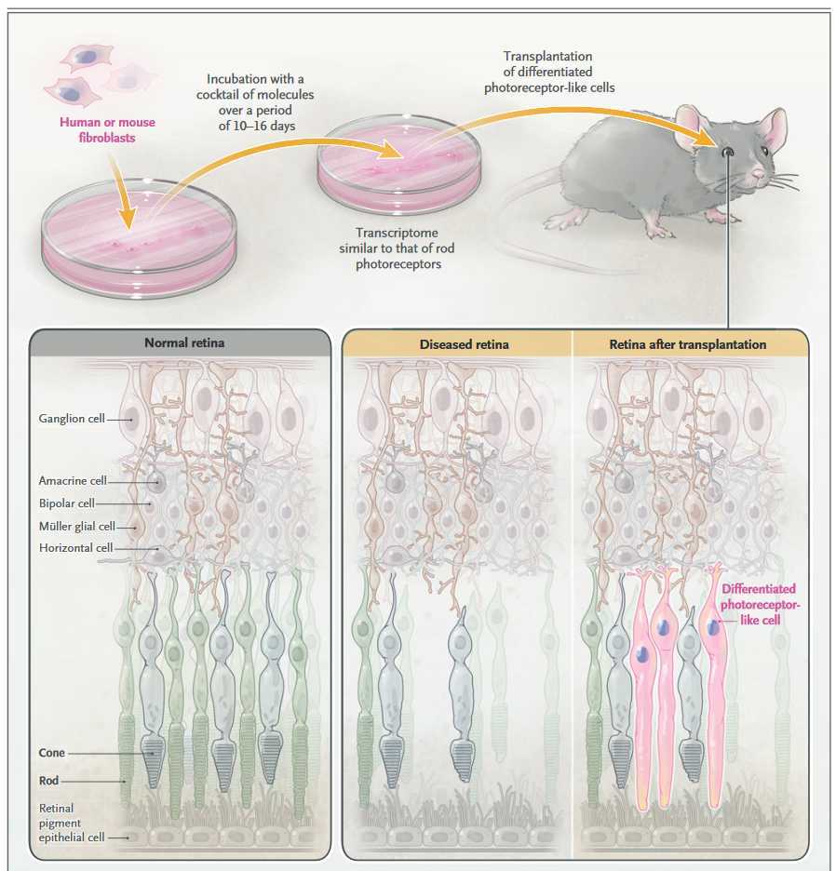
Chemically induced photoreceptors

Slide 46
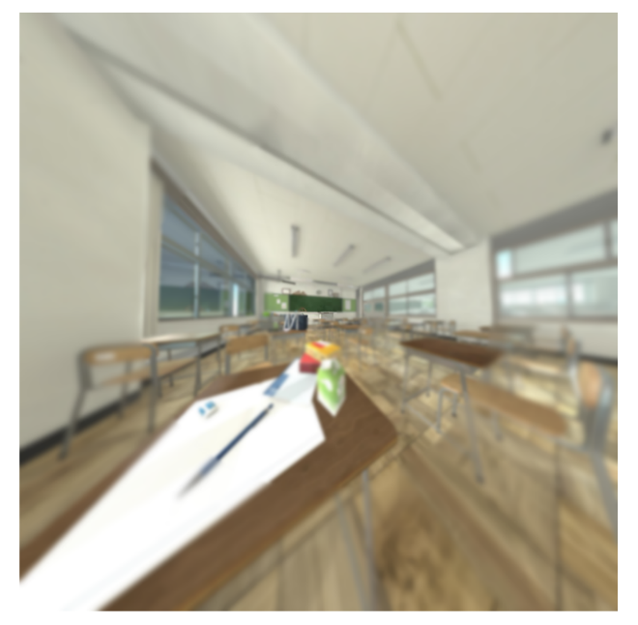
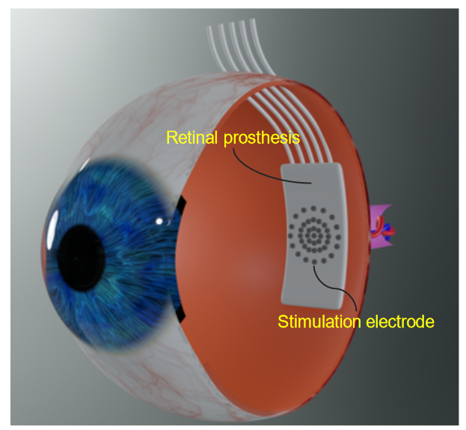
Retinal Prosthesis
Implantable metaverse with retinal prostheses and bionic vision processing
Ning Xi, Jiaxun Ye, Chao Ping Chen, Qiang Chu, Haiyang Hu, Seak Pang Zou

Slide 47
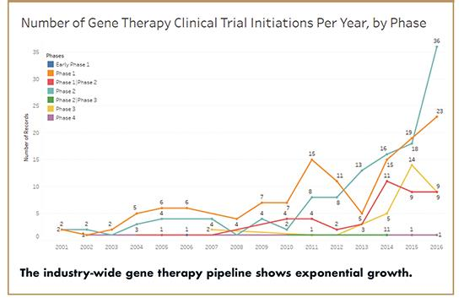
http://drug-dev.com/gene-cell-therapy-its-growing-potential-to-disrupt-drug-research-healthcare-delivery/

Slide 48
Gene therapy is a reality but…
Can we miss the boat?
How many studies are failing?
Is there a risk to loose momentum?

Slide 49
Early detection means
Treatment success

Slide 50


Do we intervene here…
LCA
EO-RCD
RCD
Late-RCD
Or here…

Slide 51

There are multiple proposed Therapies
Methotrexate
Anti
oxidants
STEM cell
Gene editing
Genetic Therapy
Gene replacement
RNA therapy

Slide 52








Gene-dependent
Gene-INDEPENDENT
RPE65
Methotrexate
Therapies
CVF
CEP290
Opto-G
RPGR
Anti-oxidants
SC
CEP290
ABCA4
RHO
USH2A

Slide 53
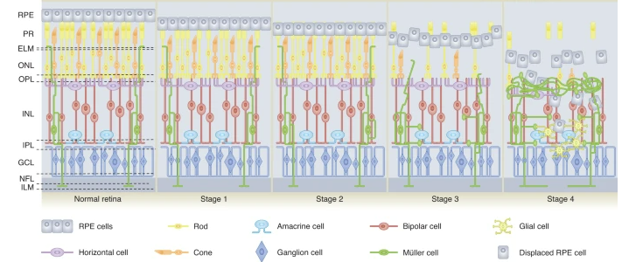
A therapy according to the stage
Review Article Published: 31 January 2022 Bioengineering strategies for restoring vision
Jasmina Cehajic-Kapetanovic, Mandeep S. Singh, Eberhart Zrenner &
Robert E. MacLaren Nature Biomedical Engineering volume 7, pages387–404 (2023)

Slide 54
Vision Sciences
Living a Momentum

Slide 55

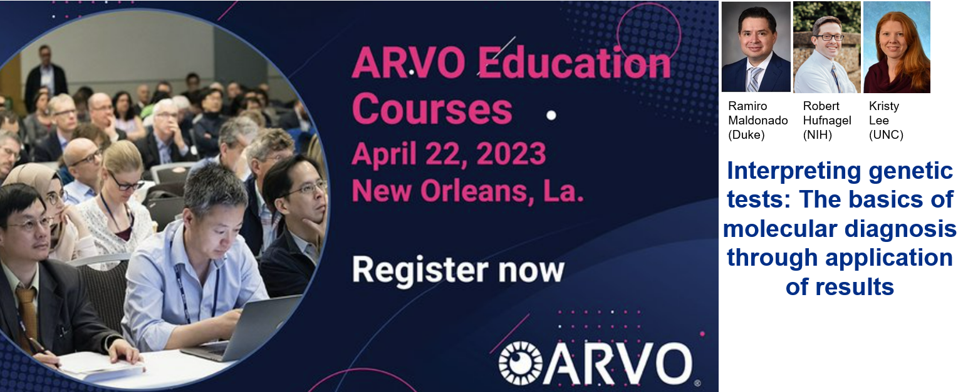
Genetic testing interpretation can be complex
ARVO 2024
Seatle, WA

Slide 56
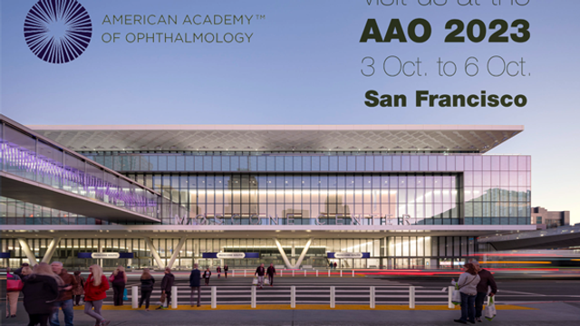

AAO course 2024
Game of Genes

Slide 57

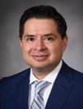
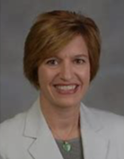
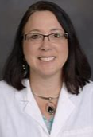
ERG in children
Workshop

Slide 58

Title

Slide 59








Thank you!
Ramiro.Maldonado@duke.edu
@RamMaldonado32
ramiro-s-maldonado-md
ramiro.maldonado@duke.edu

Slide 60
2024 SPN Vision
Exchange
Q&A

Slide 61
2024 SPN Vision
Exchange

Slide 62


Slide 63
2024 SPN Vision
Exchange

