Slide 1



2024 SPN Vision
Exchange

Slide 2

Dr. Mark Dacey is the Director of the Uveitis Service at Colorado Retina Associates in Denver, and the Co-Chair of the Subspecialty Committee for Retina Consultants of America.
He graduated with honors from Duke University and the University of Michigan Medical School, completed his ophthalmology residency at UT Southwestern, and fellowship in ocular immunology and uveitis with Dr. Stephen Foster at the Massachusetts Eye and Ear Infirmary.
Mark Dacey, MD

Slide 3

Anti-inflammatories in uveitis, Dme, and rvo
Mark s. dacey, m.d.
President, rocky mountain uveitis
Retina consultants of America
Assistant clinical professor, university of colorado

Slide 4


Financial disclosure
AbbVie/Allergan: consultant, speakers’ bureau, advisory board
Bausch & Lomb: consultant, speakers’ bureau, advisory board
EyePoint: consultant, speakers’ bureau, advisory board
Priovant Pharmaceuticals: consultant, advisory board
Speaker is being compensated for their presentation today by International Physician Networks, L.L.C. (“SPN”). However, neither SPN nor any pharmaceutical company has influenced the content of this presentation nor has SPN independently verified the presentation for accuracy.
ROCKY MOUNTAIN UVEITIS

Slide 5
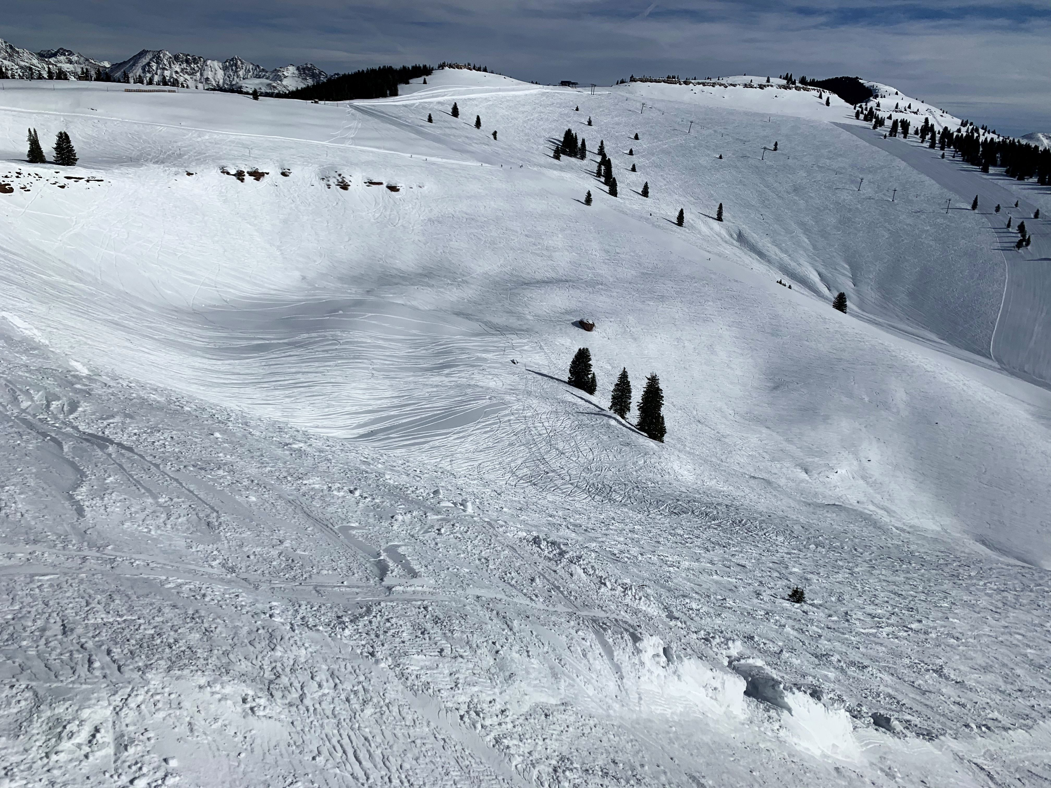
introduction
B.S.: Duke University
M.D.: University of Michigan
Ophthalmology Residency: UT Southwestern
Uveitis Fellowship: Massachusetts Eye/Ear Infirmary, Mentor: C. Stephen Foster, MD
President, Rocky Mountain Uveitis, Denver, CO
Assistant Clinical Professor of Ophthalmology, University of Colorado
ROCKY MOUNTAIN UVEITIS

Slide 6
Uveitis: an overview
Introduction
What is uveitis?
Why have a uveitis specialist?
Local therapies for uveitis, DME, and RVO
Systemic therapies for uveitis
Clinical research in uveitis: where ideas begin
Summary
ROCKY MOUNTAIN UVEITIS

Slide 7
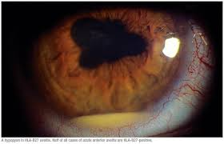
What is uveitis?
Literally, inflammation of the uvea, described in 300 BC
Really means inflammation anywhere in/around the eye
1/1000 incidence in the general population
3rd leading cause of preventable blindness in the US
90% inflammatory/autoimmune, 10% infectious/masquerade
Disease largely of young, healthy patients (average onset early 30s)
So… relatively rare diseases, young working age patients, with significant potential for vision loss
ROCKY MOUNTAIN UVEITIS

Slide 8
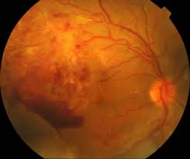
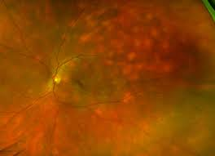
Subtypes of uveitis
Anterior segment: iritis, scleritis, peripheral ulcerative keratitis, ocular cicatricial pemphigoid, stromal keratitis
Posterior segment: pars planitis, VKH, birdshot retinopathy, MFC, PIC, retinal vasculitis, intraocular lymphoma, chorioretinitis, posterior scleritis, MEWDS, cancer-associated retinopathy, autoimmune retinopathy
Orbit: inflammatory orbital pseudotumor, orbital myositis, dacryoadenitis, ocular cicatricial pemphigoid, optic neuritis
ROCKY MOUNTAIN UVEITIS

Slide 9
Systemic associations of uveitis: medicine meets ophthalmology
HLA-B27
Ankylosing Spondylitis
Crohn’s and Ulcerative Colitis
Syphilis
Tuberculosis
Toxoplasmosis
Multiple Sclerosis
Psoriatic Arthritis
CNS Lymphoma, systemic malignancies
Lupus
Granulomatous polyangiitis
Relapsing polychondritis
Leukemia
Sarcoidosis
Behcet’s disease
Juvenile idiopathic arthritis
ROCKY MOUNTAIN UVEITIS

Slide 10
Window to systemic disease
Other ophthalmologists: glaucoma, oculoplastics, cornea, retina, cataract, neuro-ophthalmology, pediatrics
Internal Medicine: GI, cardiology, neurology
Other specialists: ENT, dermatology, rheumatology, hematology/oncology
Why is this important? Diversity of referral sources!
ROCKY MOUNTAIN UVEITIS

Slide 11
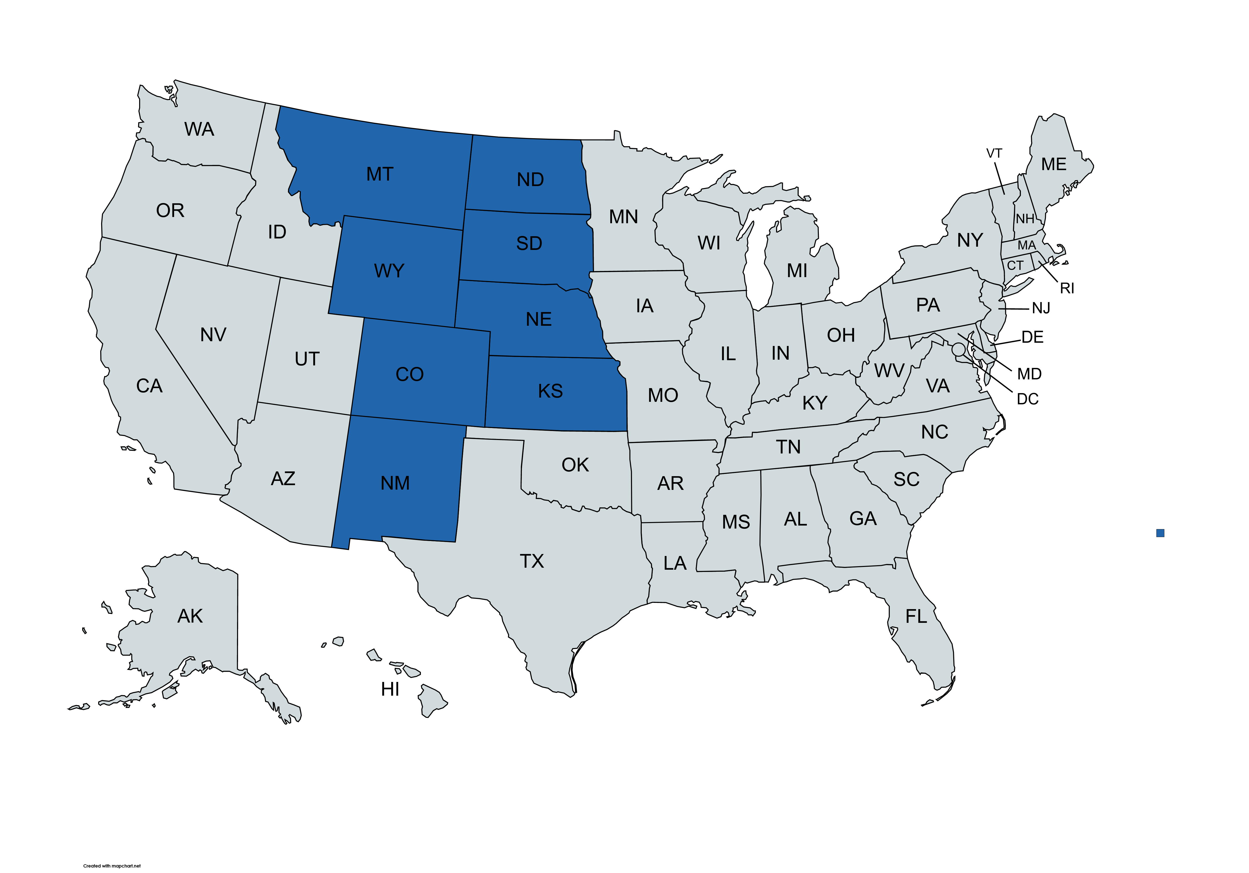
Why have a uveitis subspecialist?
ROCKY MOUNTAIN UVEITIS

Slide 12
Why have a uveitis specialist?
Geographic scope of the practice
Diversity of referral sources, new referral sources
Will attract referrals even from rival groups
Better care for “orphan diseases”
Frees up other docs (retina) to do what they are best trained to do, everyone is more efficient
Unique research opportunities
Leading to… strength in payer negotiations and improved contracting!
ROCKY MOUNTAIN UVEITIS

Slide 13
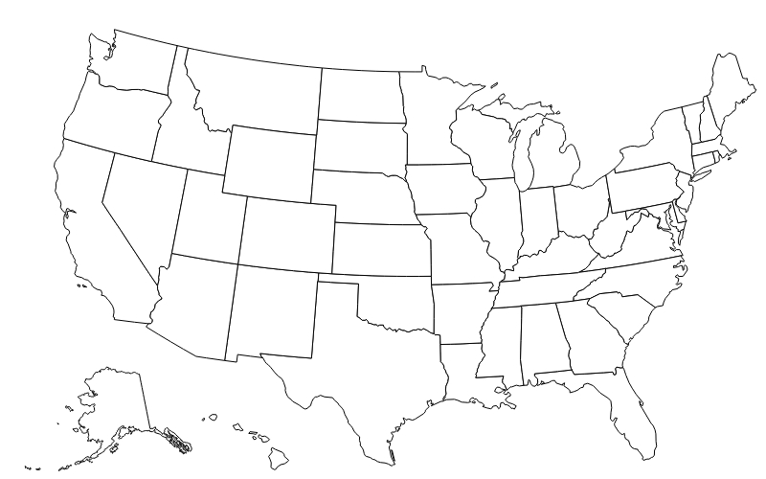
History in Private Practice: 2010

Slide 14




Myth vs reality
ROCKY MOUNTAIN UVEITIS

Slide 15
History in Private Practice: 2024

Slide 16

Uveitis treatments: many shapes and flavors
Topicals: steroids, cycloplegics, NSAIDs
Local injections: periocular steroid injections, Ozurdex, Yutiq, Xipere, Retisert
Oral medications: Prednisone
Traditional immunosuppressants: MTX, CellCept, Cyclosporine
Biologic immunosuppressants: Humira, Remicade, Simponi, Rituximab, Actemra
ROCKY MOUNTAIN UVEITIS

Slide 17
Topical Steroid Options
Steroid | Trade Name
Difluprednate 0.05% | Durezol
Prednisolone acetate 1% | Generic, Pred Forte, Omnipred
Dexamethasone 0.1% | Generic
Fluoromethalone 0.25% | FML Forte
Fluoromethalone 0.1% | Generic, FML, Flarex
Rimexolone 1% | Vexol
Medrysone 1% | HMS
Prednisolone acetate 0.125% | Pred Mild
Loteprednol 0.5% | Lotemax
Loteprednol 0.2% | Alrex

Slide 18
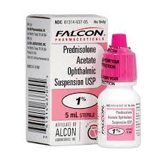
Prednisolone Acetate
Historical gold standard in treatment of anterior uveitis
Can be administered as frequently as every 30 minutes
Often limited by longterm side effects
  Cataracts form, on average, with >800 drops
  Glaucoma can occur in up to 30% of patients
ROCKY MOUNTAIN UVEITIS

Slide 19
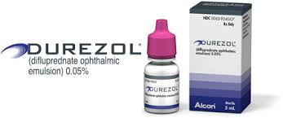
Difluprednate (Durezol)
Durezol (Difluprednate Ophthalmic Emulsion 0.05%) compared with Pred Forte 1% ophthalmic suspension in the treatment of endogenous anterior uveitis.
  Foster CS, Davanzo R, Flynn TE, McLeod K, Vogel R, Crockett RS. J Ocul Pharmacol Ther. 2010 Oct; 26(5):475-83.
  PF 8x/day vs Durezol QID
  Durezol noninferior to PF at 14 days in AC cell grade improvement (2.1 vs 1.9 respectively). 68.8% of Difluprednate pts had AC clearing at day 14 compared with 61.5% of PF pts
  Durezol at least as effective as PF at much less frequent dose
ROCKY MOUNTAIN UVEITIS

Slide 20
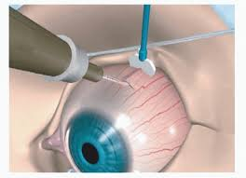
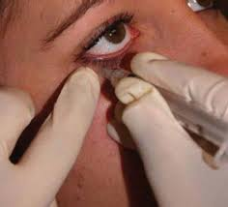
Uveitis: periocular steroid injections
Can be administered sub-tenon’s or trans-septal
  Historically, this was the most common way to administer steroids to the eye
  High rates of ptosis, cataract, and glaucoma
  Can be quite painful
  Limited efficacy to 6-8 weeks
ROCKY MOUNTAIN UVEITIS

Slide 21
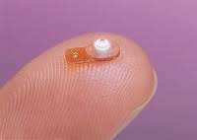
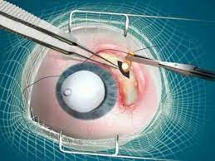
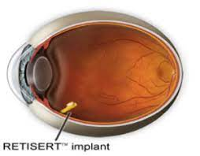
Uveitis: local therapies
Retisert (fluocinolone implant)
  Steroid implant sewn into the scleral wall
  FDA approved in 2000
  3 year duration
  100% cataract formation
  40% glaucoma surgery
ROCKY MOUNTAIN UVEITIS

Slide 22
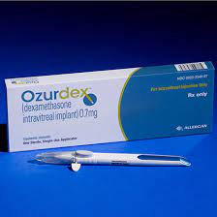
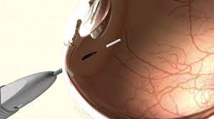
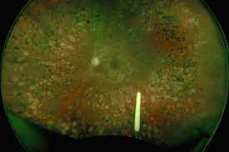
Uveitis: local therapies
Ozurdex (dexamethasone implant)
  Steroid implant injected in clinic
  FDA approved in 2010, also approved for DME/RVO
  3-4 month duration
  100% biodegradable
  15% cataract formation
  2% glaucoma surgery
ROCKY MOUNTAIN UVEITIS

Slide 23
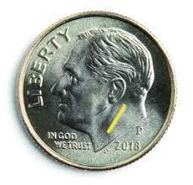
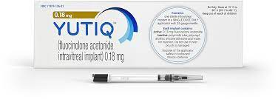
Uveitis: local therapies
Yutiq (fluocinolone implant) (Iluvien for DME)
  Steroid implant injected in clinic
  FDA approved in 2018
  2.5-3 year duration
  Biocompatible but not biodegradable
  90+% cataract formation
  5-10% glaucoma surgery
ROCKY MOUNTAIN UVEITIS

Slide 24
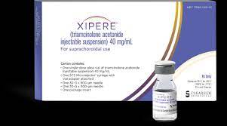
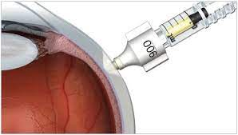
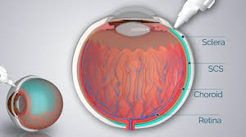
Uveitis: local therapies
Xipere (triamcinolone injection)
  Suprachoroidal injection, novel drug delivery
  FDA approved in 2021
  2 injections last ~1 year
  15% cataract formation
  <1% glaucoma surgery
ROCKY MOUNTAIN UVEITIS

Slide 25
Uveitis: systemic therapies
Average retina physician uses Prednisone for a mean duration of 21 months at a dose of 40 mg/day
  Rates of DM, HTN, MI, CVA, osteoporosis, fungal infection all significantly higher
Goal is a steroid-sparing remission: only can be achieved through IMT (immunomodulatory therapy)
Follow the lead of rheumatology, GI, dermatology
ROCKY MOUNTAIN UVEITIS

Slide 26
Uveitis: systemic therapies
Methotrexate: oral medication once a week
Mycophenolate mofetil (CellCept): oral medication twice daily, on an empty stomach
Cyclosporine: oral medication twice daily
Adalimumab (Humira): sc injection every 2 weeks - **only FDA-approved immunosuppressant for uveitis**
Infliximab (Remicade): IV infusion once monthly
Tocilizumab (Actemra): IV infusion once monthly
ROCKY MOUNTAIN UVEITIS

Slide 27
Biosimilars in uveitis - humira
Adalimumab (Humira)
  16+ biosimilars, all released in the past 6 months
  $18B/year drug, most prescribed immunosuppressant in the world, 13 approved indications
  3 studies (VISUAL 1, 2, and 3) led to FDA approval for noninfectious posterior segment uveitis, then anterior uveitis, and pediatric uveitis
  >1000 patients on Humira, insurances mandated switch to biosimilars for ~6% cost savings
  Zero (!) patients have flared who were stable previously
ROCKY MOUNTAIN UVEITIS

Slide 28
Biosimilars in uveitis - remicade
Infliximab (Remicade)
  Once monthly intravenous infusion
  Excellent data for birdshot, intermediate uveitis, VKH
  No uveitis studies, but retrospective pooled data is excellent, >80% efficacy in preventing flares
  Switch to insurance-mandated biosimilars in 2021-2022, again ~6% savings
  10-15% of previously stable patients had new flares within 4 months (pooled data from CRA, UCLA, and Johns Hopkins)
  ¼ anti-mouse antibody, may play a role in the higher rate of flares
ROCKY MOUNTAIN UVEITIS

Slide 29
Biosimilars in uveitis - enbrel
Differential Effectiveness of Etanercept and Infliximab in the Treatment of Ocular Inflammation
  Galor A, Perez VL et al. Ophthalmology 2006; 113:2317–2323 © 2006
  Patients treated with infliximab had a significant decrease in uveitis recurrences after starting therapy compared with those treated with etanercept (79% vs. 0%, P=0.004).
Etanercept and uveitis in patients with juvenile idiopathic arthritis
  Schmeling H and Horneff G. Rheumatology 2005 44(8):1008-1011
  Frequency and severity of uveitis seemed not to be influenced by etanercept in JIA patients
ROCKY MOUNTAIN UVEITIS

Slide 30
Uveitis treatment paradigms
Use systemic medications much more frequently than general ophthalmology
Can “kill 2-3 birds with one stone”
Often use local therapies for CME in combination with systemic therapies
Stepladder approach to IMT: every patient responds differently
  Example: Birdshot patient, starts with CellCept 1 gram BID, then 1500 mg BID, then adds Cyclosporine 100 mg QD, then changes to IV Remicade infusions before achieving quiescence
Uveitis is a humbling field: your first diagnosis is not always 100% correct
ROCKY MOUNTAIN UVEITIS

Slide 31
What’s new in uveitis?
Golden age for uveitis research
  Topical nonsteroidal therapy for anterior uveitis
  Phase 4 for intravitreal steroid injection
  Intravitreal injection of immunosuppressant medication for uveitic CME
  3 studies for systemic therapies for prevention of uveitis: time to treatment failure
ROCKY MOUNTAIN UVEITIS

Slide 32
Uveitis studies lead to retina drug development
Pharma companies often begin studying a drug with uveitis; less patients required for FDA approval
Model followed for:
  Ozurdex (FDA approved in 2010 for uveitis, 2015 for DME)
  Port Delivery System (studies for MTX in uveitis in 2016-17, FDA approved for wet ARMD in 2021)
  Yutiq (FDA approved in 2018 for uveitis, ongoing studies now for wet ARMD)
  Xipere (FDA approved in 2021 for uveitic CME, ongoing studies now for wet ARMD)
ROCKY MOUNTAIN UVEITIS

Slide 33
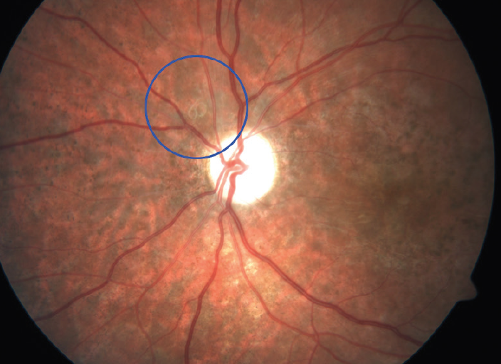
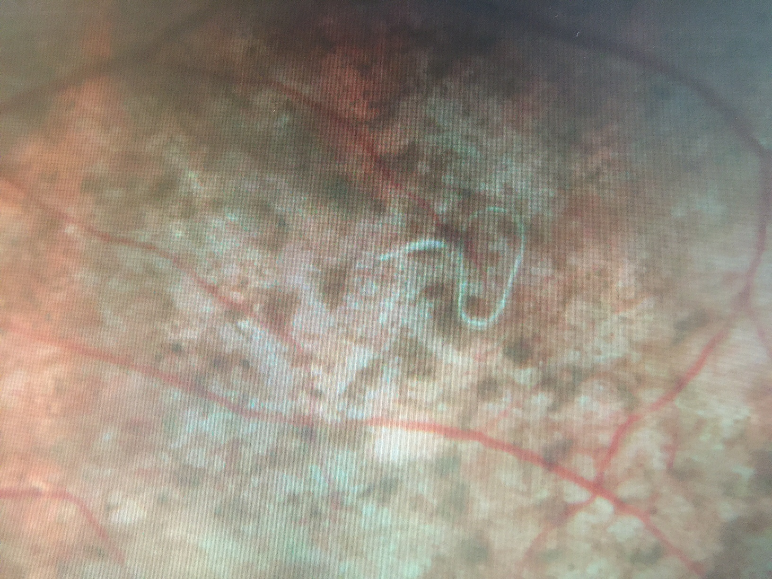
3 cases that show why uveitis is never boring!

Slide 34
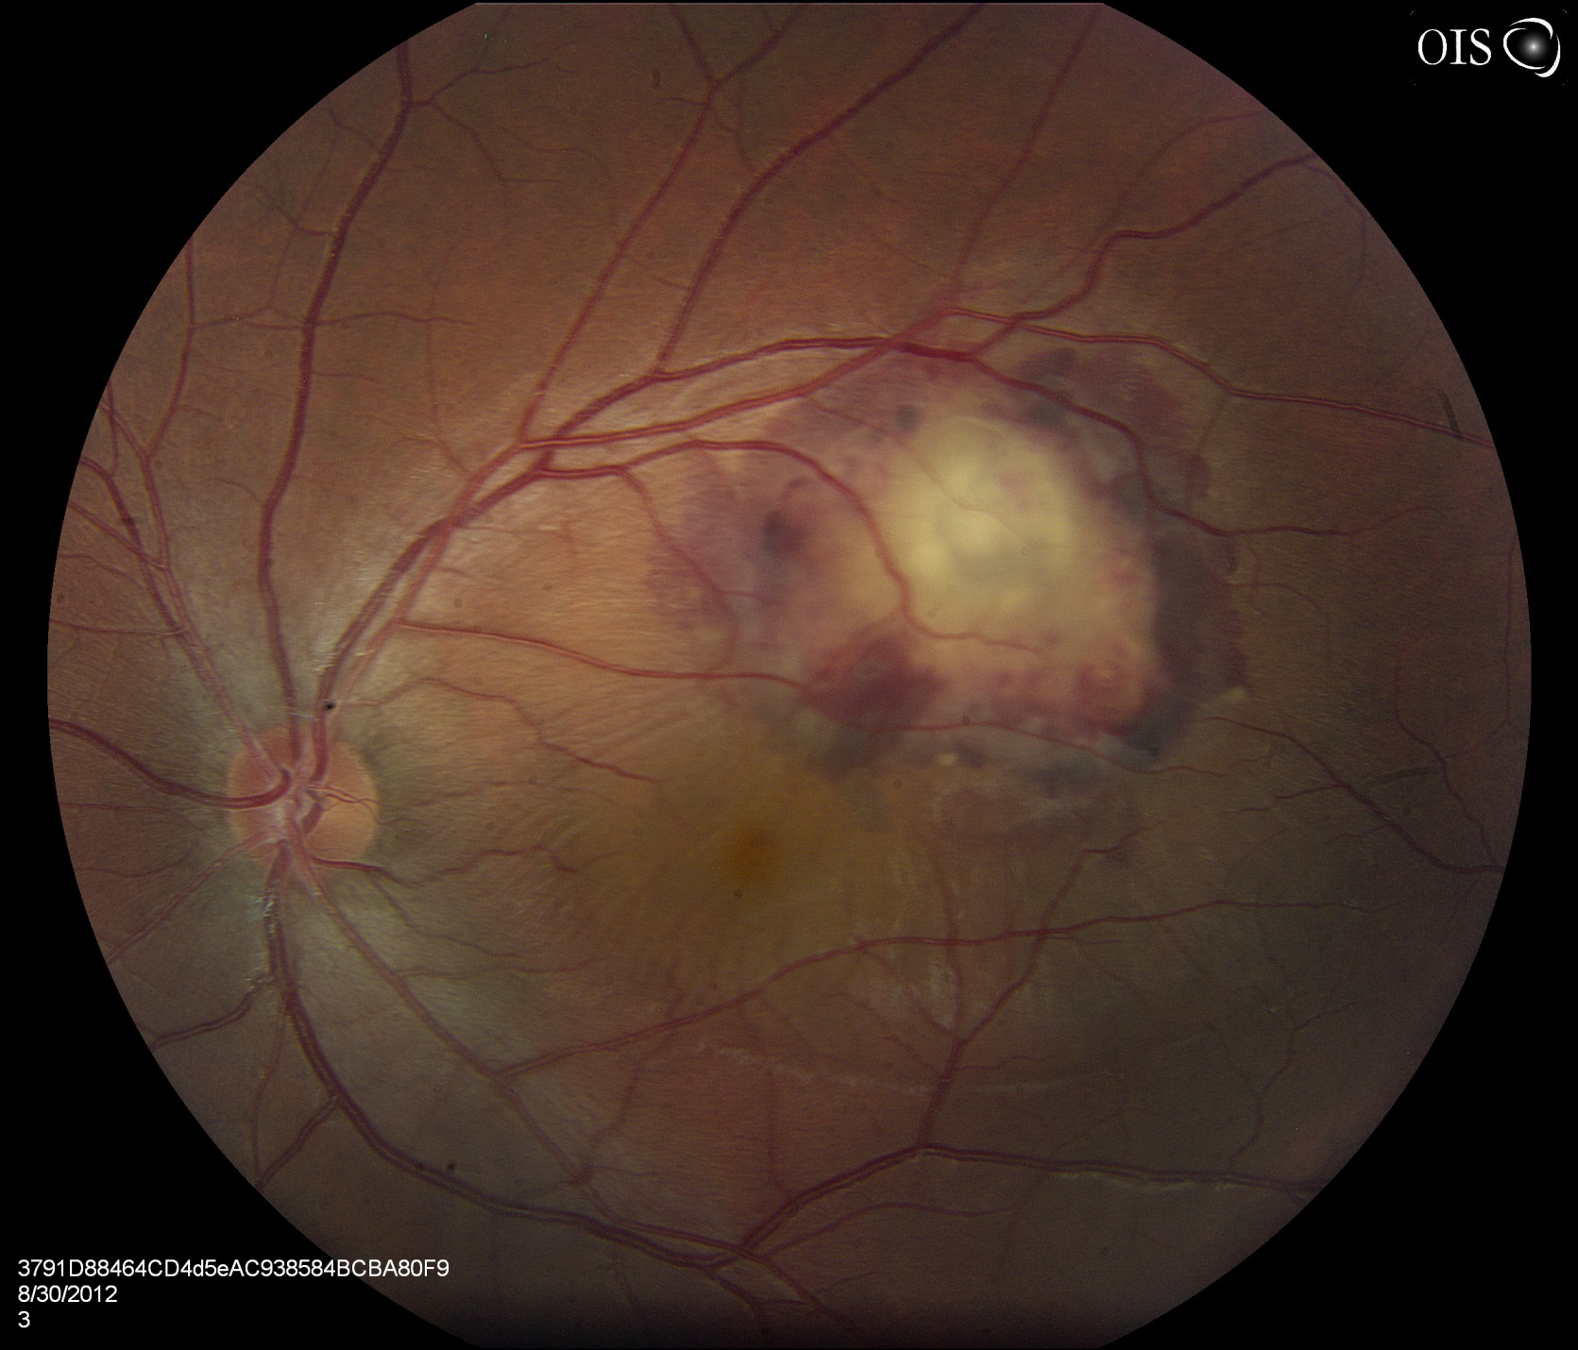
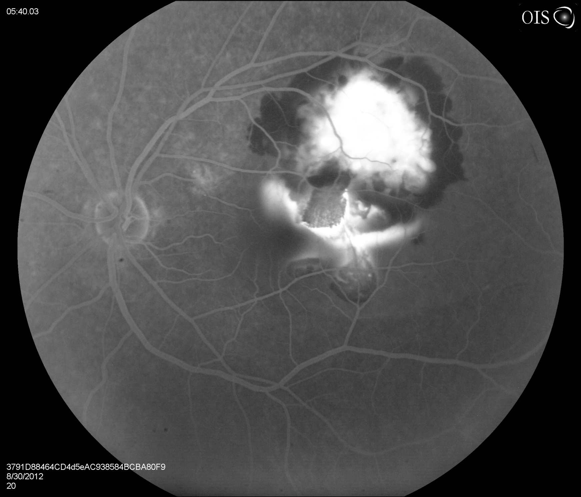
Case #2

Slide 35
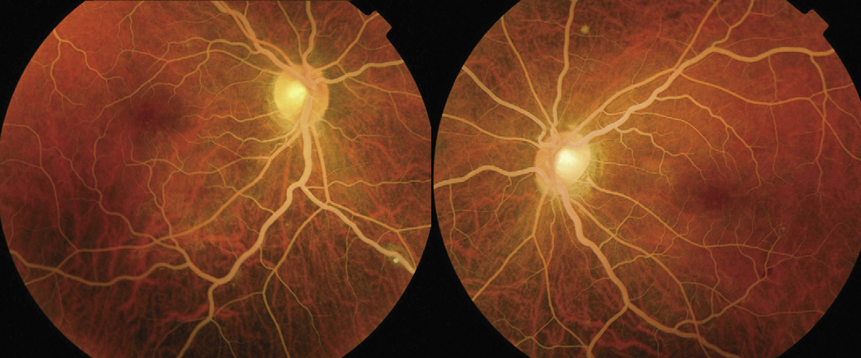
Case #3

Slide 36
summary
Uveitis is:
  An emerging field, particularly in private practice
  A challenging field, requiring support staff, communication, and a dedicated team
  Very beneficial for practices, internally and externally
  Very different from traditional retina and general ophthalmology
  A paradigm for posterior segment drug development
  An incredible field in which to be involved in 2024!
ROCKY MOUNTAIN UVEITIS

Slide 37

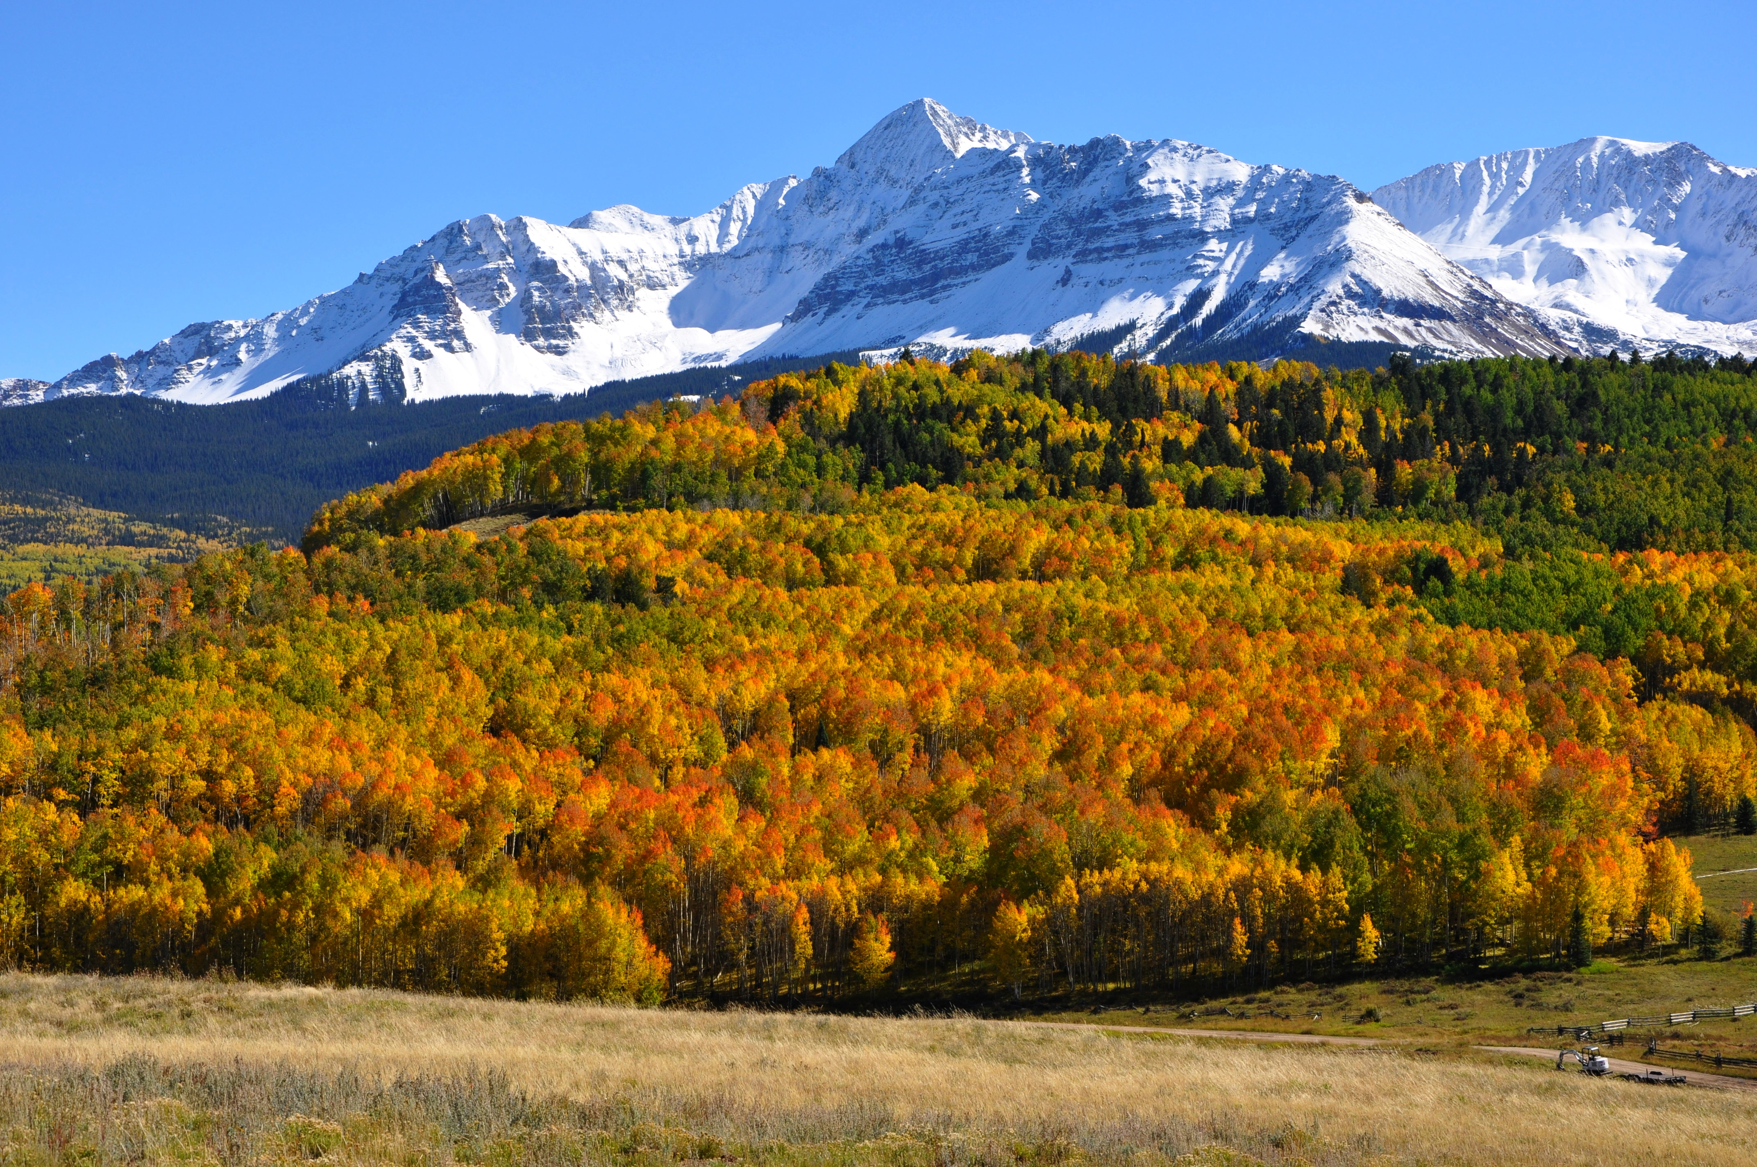
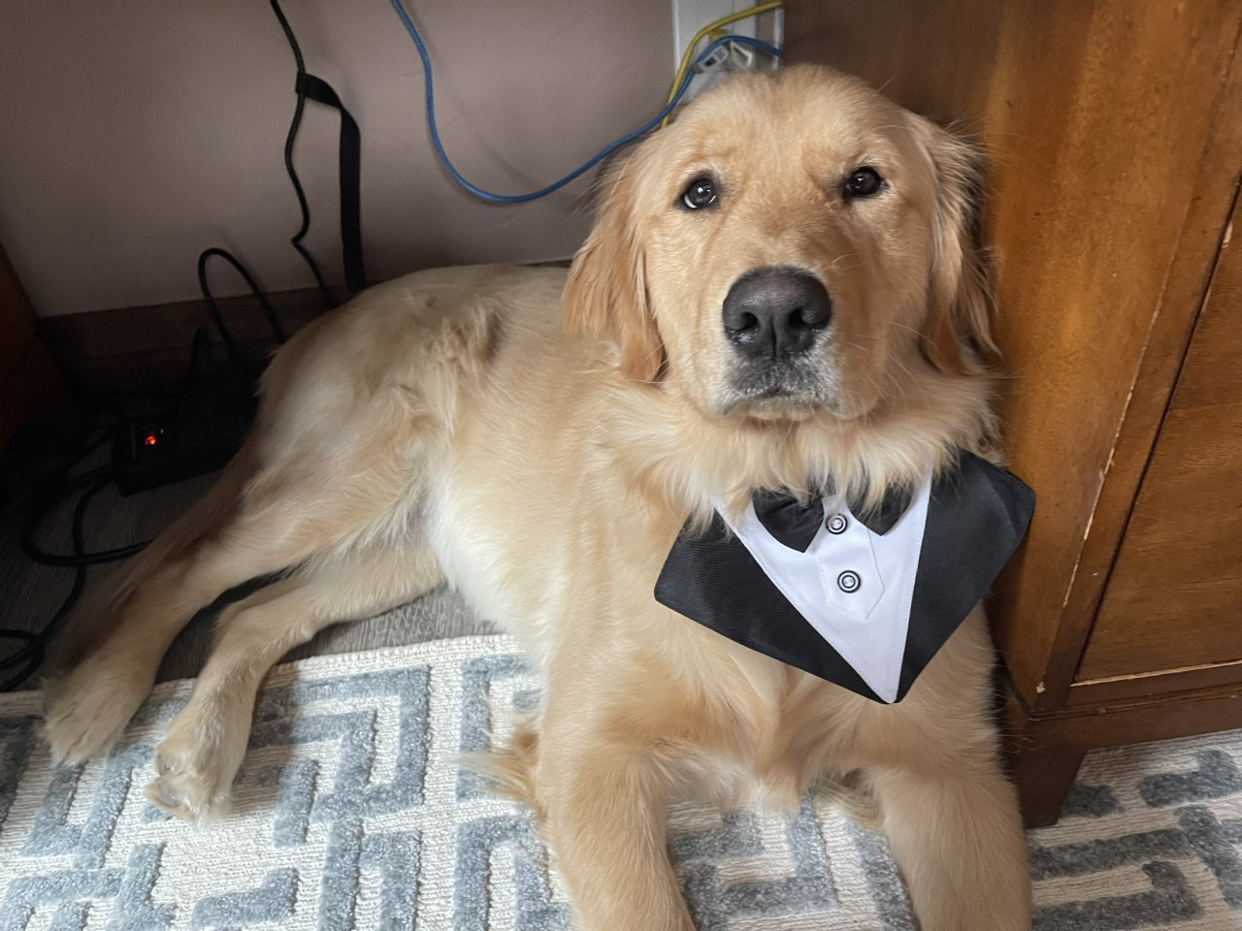
Thank you!
Shane Dixon
Uveitis Team at Rocky Mountain Uveitis
Ice Lakes, Silverton, Colorado Mt. Wilson, Telluride, Colorado Barkley

Slide 38
2024 SPN Vision
Exchange
Q&A

Slide 39
2024 SPN Vision
Exchange

Slide 40


Slide 41
2024 SPN Vision
Exchange

